Slide 1
Danube Region Programme Main Cornerstones
Czech Info Day
27th September 2022
online

Slide 2
Agenda
Programme Area
Programme Mission
Budget
Thematic Portfolio
Programme and Project Intervention Logic
Main factors for successful Project Development
Update on 1st CfP and further information offers

Slide 3
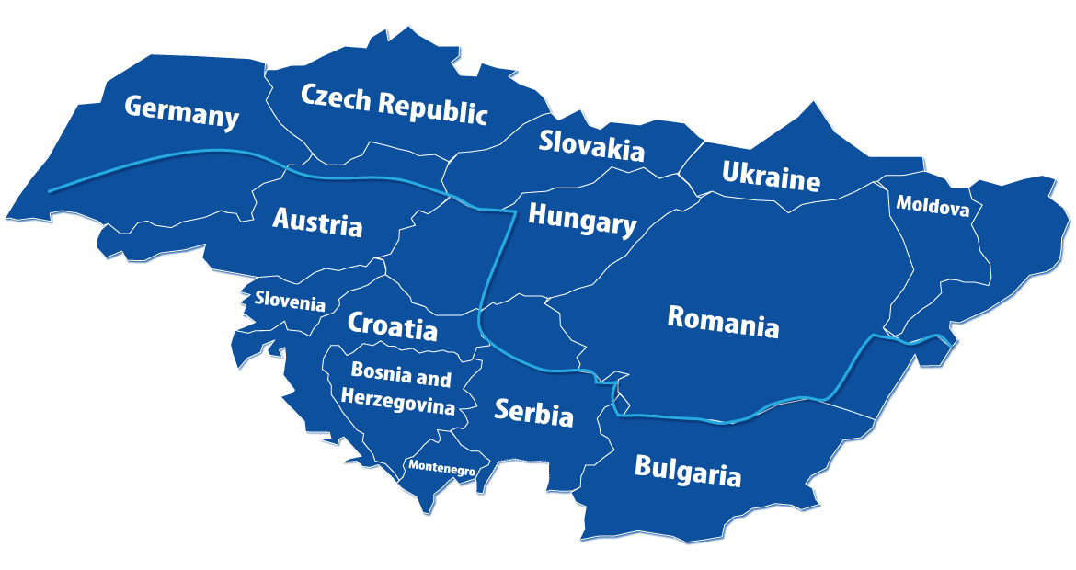
Programme Area

Slide 4
Programme Mission
“EU Cohesion Policy contributes to strengthening economic, social and territorial cohesion in the European Union. It aims to correct imbalances between countries and regions.” European Commission
“DRP supports policy integration in the Danube area through projects addressing key challenges and opportunities of the region in specific fields of action, below the EU-level (not duplicating efforts in policy integration at the EU-level e.g. TEN-T) and above the national level. Transnational projects should influence national, regional and local policies (policy driver).” DRP AM

Slide 5
DRP and EUSDR
Same geographical area
DRP fully embedded in EUSDR …
but EUSDR with larger (thematic) scope
DRP is a funding instrument
EUSDR a strategic framework
DRP is directly supporting the governance of the EUSDR …
… but otherwise one amongst other funding instruments relevant to the EUSDR
DRP
EUSDR
Each application has to prove the contribution to and embeddedness of the EUSDR in the proposal

Slide 6
Budget
EU Contribution | National contribution | Total
215,047,857,00 | 53,761,965,00 | 268,809,822,00
“INTERREG Funds” (combining ERDF, IPA and NDICI funds)
EU contribution 80%
Up to 50% of total Programme budget envisaged to be allocated to 1st CfP
18.5000 EUR preparation cost (in case of successful application)
EoI: no breakdown of PP budget to budget lines (overall PP budget to be indicated by default under external expertise)

Slide 7
Budget by Priority
(EU contribution)
40.489.751 EUR
74.586.383 EUR
55.407.028 EUR
Support to the governance of the EUSDR
44.564.695 EUR

Slide 8
Priorities and Specific Objectives
Priority | Specific Objectives | DRP versus DTP
1. A more competitive and smarter Danube Region | Enhancing innovation and technology transfer | Clearer demarcation from Horizon Europe, focus shift towards technology transfer and skills development in selected fields/ no more social innovation S.O. (certain topics now under S.O.s 3.1., 3.2 and 4.2
 | Developing skills for smart specialisation, industrial transition and entrepreneurship
2. A greener low carbon Danube Region | Promoting renewable energy | Climate change new / (renewable) energy now in an environmental context (before “old” priority 3)
 | Climate change adaptation and disaster management
 | Water and sediment quality
 | Biodiversity in ecological corridors and eco-regions

Slide 9
Priorities and Specific Objectives
Priority | Specific Objectives | DRP versus DTP
3. A more social Danube Region | 3.1. Accessible and inclusive and effective labour markets | Replaces the “old” priority 3 on transport/energy (transport aspects can still be tackled, esp. under priority 1 and 4; energy now in priority 2); culture moved from old environmental priority 2 to new social priority 3
 | 3.2. Accessible and inclusive quality services in education, training and lifelong learning
 | 3.3 Socio-economic development through heritage culture and tourism
4. A better cooperation governance | 4.1. Support to the governance of the EUSDR | Two S.O.s now under priority 4, “regular” projects covered by S.O.4.2. (clearer territorial focus now)
 | 4.2. Increased capacities for territorial and macro-regional governance

Slide 10
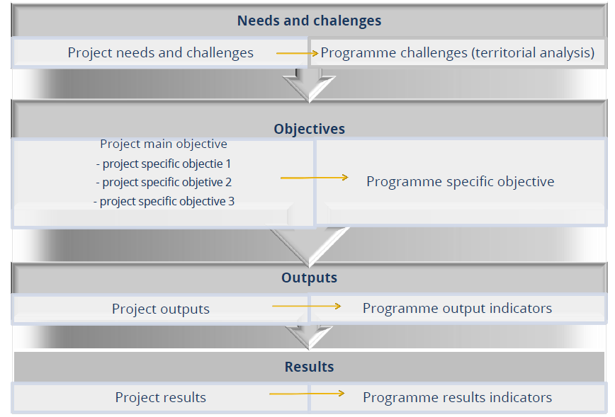
Intervention Logic
Check challenges in DRP INTERREG Programme!
Read Programme documents! Discuss fit internally, with NCP and JS
Menu of options offered in JEMs
(explanations, definitions and further background part of the application package)

Slide 11
Intervention Logic
Output indicator | Result indicator
RCO82 Participations in joint actions promoting gender equality, equal opportunities and social inclusion | RCR85 Participations in joint actions across borders after project completion
RCO 83 Strategies and action plans jointly developed | RCR 79 Joint strategies and action plans taken up by organisations
RCO 84 Pilot actions developed jointly and implemented in projects | ISI: Organisations with increased institutional capacity due to their participation in cooperation activities across borders, other than organisations counted under RCO 87 Organisations cooperating across borders (PPs, etc.) – e.g. organisations external to the partnership
RCO 116 Jointly developed solutions | RCR 104 Solutions taken up or up-scaled by organisations
RCO 87 Organisations cooperating across borders | ISI: Organisations with increased institutional capacity due to their participation in cooperation activities across borders
RCO118 Organisations cooperating for the multi-level governance of macro-regional strategies | RCR 84 Organisations cooperating across borders after project completion
RCO120 Projects supporting cooperation across borders to develop urban-rural linkages | Not applicable

Slide 12
Intervention Logic
ALL levels of the intervention logic and the relation between them matter!!
Challenges: often neglected by applicants and/or developed based on generic assumptions only
Objectives: fit to one Programme S.O. must be ensured (not only semantically) and
… project outputs/result(s) and activities have to be substantially aligned with them
Partnership set-up has to support the intervention logic (often THE weak point of applications)
Mind that you face a competitive scenario both in 1st and 2nd step (extend to which your IL is consistent matters…)
Mind that the intervention cannot be changed between step 1 and 2

Slide 13
Work Plan
No Work Packages any longer under INTERREG 2021-2027 Programmes; activities structured along specific project objectives
No WPs management/communication any longer (seen now as horizontal tasks for achieving project objectives)
Budget not structured along WPs any longer, only along budget lines
Budget to be indicated per activity; overall budget envisaged for management to be indicated in the management section of JEMs and per PP
Outputs and/or deliverables to be defined per activity
Activities and related outputs/deliverables have to clearly support the overall intervention logic

Slide 14
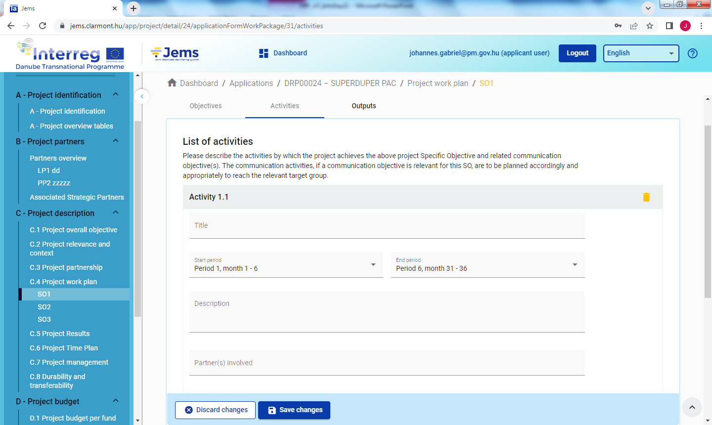
Work Plan Development in JEMS

Slide 15
A competitive project ….
… offers a clear vision on which challenges of the Danube Region shall be tackled and how
… provides a consistent package of objectives, activities and outputs (IL)
… manages to carefully align the scope and composition of the partnership to the project intervention logic
Please bare in mind that there is a limit of changing PPs between 1st and 2nd step but there is no limit for adding ;) PPs for the 2nd step
… avoids unnecessary formal (e.g. hasty description of activities) or technical (inconsistent selection of output or result indicators) mistakes
… applies effective time management

Slide 16
Information & advice on 1st CfP
and further updates
DRP INTERREG Programme (website)
Recorded Thematic Seminars (website)
Applicants Package (Applicants Manual, Guidelines for filling the AF in JEMS, Call Announcement – all on website, coming soon)
Webinar on how to use JEMS (early October, tbc)
General webinar on 1st CfP (early October, tbc)
National Contact Point
JS: ad-hoc advice on technical/formal issues and one bilateral consultation per proposal (on request and based on a 2-page project outline); contact your PO!

