Slide 1
EU Budget for the future
New legislative package for cohesion policy 2021-2027
#CohesionPolicy #EUinmyRegion

Slide 2

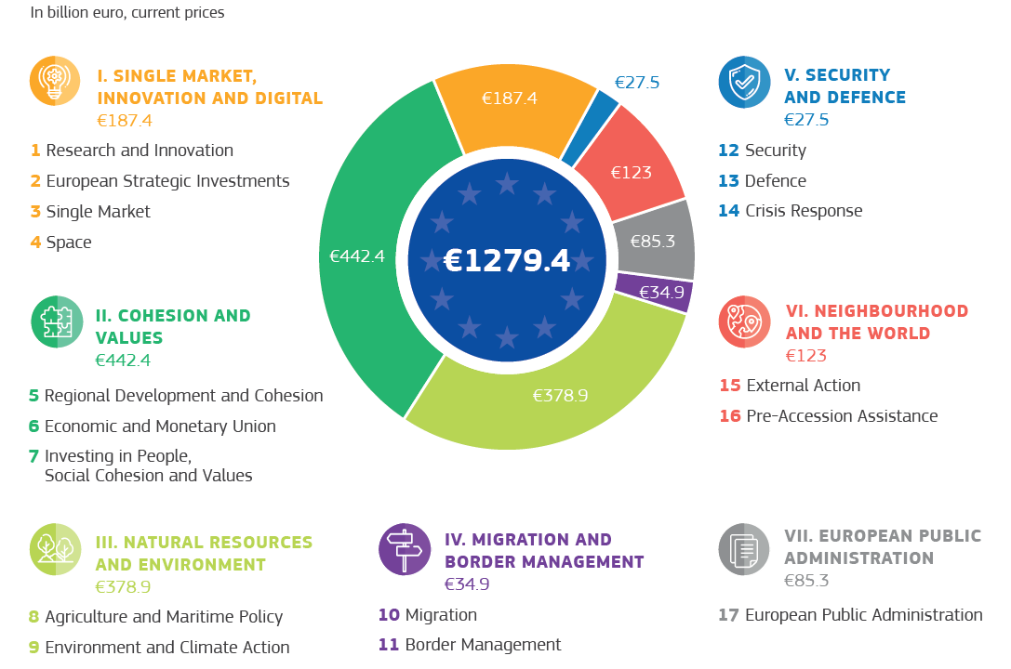
AligNed to political priorities Simplification, transparency and flexibility
Source: European Commission
Notes:
Source: visual from General Factsheet p 3, title from Communication part 3, text Communication page 4, COM(2018) 321/4.
A BUDGET FOR EUROPE’S PRIORITIES
The future long-term budget will be a budget for the Union’s priorities.
The Commission’s proposals will bring the structure and the programmes of the EU budget fully into line with the positive agenda of the Union post-2020 as agreed in Bratislava and Rome. The new architecture of the future Multiannual Financial Framework will provide greater transparency on what the EU budget is for and how the different parts of the budget will contribute. It will also provide the flexibility necessary to respond to evolving needs.
Programmes will be arranged around the main thematic spending priorities. These will correspond to the headings in the formal budget structure. Within each priority, programmes will be grouped in policy clusters, which will be reflected in the titles of the annual budget. This will provide greater clarity on how they will contribute to policy goals.
In practice, the formal structure of the budget only tells part of the story. Many of the Union’s priorities are complex and multi-faceted. It would not be possible to tackle every aspect with a single programme.
Under the Commission’s proposals, investment from multiple programmes will combine to address key crosscutting priorities such the digital economy, sustainability, security, migration, human capital and skills, as well as support for small businesses and innovation. The Commission proposes to simplify these interactions under the future framework, providing a much more coherent response to Europe’s challenges. The following sections set out the main reforms and programmes under each of the spending priorities.

Slide 3

A modern, dynamic cohesion policy
Modern investment
Focus on transition to smart, low-carbon economy
Stronger conditions & link to European Semester
Comprehensive performance data (in near real time), open data
Simple, flexible, dynamic
7 funds, 1 regulation (50% shorter)
50 key administrative simplifications
Faster implementation (return to n+2)
Responsive to emerging needs (migration, economy)
For all regions
Balanced and fair "Berlin method"
75% to poorest regions, where most needed
Tackling emerging needs and economic transition across the EU

Slide 4
  Modernising the policy

Slide 5

Policy objectives
11 objectives simplified and consolidated to 5:
A smarter Europe (innovative & smart economic transformation)
A greener, low-carbon Europe (including energy transition, the circular economy, climate adaptation and risk management)
A more connected Europe (mobility and ICT connectivity)
A more social Europe (the European Pillar of Social Rights)
A Europe closer to citizens (sustainable development of urban, rural and coastal areas and local initiatives)
2 horizontal objectives:
Administrative capacity building
Co-operation between regions and across borders (embeds co-operation in mainstream)

Slide 6
ERDF THEMATIC CONCENTRATION
Maintaining spending in the key areas for growth and jobs
At national level based on GNI per head => flexibility
6% of budget to urban development, delivered through local development partnerships
For countries with: | minimum % PO1 ("smarter Europe") | minimum % PO2 ("greener, low carbon Europe")
GNI below 75% | 35% | 30%
GNI 75-100% | 45% | 30%
GNI above 100% | 60% | PO1 + PO2 min. 85%

Slide 7
Changes in Interreg
Embedding in mainstream via horizontal objectives
Cross-border programmes: from fund distributors to centres of strategic planning
New: Interregional innovation instruments
New: Maritime co-operation goes from CBC to sea-basin level
New: Specific component for the outermost regions (with co-operation outside EU)
New: Co-operation outside the EU (incorporation of IPA/ENI)
New: European Cross Border Mechanism (ECBC and ECBS)

Slide 8
Sustainable urban development
New dedicated specific objective for integrated development of urban areas
6% of ERDF to go to urban development, delivered through local development partnerships via various tools
Requirement for local development strategies – local ownership
European Urban Initiative: a coherent approach to capacity building, innovative actions, knowledge and policy development and communication

Slide 9

Coherence with other EU instruments
4 key examples:
Horizon Europe ("European excellence")
ERDF ("regional relevance", smart specialisation, innovation diffusion) & reinforced seal of excellence mechanism
CEF/CF: Transfer of EUR 10 billion from the CF to the CEF; trans-European transport networks projects to be financed both through shared and direct management
Migration: all Cohesion Policy Funds will address long-term needs linked to integration, AMIF will focus on short term needs
Reform Support Programme
European Investment Stabilisation Function

Slide 10
  Simplification and flexibility

Slide 11

Simpler
The architecture itself – 7 Funds, 1 rulebook
Rulebook half as long
Handbook of 50 key administrative simplifications (examples on next slides)

Slide 12
Programming
What's in?
Simplified, more focused and more strategic programming in structured form
Performance-oriented: Mid-term review in 2025
Synergies: Closer link with the European Semester
Annexes: to replace some 40 empowerments from 2014-2020
What's out?
No more changes of the PA during period
Eliminated overlaps between PA and programmes (e.g. enabling conditions only in progs)
Fewer procedures: combining technical adjustment with performance review

Slide 13

More flexible
New transfer possibility: Member State may request the transfer of up to 5 % of programme resources to another EU instrument
Simpler reprogramming: up to 5% of a priority (3% of programme) without Commission decision.
"5+2" Programming:
  5 years programmed initially
  2026-27 allocations programmed after mid-term reviews in 2024-25
  (basis: emerging needs, performance)
  Technical adjustment fed in (modifying allocations from 2025)

Slide 14
Simpler reimbursement
What's in?
SCOs (simplified cost options). Unit costs, fixed rates, lump sums.
"Financing not linked to costs" (= based on conditions or milestones)
TA linked to implementation or milestones, as above
What's out?
Less reimbursement of eligible costs = less paperwork, receipts, invoices
NB: The measures on this slide are potentially the most cost-saving simplifications. Study suggests could save 25% of administrative costs.

Slide 15
Eligibility
What's in?
Flexibility when responding to natural disasters
Separate and clearer rules on durability and relocation
For operations below 5 MLN EUR of total costs, VAT eligible. In all other cases VAT is ineligible.
What's out?
Applying specific rules on revenue generating operations
Appraising and adopting major projects; instead "operations of strategic importance" followed by monitoring committee

Slide 16
Simpler management and control
What's in?
More proportionate system for low-error-rate programmes: reliance on national systems, no system audit, audit sample of maximum 30 operations
Simpler process for acceptance of accounts
(and no "zero accounts")
Clarity on document retention period for beneficiaries
(5 years from end of year with last reimbursement)
What's out?
No designation procedure: roll-over of existing systems
Fewer layers of control: Certifying Authorities replaced by an accounting function (which will not duplicate controls)
Administrative verification of 100% of payment claims.
Post-2020 : risk-based sample

Slide 17
Performance, monitoring and evaluation
What's in?
Performance framework will cover all output and result indicators
"Open data" on progress every 2 months
Structured and dynamic policy dialogue between COM and MS in the annual review meeting
What’s out?
Performance reserve (replaced by "5+2")
Annual implementation and progress reports for cohesion policy
Ex ante evaluation

Slide 18
Facilitated use of financial instruments
Encouraging financial instruments (FIs) by simplification:
  Lighter ex-ante assessments
  Integrated rules for grants and FIs
  (=> easier to master rules, easier to combine instruments)
  Simpler rules on eligibility, payments and management fees
  No separate reporting
Voluntary contribution up to 5% of each Fund to new "InvestEU" instrument. Rules of InvestEU, but cohesion objectives.

Slide 19
  Solidarity and responsibility

Slide 20
Lower co-financing ceilings
"Quid pro quo": VAT eligibility
No specific rules for revenue generating projects
Ceiling | Applies to
70% | Less developed regions Outermost regions Cohesion Fund Interreg
55% | Transition regions
40% | More developed regions

Slide 22
  Allocations & eligibility

Slide 23
Step 1: "Berlin method"
(% indicates financial weight)
 | 2014-2020 | 2021-2027
GDP (incl. GNI for Cohesion Fund) | 86% | 81%
Labour market, education, demographics | 14% | 15%
Climate | - | 1%
Migration | - | 3%
Total | 100% | 100%
Labour market: unemployment rate, youth unemployment rate, employment rate
Education: early school leavers, tertiary level of education, low level of education
Demographics: population of regions, low density of population
Climate: Green House gas emissions in the non ETS sectors
Migration: Net migration of non EU citizens

Slide 25
Step 2: Caps and safety nets
Absorption and equity cap (ranges from 2.3% of GDP for RO, BG and HR to 1.55% for most MSs)
Safety nets and limits:
  - 24% lower limit – the "safety net"
  + 8% "reverse safety net"
  0% limit on increases in Member States with >120% GNI

Slide 27
Allocations by Member State
Member State | 2021-27 allocation (billions, 2018 prices) | Change from 2014-2020 period (%) | Aid intensity (EUR/head) | Change from 2014-2020 period (%)
BG | 8.9 | 8 | 178 | 15
RO | 27.2 | 8 | 196 | 17
HR | 8.8 | -6 | 298 | 0
LV | 4.3 | -13 | 308 | 0
HU | 17.9 | -24 | 260 | -22
EL | 19.2 | 8 | 254 | 12
PL | 64.4 | -23 | 239 | -24
LT | 5.6 | -24 | 278 | -12
EE | 2.9 | -24 | 317 | -22
PT | 21.2 | -7 | 292 | -5
SK | 11.8 | -22 | 310 | -22
CY | 0.9 | 2 | 147 | -5
SI | 3.1 | -9 | 213 | -11
CZ | 17.8 | -24 | 242 | -25
ES | 34.0 | 5 | 105 | 3
MT | 0.6 | -24 | 197 | -28
IT | 38.6 | 6 | 91 | 5
FR | 16.0 | -5 | 34 | -9
FI | 1.6 | 5 | 42 | 2
BE | 2.4 | 0 | 31 | -5
SE | 2.1 | 0 | 31 | -6
DE | 15.7 | -21 | 27 | -20
DK | 0.6 | 0 | 14 | -3
AT | 1.3 | 0 | 21 | -4
NL | 1.4 | 0 | 12 | -3
IE | 1.1 | -13 | 33 | -17
LU | 0.1 | 0 | 16 | -14
EU27 | 331 | -9.9 | 106 | -11

Slide 28
Continued concentration on less developed
 | 2021-2027 | 2014-2020
Cohesion Fund | 13% | 22%
ERDF Less developed regions | 62% | 53%
ERDF Transition | 14% | 10%
ERDF More developed | 11% | 15%
Total | 100% | 100%
Share CF + ERDF less developed | 75% | 74%

Slide 29
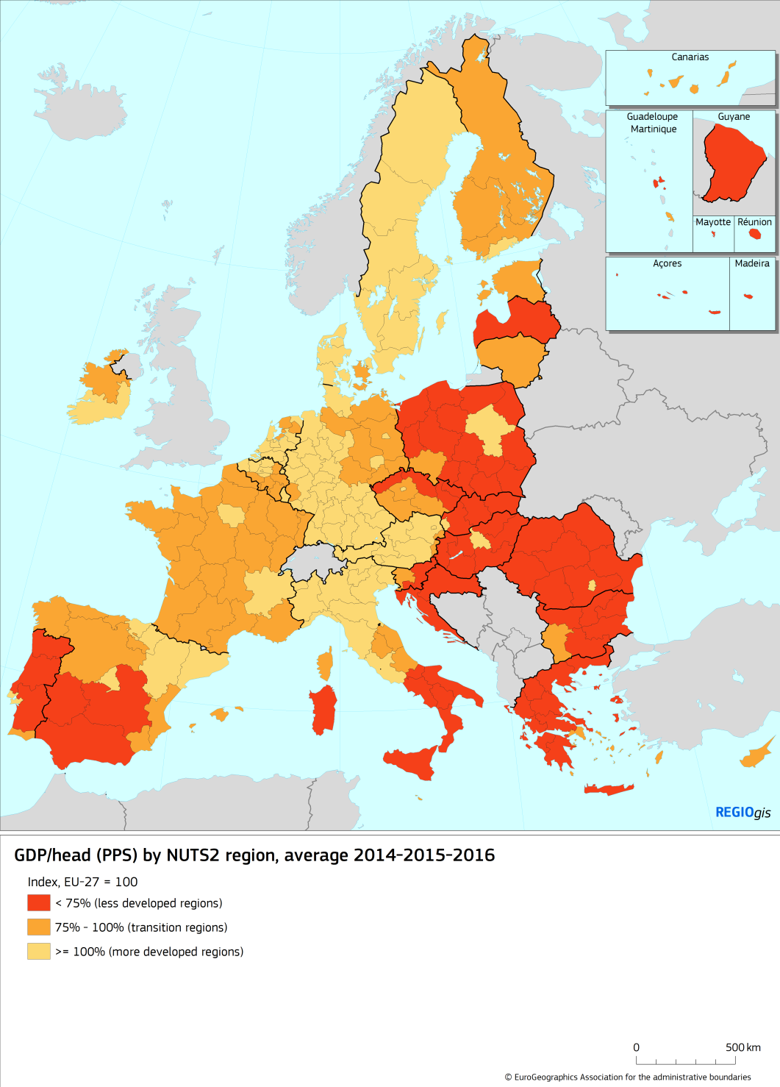
New regional eligibility map
2021-2027

Slide 30
  Next steps

Slide 31
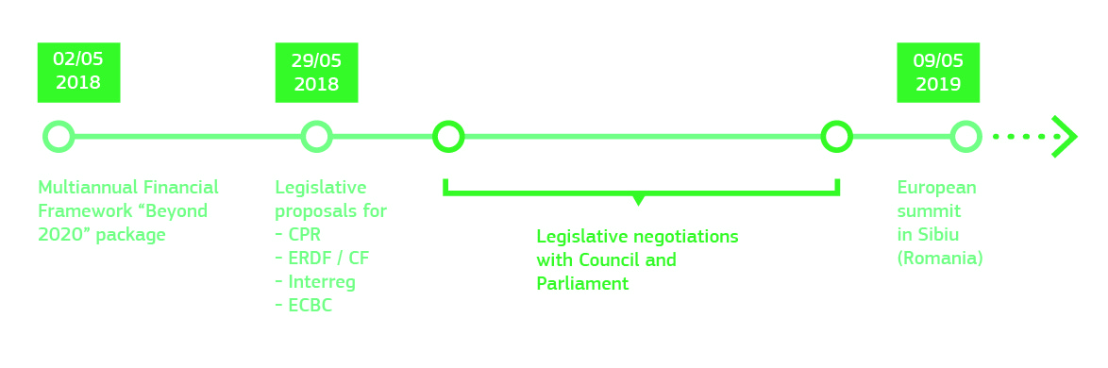
Timeline
Your help is crucial
to explain the proposal and convince our stakeholders
in the negotiation phase – we must clarify the details of the modernisation and simplification agenda to be able to "sell"

Slide 32
Thank you for your attention
#CohesionPolicy #EUinmyRegion

