Slide 1
The Strategic Call for Capitalisation
Title of the event
Place | Date
Name
Programme body

Slide 2
Agenda
Thematic scope
Call budget
Aim of the call

Support measures

Functioning of the call
Synergy requirements
Timeline

Slide 3
Call Objective
To reduce the effects of borders
on flows and functional linkages among central European regions, for a more competitive and resilient central Europe
Notes:
Indeed, this call is strategic since, by funding capitalisation projects, it has the ambitious aim to [read out slide]

Slide 4
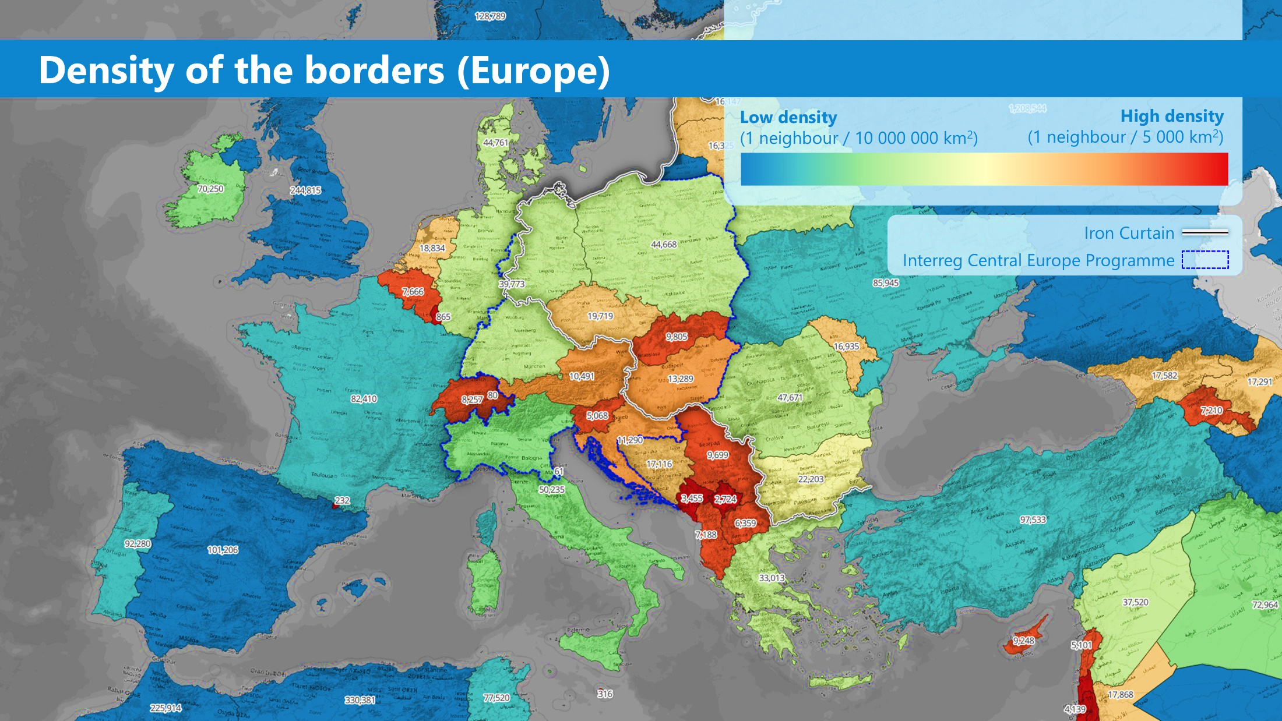
Why? Border Density in CENTRAL EUROPE
Source: CESCI
Notes:
When looking at our central European area in the bigger picture, it becomes more evident why there is the need for such call → particularly high density of borders in CE. There are 15 national inner borders and many more informal borders as e.g. the former Iron Curtain

Slide 5
Negative Effects of Borders
Lower Growth
It is estimated that, at the European level, the costs of border obstacles add up to 458 billion euros, which accounts for 3% of European GDP.
Lower Employment
It also means losing more than 6 million jobs, which is 3% of European employment.
Lower Efficiency
Solutions for shared challenges often remain at the local level, and do not unfold their full potential for the central Europe area.

Slide 6
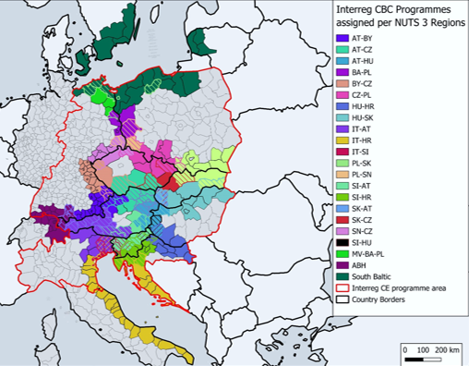
How Interreg Addresses Border Effects
Cross-border cooperation in CE Interreg CE transnational cooperation
Notes:
Indeed, Interreg is already tackling the negative effects of borders in central Europe in many ways:
There are 22 different cross-border programmes addressing the internal borders of central Europe, delivering solutions that are tailored to the local needs. BUT, Solutions often remain at local level, with little participation of policy makers for a structural change. AND there is potential for adapting and transferring existing CBC solutions to other borders
In the same area there are then TN Interreg CE projects which are deliver solutions along spatial interactions and functional linkages, with the (multi-level) engagement of policy makers and implementers. BUT, specific local needs might remain not addressed (in particular in regions not involved in a certain project)
As a result of this situation, there are many transnational and cross-border project solutions that tackle the same problem from different angles (e.g. integration of transport systems, climate change adaptation, and risk prevention). BUT: These solutions are hardly coordinated, resulting in a lower efficiency.
Even though some coordination is happening bottom-up (in single cases, often without us knowing), there is much unexploited potential for increasing the efficiency of existing cooperation solutions in a strategic way. And that’s what our call is about.

Slide 7
How the Call will Increase Impact
Through funding capitalisation projects that leverage synergies by breaking the silos between Interreg strands
Notes:
To put the aim of the call into practice [read the slide and add: Combining and further tailoring relevant outputs and results from transnational and CBC projects can effectively increase the impact of Interreg as a whole]

Slide 8










The Call Mechanism
Previous projects
Strategic Project for Capitalisation
Impact
Outputs and results of transnational project(s)
UPSTREAM
to policy level
Outputs and results of cross-border project(s)
New target groups
New territories
Addressing specific needs and challenges of new stakeholders and territories
Outputs and results fitting the new needs
DOWN-STREAM
Outputs and results of other project(s)
New sectors
Notes:
[Explain the mechanism as it is depicted on the slide, without too many details. The two dimensions of impact will be deepened in the next slide]
[Also mention that the definition of outputs and results is in the programme manual and its annex 1]

Slide 9


Directions to Increase Impact
Upstreaming
Outputs and results are tailored and targeted to policy makers in order to address border issues through new or improved territorial or thematic policies and strategies
Downstreaming
Outputs and results are tailored in a way that they can be rolled out at the most appropriate level (applied in other regions facing similar issues or other sectors than the ones initially addressed)
Notes:
The two approaches are complementary and a combination of the two in one capitalisation project is possible.

Slide 10
Thematic Scope
The call will be open for proposals in all 4 funding priorities and 9 specific objectives of the programme.
However, applicants are encouraged to consider thematic areas that show higher capitalisation potential and are of high importance for central Europe:
Notes:
[Read intro bullet points and introduce the topics but no need to read it out. Point out that this information is available on the call preview page of the programme website]

Slide 11


Minimum Requirement for Synergies
Project proposals must take up existing outputs and results from:
+
At least two Interreg CENTRAL EUROPE projects 2021–2027 (first and second call)
At least two Interreg cross-border cooperation projects 2021-2027
(or, if relevant, 2014-2020), addressing internal central European borders

Slide 12
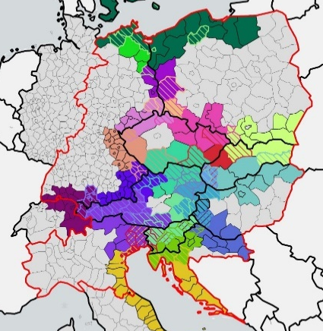
Interreg CBC programmes addressing internal central European borders
Interreg A Austria-Czechia
Interreg A Austria-Germany/Bavaria
Interreg A Austria-Hungary
Interreg A Czechia-Poland
Interreg A Germany-Austria-Switzerland-Liechtenstein
(Alpenrhein-Bodensee-Hochrhein - ABH)
Interreg A Germany/Bavaria-Czechia
Interreg A Germany/Brandenburg-Poland
Interreg A Germany/Mecklenburg-Western Pomerania/
Brandenburg-Poland
Interreg A Germany/Saxony-Czechia
Interreg A Hungary-Croatia
Interreg A Hungary-Slovakia
Interreg A Italy-Austria
Interreg A Italy-Croatia
Interreg A Italy-Slovenia
Interreg A Poland-Denmark-Germany-
Lithuania-Sweden (South Baltic)
Interreg A Poland-Germany/Saxony
Interreg A Poland-Slovakia
Interreg A Slovakia-Austria
Interreg A Slovakia-Czechia
Interreg A Slovenia-Austria
Interreg A Slovenia-Croatia
Interreg A Slovenia-Hungary
Notes:
To mention the list of eligible CBC programmes available on the website

Slide 13
Additional Synergy Potentials
Additionally, projects may also take up:
  Outputs and results of relevant projects funded by other programmes, such as for example: Interreg CENTRAL EUROPE 2014–2020, other Interreg transnational programmes, Interreg cross-border programmes at external borders of central Europe, mainstreaming programmes
  Knowledge and tools developed under the B-Solutions initiative of the European Commission, tackling obstacles caused by internal central European borders.
Only if relevant for the scope of the project
and the aim of the call!
Notes:
[Read slide and emphasise that „the more is not the merrier“. To also mention that the list of B-solutions in CE will be published at the call launch]

Slide 14
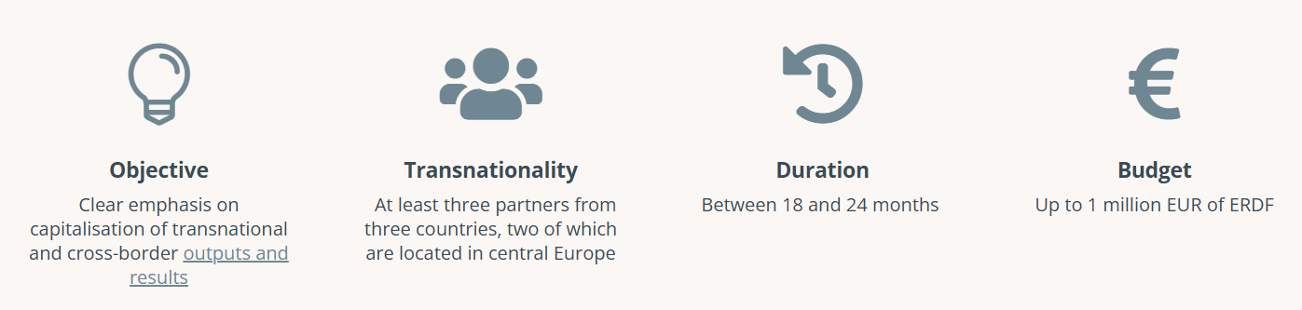
Key Project Features
Operations of Strategic Importance (OSI)
!
They widen the impact and multiply the effects of projects already approved in previous calls, thus increasing efficiency and effectiveness for the benefit of CE regions.
They will benefit from high visibility through special programme communication measures

Slide 15
Call Budget
23 Million Euros ERDF (indicative)
ERDF funds will be allocated to each of the nine programme specific objectives
Projects will therefore be selected at the specific objective level

Slide 16
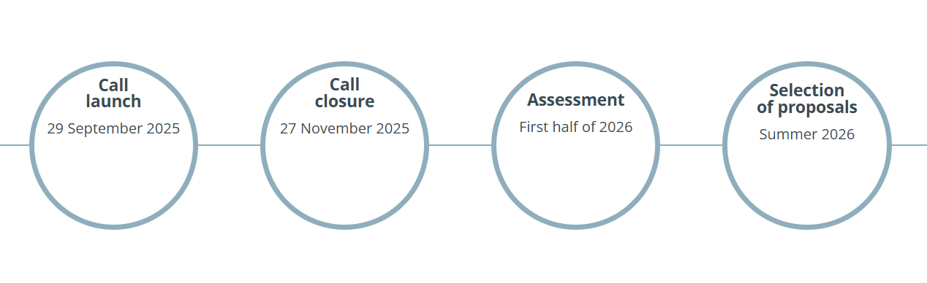
Call Timeline
Notes:
[Read slide and add expected project start in autumn 2026]

Slide 17
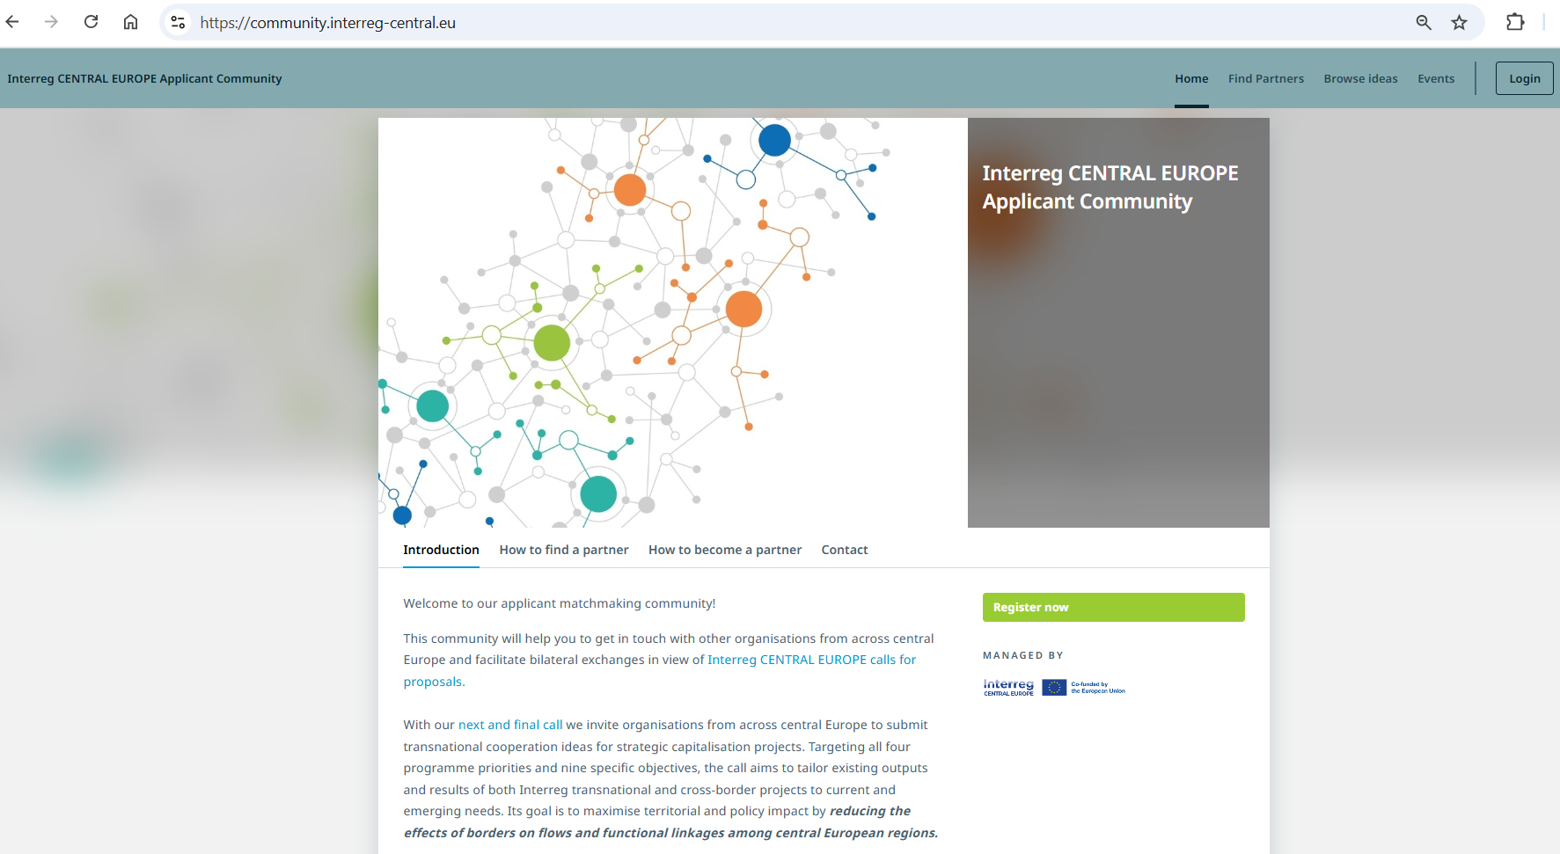
Join our Community to Find Ideas and Partners
Notes:
The Interreg CENTRAL EUROPE applicant community is a good place to start building your partnership.
It helps you in finding relevant partners according to thematic areas, institutional profiles, geographical location, etc.
You can also share your initial idea and ask other organisations to contribute to it.
Last but not least, it is also a communication platform on which you can set bilateral meetings and where we will host our consultations

Slide 18
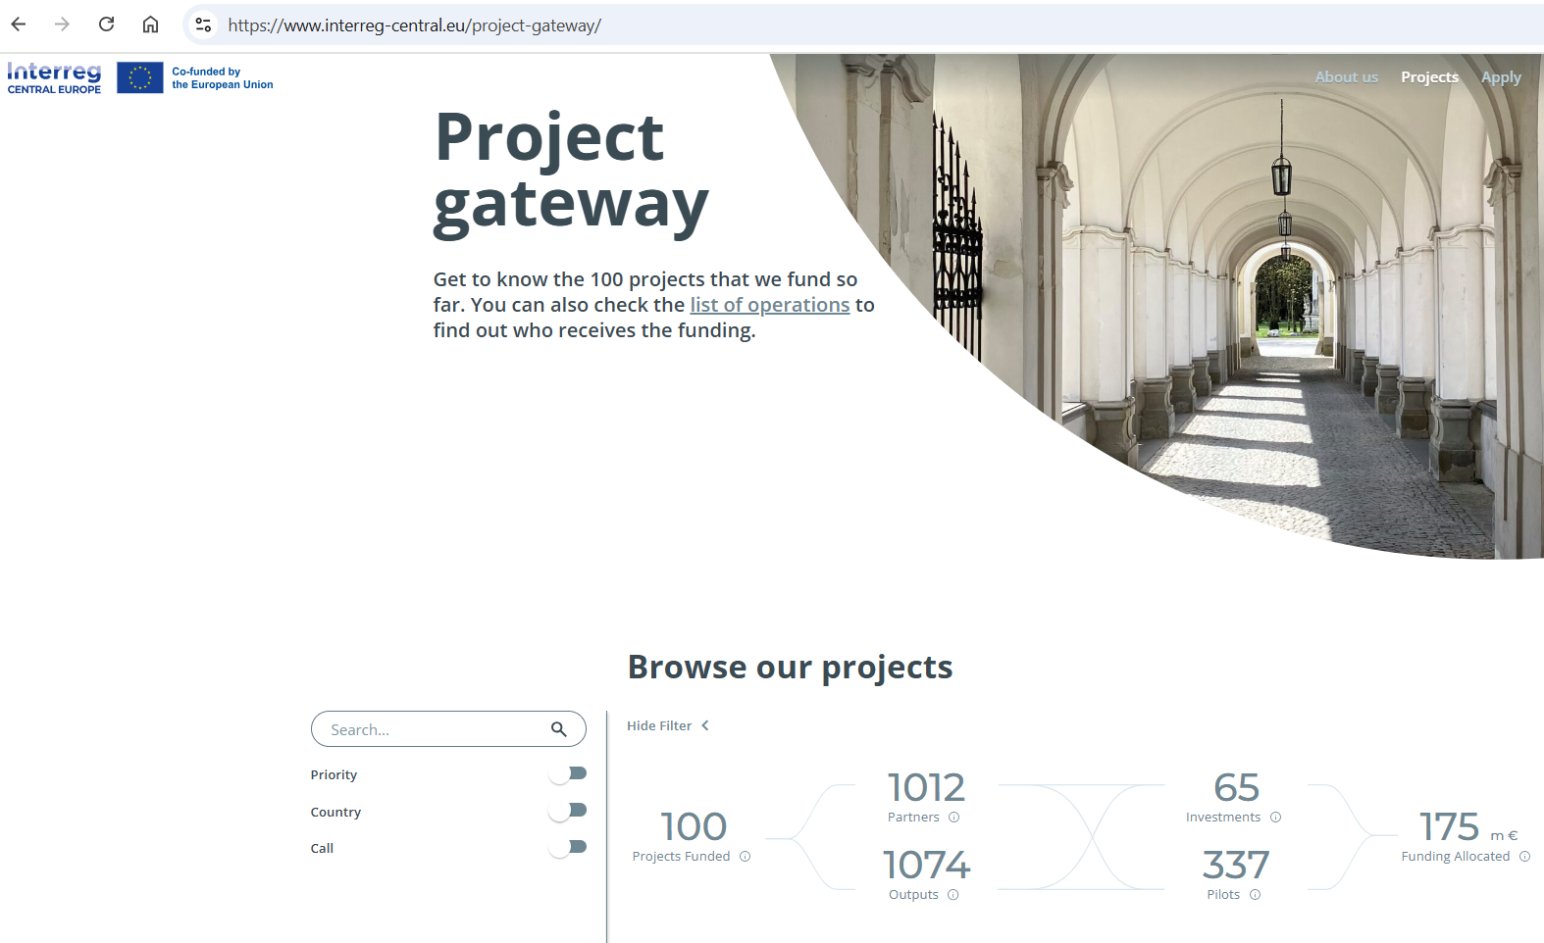
Where to Find Transnational Outputs and Results
Notes:
[Inform that on our website, all running projects can be found and filtered according to their thematic focus and location. Each project has its own subsite, in which they present a list and short description of the outputs and pilots they are working on.]

Slide 19
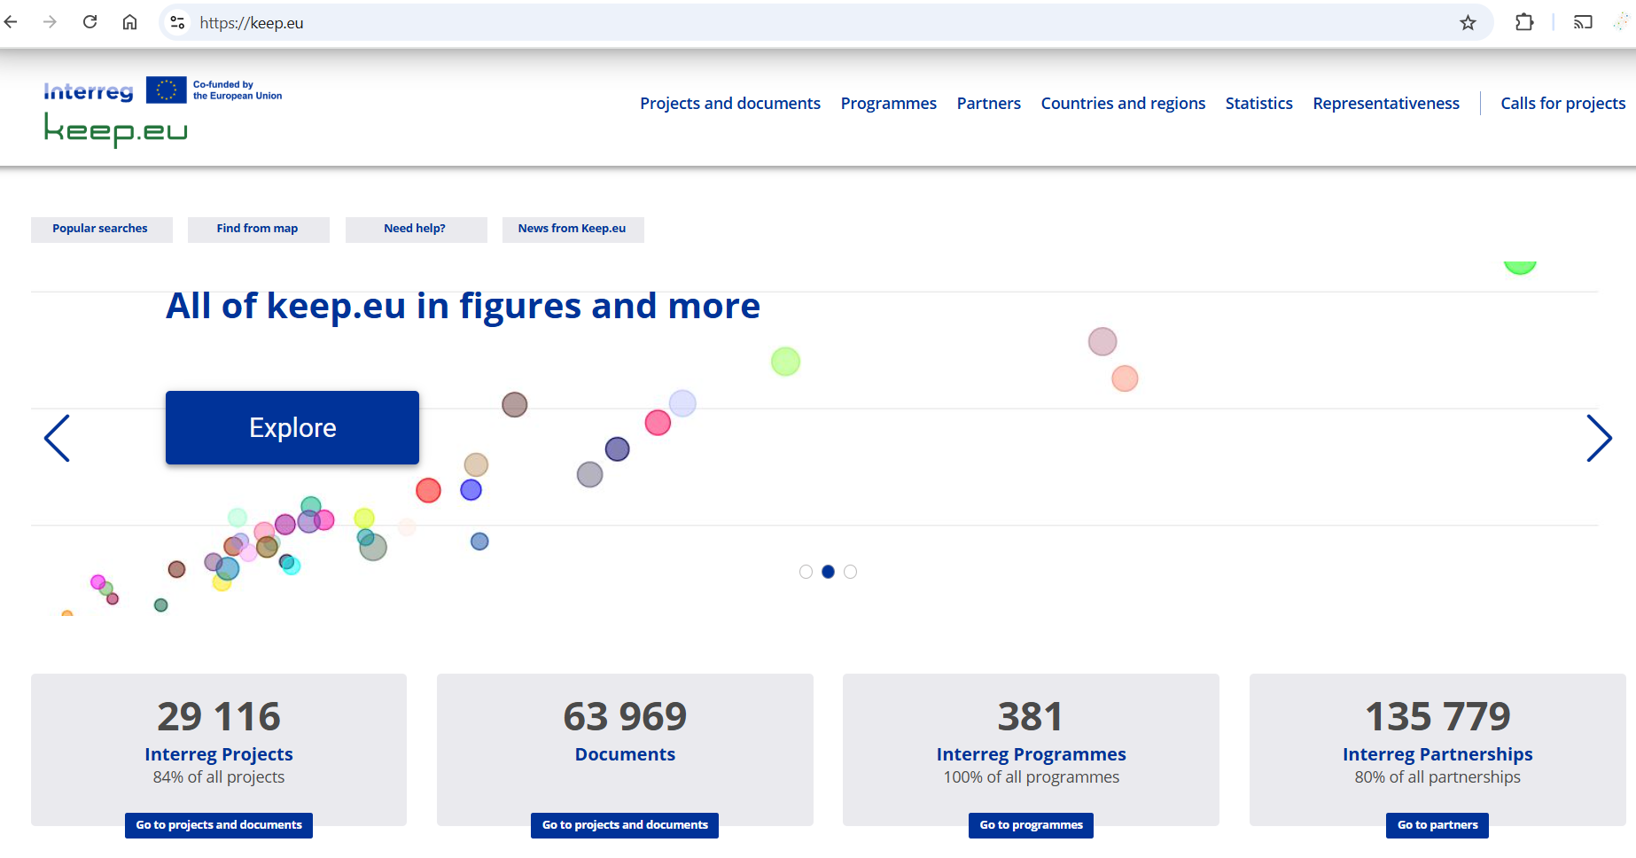
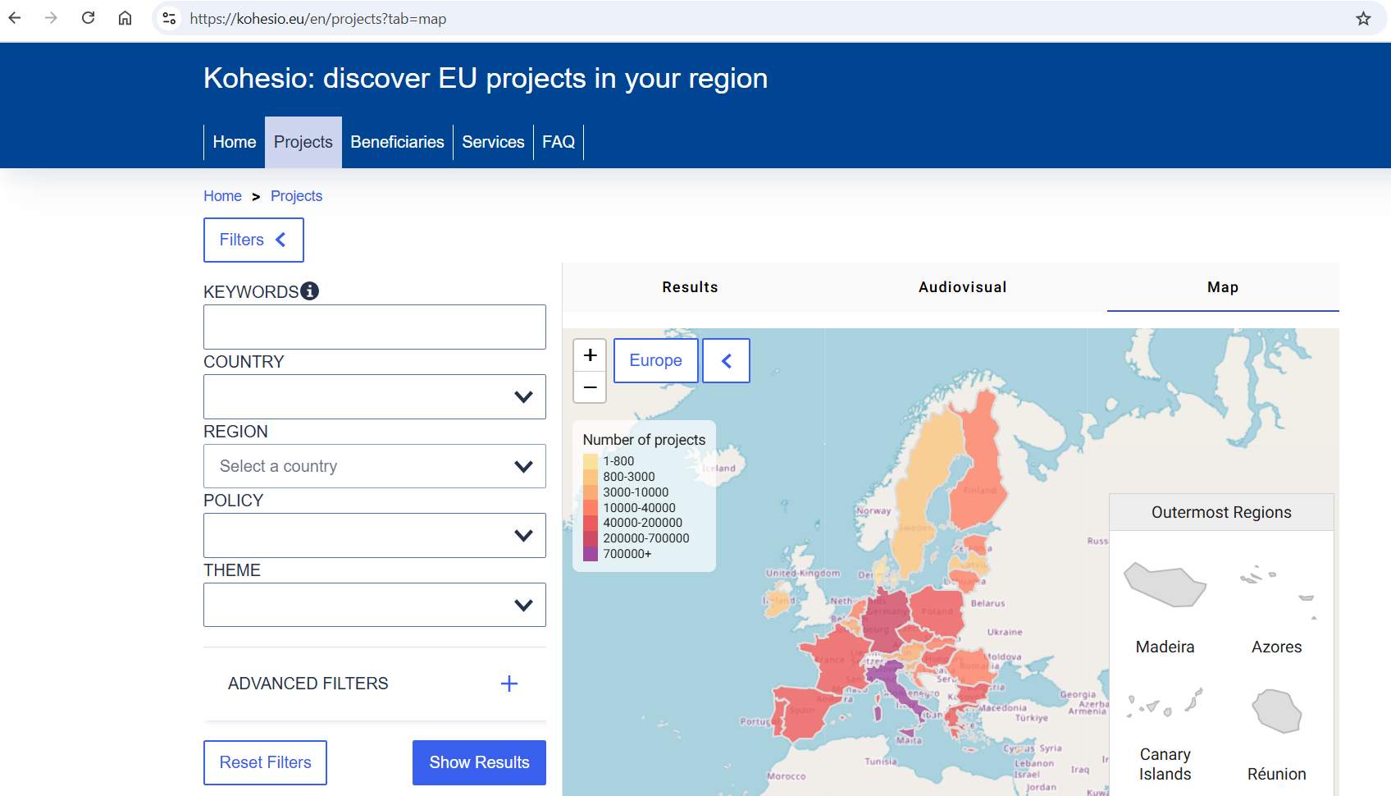
Where to Find Cross-Border Outputs and Results
Notes:
[For finding outputs and results of cross-border projects, recommended starting points are the databases KEEP.eu and KOHESIO.eu. Both can be filtered geographically and thematically and include valuable information.]

Slide 20
Upcoming Programme Support
Webinars
Videos
National
Support
Individual Consultations
Call launch webinar on 29 September, followed by a Q/A webinar fully dedicated to your questions.
Set of video tutorials and explainers that introduce key aspects of the call and provide hints (to be published over summer).
A broad range of support and guidance will be offered by the national contact points in national languages.
Individual consultations will be offered to advise applicants on contents, communication, and finance issues after the call launch.
Notes:
[Read slide.] For individual consultations, mention that they are not compulsory but highly recommended

