Slide 1
Interreg Europe support
Erika Fulgenzi
Policy Officer | Interreg Europe JS
e.fulgenzi@interregeurope.eu
dateevent name in town

Slide 2
Summary
Partner search
Project idea database
Programme feedback
Application Pack
Events

Slide 3
Partner search

Slide 4
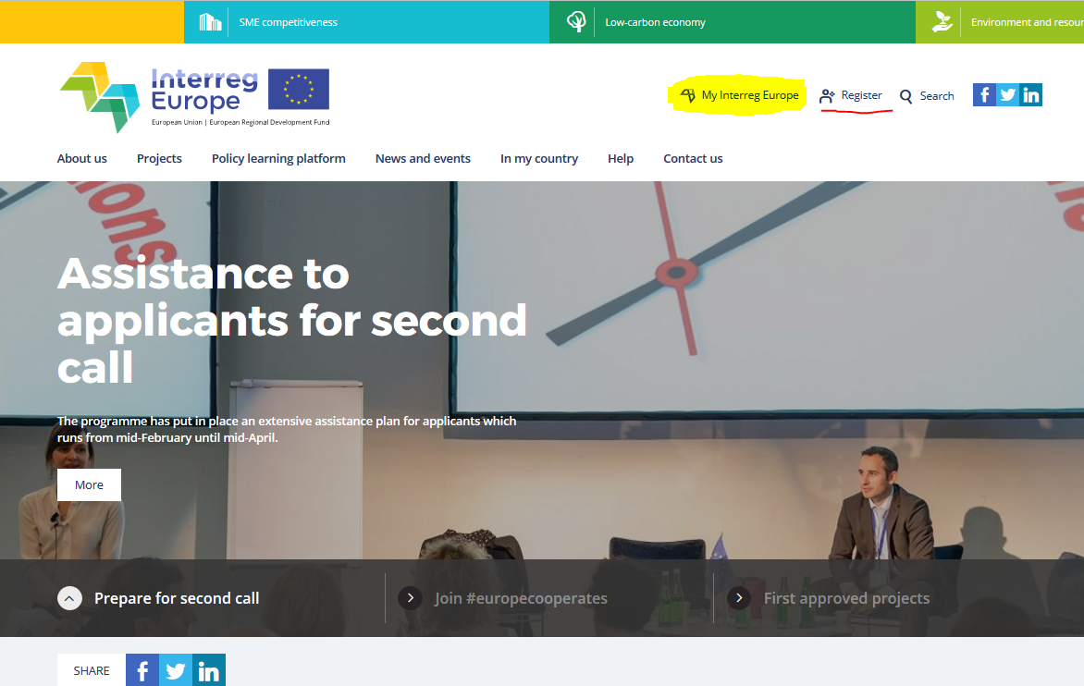
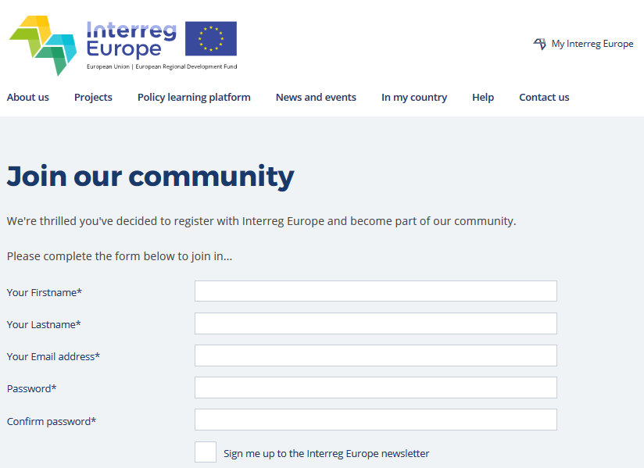
Interreg Europe community

Slide 5
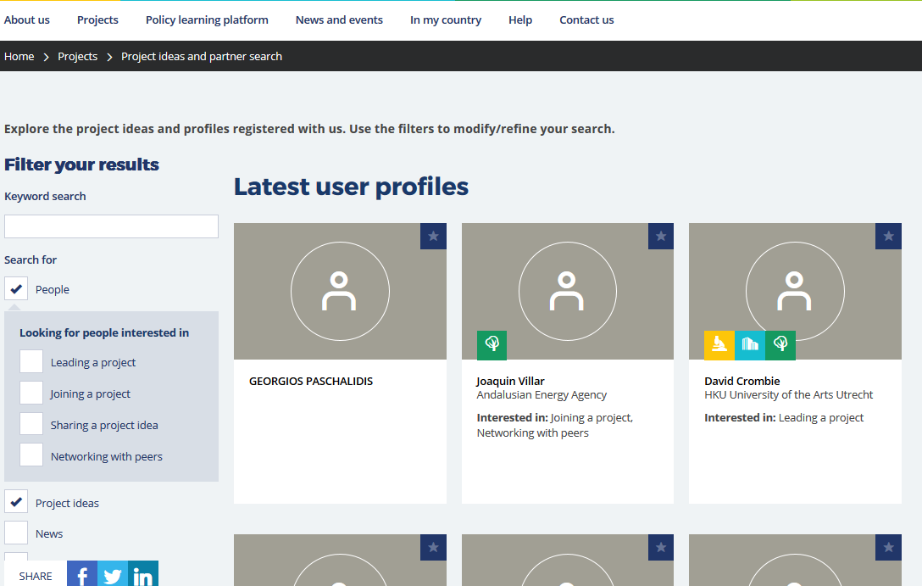
Interreg Europe community

Slide 6
Project idea database

Slide 7
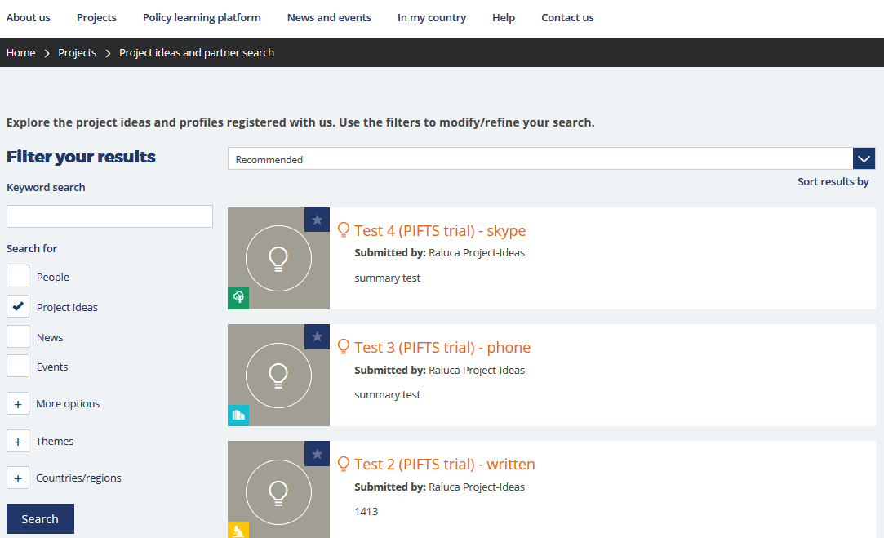
Check published ideas

Slide 8
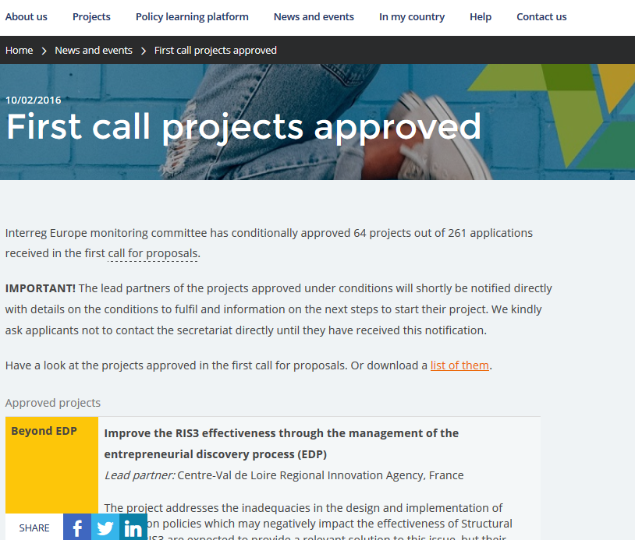
Check approved projects

Slide 9
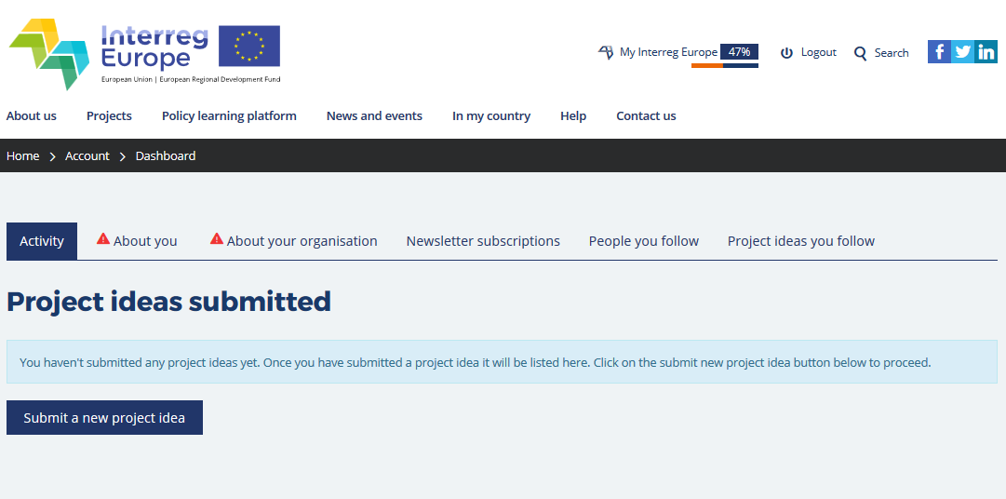
Submit a project idea

Slide 10
Programme feedback

Slide 11
Weekly Q&A sessions
Regular live talk with potential applicants
  Starting Friday 4 March
  Always from 10-11am
    4, 11, 18 March
    1, 8, 22, 29 April
    6 May
  Questions gathered via registration & on the spot
  Answered during a live webinar on Fridays
  https://attendee.gotowebinar.com/rt/1913615698606971906

Slide 12


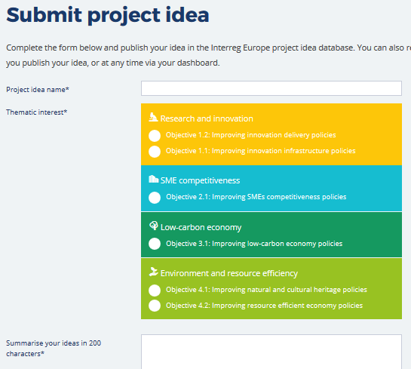



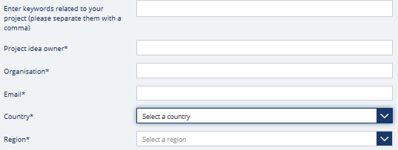


Send idea for feedback
Publish your idea
  Log into My Interreg Europe
  Submit your project idea

Slide 13
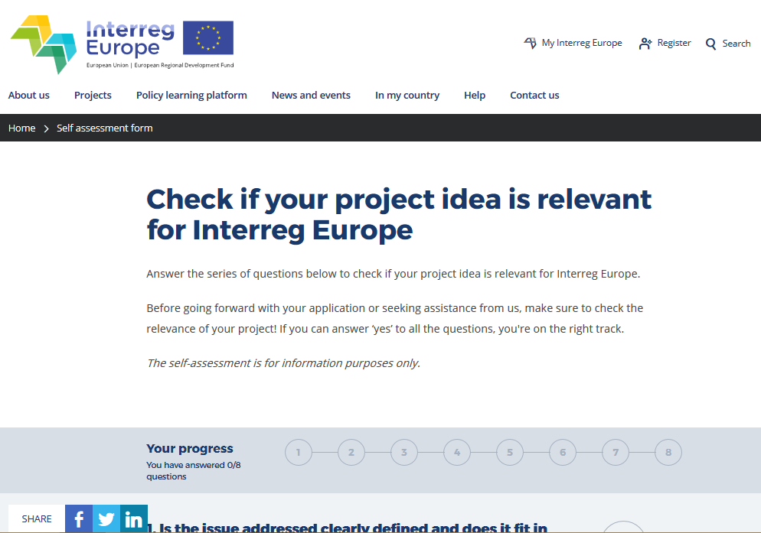
Assess the idea yourself

Slide 14
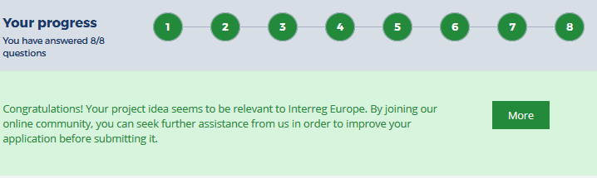
Send it for feedback
If green, submit your idea for our feedback
      Written
      Oral (phone/ Skype)
      Face-to-face at national event
        check for events at: www.interregeurope.eu/in-my-country/
Note! Conditions apply
    No feedback during first call
    No full assessment on project proposal done

Slide 15
Application pack

Slide 16
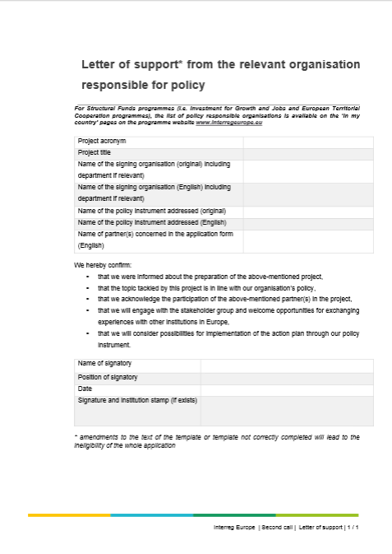
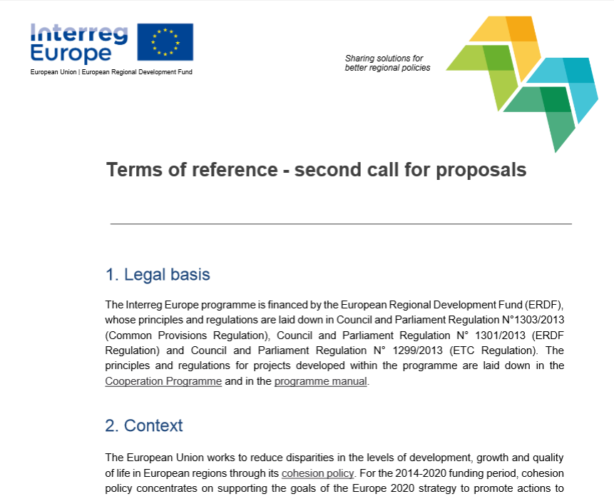
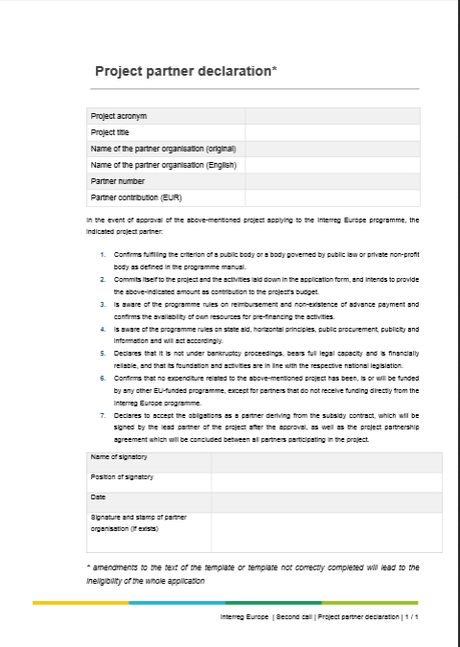

Available online
  http://www.interregeurope.eu/projects/apply-for-funding/

Slide 17
events

Slide 18
Lead applicant workshop
Live in Rotterdam – 23 March
  For those not present in Rotterdam / or as a revision
  Register at: www.interregeurope.eu/projects/project-assistance/
Webinar week – 12-15 April, 10-11 am
  Pre-recorded content from workshop & live Q&A
      Designing project methodology: 12 April
      Building relevant partnerships: 13 April
      Managing budget and finances: 14 April
      Planning a project communication strategy: 15 April

Slide 19
Thank you!
Questions welcome

