Slide 1
On the second call
Erika Fulgenzi
Policy Officer | Interreg Europe JS
e.fulgenzi@interregeurope.eu
dateevent name in town

Slide 2
Summary
Terms of reference
Lessons learnt from the first call
Few points about application
About assessment

Slide 3
Terms of reference

Slide 4
Second call for proposals
Timing:
Opening: 5 April (iOlf available)
Closing: 13 May (Midday CET)
22 February: assistance to applicants launched
Early 2017 – expected start of projects
No thematic restrictions:
Call open to all investment priorities
Projects under priority axes 3 and 4 welcome
Procedure:
on-line system

Slide 5
Lessons learnt

Slide 6
Eligibility
High rate of ineligibility (33%)
Main cause of ineligibility: letters of support and partner declaration (missing or incorrect)
Make sure all documents are provided and correct.
Don’t prepare them at the last minute.

Slide 7
Eligibility
Lessons learnt integrated in 2nd call application pack:
1/ Improved instructions in the application pack:
Reformulation of the criteria and their meaning
Warning messages included in different documents
2/ Full online application
Compulsory documents to be uploaded on iOLF
Project summary no longer necessary

Slide 8
Quality: common weaknesses
Criterion 1: Topic addressed
Needs to be clearly in line with priority axes
Needs to be focused and as specific as possible
Needs to be reflected in all policy instruments addressed

Slide 9
Quality: common weaknesses
Criterion 1: Policy instruments
Needs to be precisely defined (e.g. indication of the specific priority addressed)
For Structural Funds: the instrument addressed needs to be the Operational / Cooperation programme itself

Slide 10
Quality: common weaknesses
Criterion 3: Policy relevance of partners
Policy relevance = involvement of an organisation in the policy making process and capacity to influence to policy instrument
Core elements of the quality of partnership (dedicated questions in section B.2 of the application form)
Letter of support is not sufficient to demonstrate policy relevance of a partner

Slide 11
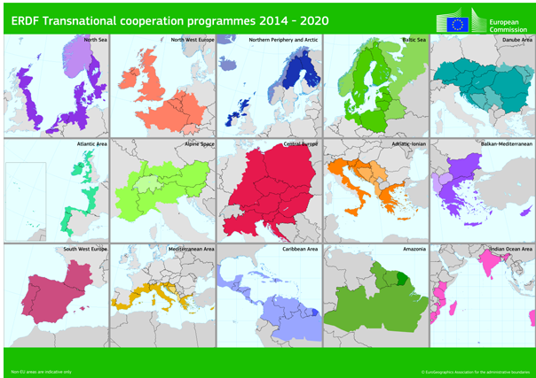
Quality: common weaknesses
Criterion 3: Geographical features
Coverage: going beyond transnational area

Slide 12
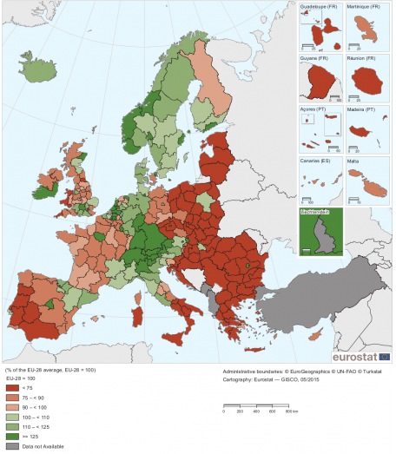
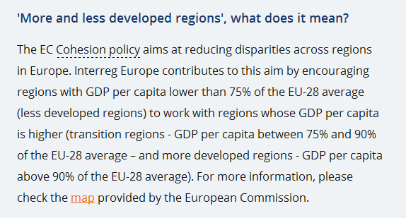
Quality: clarification
Criterion 3: mixing more and less developed regions (GDP)
Mix more and less developed regions (GDP)

Slide 13
Quality: common weaknesses
Criterion 3: multiple involvement
Involvement in numerous applications is demanding and is not recommended
Be strategic: select only the most relevant project(s) for your region
Justify in case you are involved in several applications (section B.2 of the application form)

Slide 14
Quality assessment: conclusion
Importance of the application form
Fairness and equal treatment principles:
Application Form = the only basis for assessment
same information requested from all
same technical requirements for all (e.g. text limits)
Application form has to be self-explanatory
Additional information / clarification not possible after submission

Slide 15
On application

Slide 16
Recommendations for applicants
Read the programme manual and check assessment criteria
Start from your need
Be specific, make sure the topic addressed is focused and reflected in the policy instruments
Take the learning process seriously
First activities, then budget planning
Communication serves your project

Slide 17
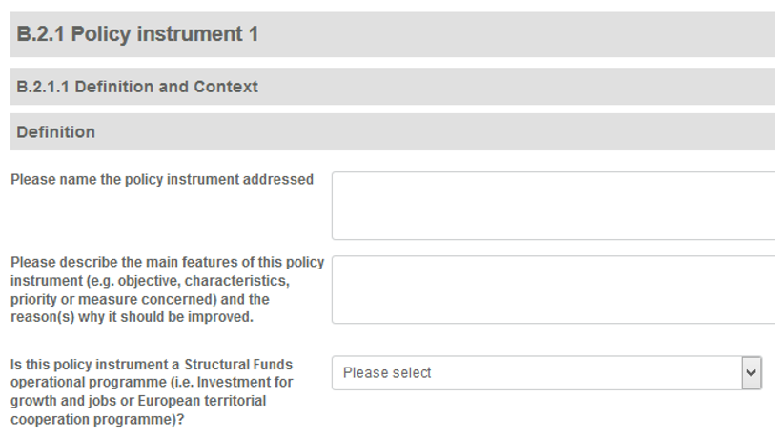
In the application form
Policy instruments

Slide 18
In the application form
Territorial context

Slide 19
In the application form
Detailed description of activities in D.1

Slide 20
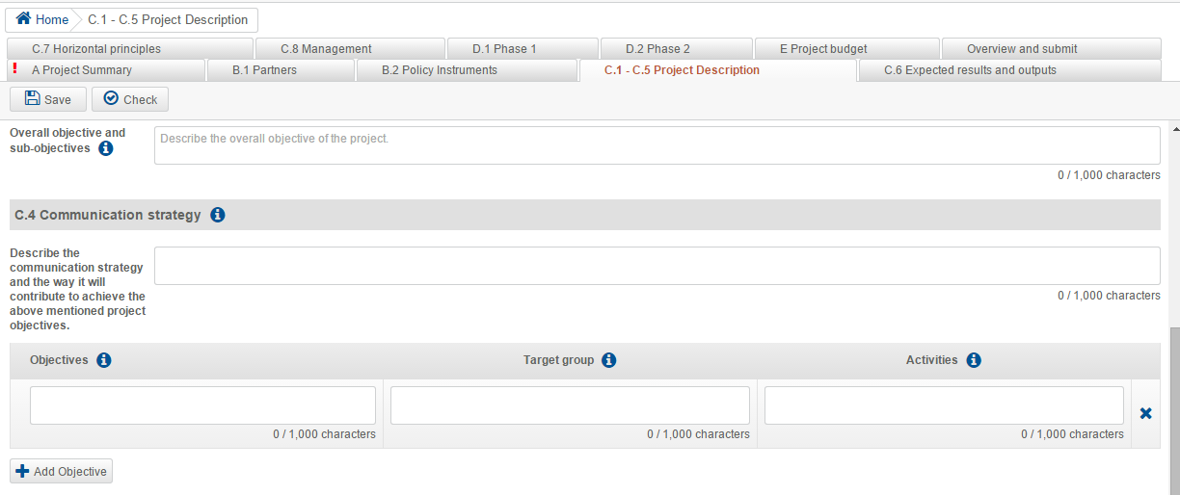
In the application form
C4: objectives, target groups and activities
D1: Workplan per semester

Slide 21
On assessment

Slide 22
Selection procedure
2-step procedure
I. eligibility assessment
fulfilment of technical requirements
II. quality assessment
2 step qualitative evaluation
Detailed description in the programme manual (§5.3):

Slide 23
Eligibility principles
Technical yes or no process
No correction possible
Only eligible applications are further assessed

Slide 24
Is your answer ‘yes’?
Is your application complete (application summary, partner declarations, support letters)?
Is the application filled in according to instructions?
Is it in English?
Are all partner declarations:
Signed and dated
With name of partner identical to application form
With stated amount covering at least the amount of partner contribution
With no amendments to the standard text

Slide 25
Is your answer ‘yes’?
Are all support letters:
Attached to the application form
Signed and dated by relevant organisation (check the country-specific list!!)
With name of partner(s) identical to application form
With no amendments to the standard text
Are at least 3 countries of which 2 are EU members involved and financed by Interreg Europe?
Is half of the policy instruments related to Structural Funds?

Slide 26
Quality assessment
2nd step for eligible applications
2-step approach
strategic assessment
operational assessment
Scoring system (0-5)
Decision by monitoring committee

Slide 27
Strategic assessment
Criterion 1: Relevance of proposal
Criterion 2: Quality of results
Criterion 3: Quality of partnership
Only projects reaching at least an adequate level (≥3.00) are further assessed for operational criteria.

Slide 28
Operational assessment
Criterion 4: Coherence of proposal & quality of approach
Criterion 5: Communication and management
Criterion 6: Budget and finance
Only projects reaching at least an overall adequate level (≥3.00) are recommended for approval (with conditions) to the monitoring committee.

Slide 29
Assessment provisional timing
May - June 2016 | Eligibility check
June – October 2016 | Quality assessment
End 2016 | Decision & notification
Early 2017 | Negotiation of conditions
Early 2017 | Effective start date of projects

Slide 30
Useful links
Programme manual
www.interregeurope.eu/help/programme-manual/
Application pack
www.interregeurope.eu/projects/apply-for-funding/
Online application/ reporting system
www.iolf.eu/
Interreg Europe community
www.interregeurope.eu/account/dashboard/

Slide 31
Thank you!
Questions welcome

