Slide 1
National Info Day
DTP 2nd Call for Proposal
22nd February 2017
Prague

Slide 2
Agenda
Application and Assessment (Applicants Manual part 4)
How to develop a Successful Project (AM part 6)
Intervention Logic

Slide 3
1.1 Application
1-Step application procedure
Maximum project duration: 36 months
Launch: May 2017
Deadline for submission: not before June 2017
Though the CfP is not officially launched yet, most important documents are already available
Technical framework for submission like DTP 1st CfP
http://www.interreg-danube.eu/calls/calls-for-proposals/second-call-for-proposals

Slide 4
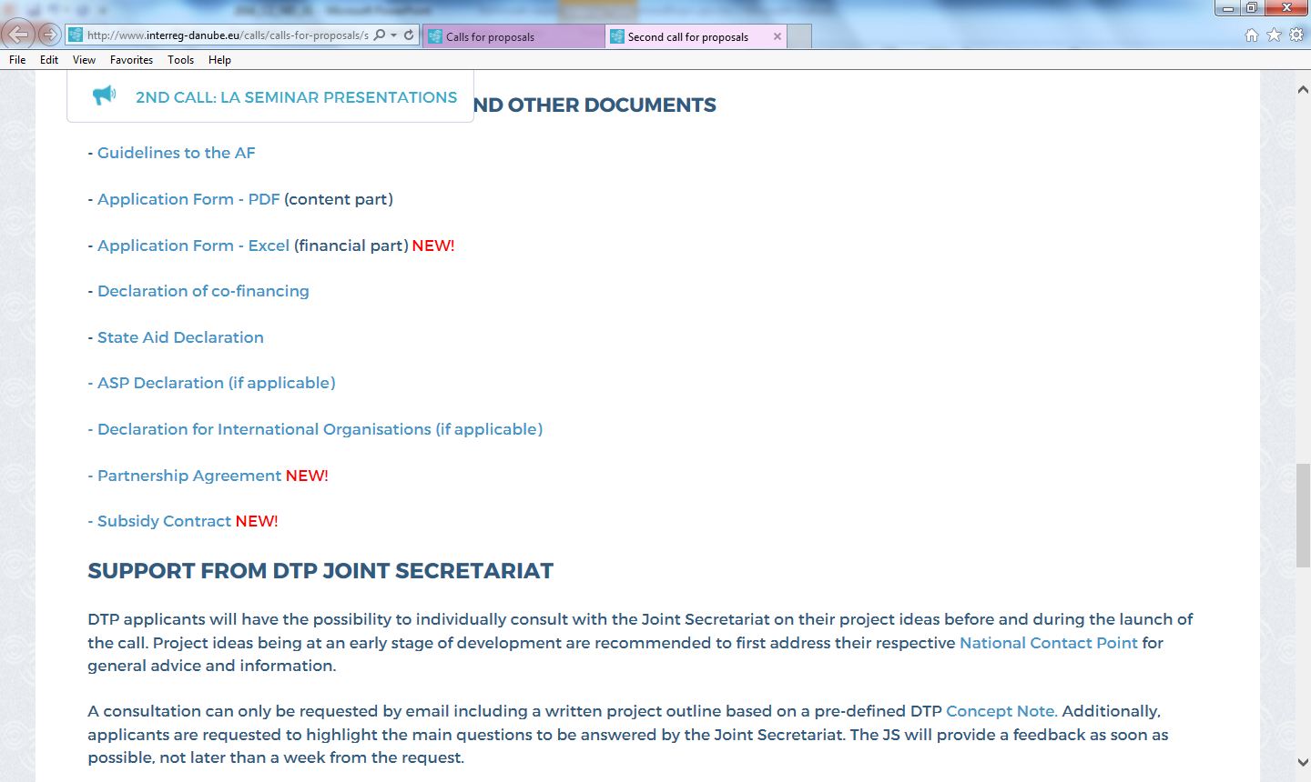
1.1 Application

Slide 5
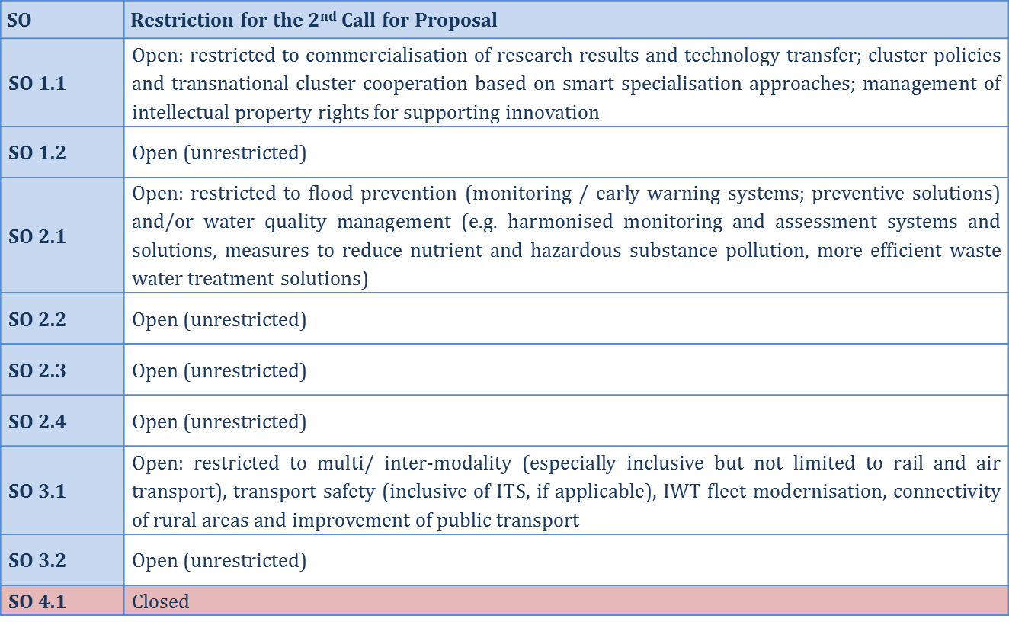
1.1 Application

Slide 6
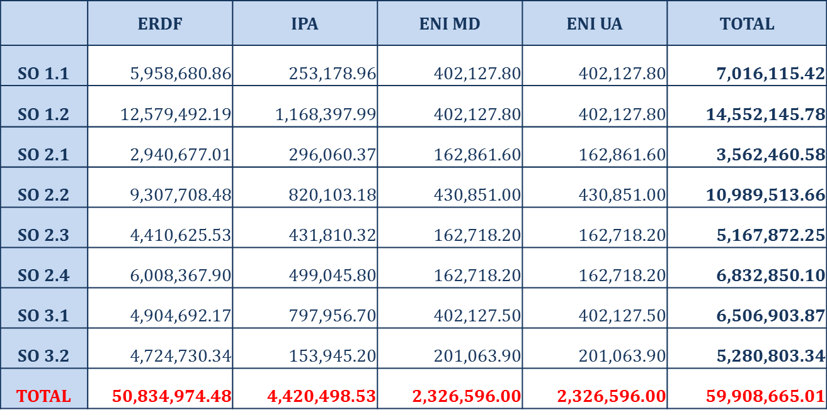
How much money do I have?
Budget of the 2nd Call for Proposals in EUR
Planned to be available at the launch of the call!

Slide 7
1.2 Eligibility Assessment
Eligibility check
Eligibility of the proposal - 9 Yes/No questions
Eligibility of the partners - 3 Yes/No questions

Slide 8
1.2 Eligibility Assessment
1. The AF in all its parts has been submitted within the set deadline | Deadline (date and time) to be provided in the Call Announcement.
2. The AF in all its parts has been submitted in the official templates and through the DTP website | Official templates to be published by DTP on the website/ All AF parts to be submitted through DTP website.
3. The AF in all its parts, including the annexes have been submitted in one single package | Application Form pdf xls Annexes (…)
4. The AF is compiled in English | AF is to be compiled in EN.
5. Partnership is composed by at least three financing partners from at least three participating countries of which at least one (LP) is located in a Member State | Financing Partners – ERDF, IPA, ENI PPs LA – ERDF PP.
6. Lead Applicant is an eligible beneficiary | LA fulfills the eligibility criteria.
7. At least 3 joint cooperation levels are indicated | According to Art 12(4) of EU reg. 1299/2013: Joint development Joint implementation Joint staffing Joint financing

Slide 9
1.2 Eligibility Assessment
8. The proposal contributes to at least two programme output indicators | The proposal contributes to the mandatory output indicator (documented learning interaction) and at least another one.
9. Completeness of Partnership Agreement | PA is signed by all directly financed partners.
Failure to meet criteria 1-9 leads to the rejection of the whole project proposal!

Slide 10
1.2 Eligibility Assessment
10. Financed partners (ERDF/IPA/ENI) are eligible | ERDF, IPA, ENI PPs fulfil the requirements of Applicants Manual Part 2 section II
11. Completeness of submitted ERDF/IPA/ENI partner documents | For each ERDF (incl. LA), IPA and ENI PP there should be enclosed a duly filled in and signed copy of: Declaration of co-financing State Aid declaration Declaration of International Organisations (if relevant)
12. Completeness of submitted ASP documents | For each ASP there should be enclosed a duly filled in and signed copy of ASP declaration
Failure to meet criteria 10-12 by one PP leads to the rejection of the respective PP!

Slide 11
1.2 Eligibility Assessment
BUT
A 5-day healing period is granted to submit missing documents (i.e. Annexes) and meet the eligibility criteria!

Slide 12
1.3 Quality Assessment
Relevance of the proposal: 2 main criteria, 4 sub-criteria,
each 0-5 points
< 60%
> 59%
Strategic relevance: 5 main criteria, 17 sub-criteria, each 0-5 points
< 60%
> 59%
Operational relevance: 4 main criteria, 14 sub-criteria
>74%
Direct approval
74% - 60%
Approval decided by MC
< 60%

Slide 13
1.3 Quality Assessment
Relevance of the proposal
1. Is the project relevant for the Programme?
Project topic - in line with the SO and Call provisions
Project - is NOT investment or research oriented and it does not target mere networking
Project - is NOT a duplication of previously funded actions
Project intervention logic - coherent with the Programme intervention logic
2. Is the need for transnational cooperation demonstrated?
Project transnational dimension and impact - demonstrated through geographical coverage and planned activities
Added value of the transnational cooperation - clearly demonstrated in comparison to a national/ cross-border approach

Slide 14
1.3 Quality Assessment
Strategic Relevance
1. Are the territorial needs and challenges identified and duly justified?
Needs and challenges - coherently and comprehensively described
Clear link between planned activities and described needs/ challenges
Needs and challenges - consistent with the programme objectives
Capitalisation of previous results and synergies
2. Is the project intervention logic coherent?
IL elements - clearly defined and interlinked
3. To what extent does the proposal contribute to an EU strategy or policy?
Relevant strategies/ policies
Relevant EUSDR PA(s), targets and actions
EUSDR is embedded in the proposal (e.g. involvement of EUSDR bodies, ensure uptake of results by EUSDR)

Slide 15
1.3 Quality Assessment
4. Is the partnership composition relevant, justified and balanced for the proposed project?
Geographical coverage - consistent with the territorial needs
PPs - competent to implement planned activities and produce envisaged outputs
All relevant sectors and levels of governance are present
Partnership is balanced
Harmonized benefits for all countries
Equitable distribution of tasks; PP involvement - concordant with the project activities
5. Is the target group defined and has ownership of the project results?
Relevant target groups - clearly identified and listed
Integration and use of project outputs
Concrete measures to ensure durability and transferability of project outputs
Contribution to the horizontal principles

Slide 16
1.3 Quality Assessment
Operational Relevance
1. Is the work plan realistic, consistent and coherent?
Timetable – realistic and coherent
Clear link between the activities/ outputs and methodology
Activities and outputs – achievable
Activities - comprehensively and clearly described
2. To what extent are management structures and procedures in line with the project size, duration and needs?
Clear governance of the project
Effective know-how transfer inside the partnership
Quality management structure and adequate procedures
LA - experience in implementing/ coordinating EU projects (esp. ETC) and institutional capacity to manage the project

Slide 17
1.3 Quality Assessment
3. To what extent are communication activities appropriate and forceful to reach the relevant target groups and stakeholders?
Adequate methods, means and channels to reach the target groups
Communication activities - consistent with the project deliverables and the specificities of the addressed target group
4. Does the project budget demonstrate value for money?
Activity/ WP/ BL budget - consistent with the planned actions, involved PPs and duration of activity
Spending forecast - coherent with the sequence of activities/ duration
WP1 & WP2 budget - justified by the planned activities and involved PPs
EE and equipment budget - justified and realistic for planned activities

Slide 18
1.3 Quality Assessment
Final considerations
Sound understanding of the assessment procedure / criteria helps to develop a project proposal in a more “targeted” way
Small differences in scoring can make a big difference … all sections of the AF should be carefully elaborated
Self-assess your project proposal in a critical manner and reserve enough time for revisions and adjustments!

Slide 19
2. Project Development
Applicants Manual part 6
Project generation and support from the DTP
How to set up the partnership
How to develop the intervention logic
How to set up efficient project coordination
Communication Strategy

Slide 20
2. Project Development
Result Orientation
Reinforced and (more) systematic approach to ensure direct contribution of projects to achieve Specific Objectives and Programme Objectives
Stringent alignment of projects and Programme regarding
Objectives
Results
Outputs
Exact specification quantification of project outputs along a set of limited, pre-defined output indicators

Slide 21
2.1 Intervention Logic
Programme
Project
Programme Mission
Specific Objective X
[ … ]
Project Main Objective
Contribution to Programme Specific Objective
Project Specific Objectives
Contribution to Project Main Objective
Targets
(semi-quantitative)
Result Indicator
Intensity of cooperation of key actors and stakeholders in the Danube area …
Project Result
Contribution to Programme Result Indicator
Targets
(quantitative)
Output Indicators
Nr. of strategies
Nr. of tools
Nr. of pilot actions
Nr. of documented learning interactions
Project Outputs
Contribution to Programme Output Indicators

Slide 22
2.1 Project Intervention Logic
Project Intervention Logic - Objectives
Specific Objective X
[ … ]
Project Main Objective
What is the intended strategic, long-term change?
Definition of only one concise main objective
Description of the contribution of the main objective to the Programme Specific Objective
Project Specific Objectives
What are the immediate effects of the project?
Definition of up to three concrete sub-objectives
Description of the contribution of the specific objectives to the project main objective

Slide 23
2.1 Project Intervention Logic
Project Intervention Logic – Result
Programme
Result Indicator
Intensity of cooperation of key actors and stakeholders in the Danube area …
Project Result
What is the benefit of using the project outputs?
Description of one concise result only
Description of the contribution of the project result to the Programme Result Indicator

Slide 24
2.1 Project Intervention Logic
Project Intervention Logic - Outputs
Programme
Output Indicators
Nr. of strategies
Nr. of tools
Nr. of pilot actions
Nr. of documented learning interactions
Project Outputs
What has been produced for the money given?
Project outputs have to contribute to one compulsory programme output indicator (documented learning interactions)
… and have to contribute to one up to max. 4 further programme output indicator

Slide 25
2.1 Project Intervention Logic
Intervention Logic – Outputs
Project Outputs
Programme
Output Indicators
Nr. of strategies
Nr. of tools
Nr. of pilot actions
Nr. of documented learning interactions
Output | Value
1 Danubian strategy for (…) based on 8 country reports | 1
1 Danubian strategy for (…) based on 8 country reports | 8
4 local action plans (for 4 pilots) | 4
1 E-learning platform | 1
1 internal project management manual | 1
Pilot implementation of action plans in 4 sites | 4
Implementation 1 E-learning course (4 X 25 particip.) | 1
Implementation 1 E-learning course (4 X 25 particip.) | 4
Implementation 1 E-learning course (4 X 25 particip.) | 100

Slide 26
2.1 Project Intervention Logic
Output Indicators
Documented learning interaction
process of acquiring institutional knowledge through transnational cooperation addressing common problems and\or challenges in a specific field
E.g. capacity building measures, e-learning platforms, peer-reviews …
Mandatory horizontal output indicator; each projects has to implement at least one (recommended: three) learning interactions!
Documented means that physical proofs that such a learning process has been implemented
Strategy
Should start with the definition of joint problems/ challenges and set up clear mid and long term objectives reflecting the common vision of the Danube Region in a specific field.
Should aim at policy integration in the Danube area in the selected fields and act as policy drivers below EU level but above national level.
Action plans break down the strategy goals and objectives into specific actions.

Slide 27
2.1 Project Intervention Logic
Output Indicators
Tool
means for achieving a specific task. Tools should be jointly developed at transnational level and be innovative.
Tools can be tangible (physical or technical objects) and intangible (methods, concepts or services).
e.g. analytical tools, management tools, software tools, monitoring tools, decision support tools, technical tools
Pilot action
practical implementation of newly developed solutions (e.g. services, tools, methods or approaches, even an investment)
has an experimental nature which aims at testing, evaluating and/or demonstrating the feasibility and effectiveness of a scheme
Deliverable: side product or service contributing to the development of an output
All products under WP1 and WP2 are deliverables

Slide 28
2.2 Check List
Do we have a vision regarding a concrete territorial change in the Danube Region?
Do we address Danube-specific needs (potentials) with our project idea?
Is the project idea clearly, explicitly and authentically addressing one of the SO of the DTP (taking into account thematic restrictions under the 2nd CfP)?
Partners we have in mind: is it a partnership or the partnership for the topic addressed?
Synergies with EUSDR considered? (during generation and within AF)
Intervention logic: is it really in line with DTP requirements? Does it convince us?
Did we critically self-assess all dimensions of the proposal (including operational)?
Did we double-check with the JS PO?
Did we double-check with “grandma”?

Slide 29
Contact
Johannes Gabriel
Project Officer
Joint Secretariat | Danube Transnational Programme
Honvéd utca 13-15 – 1055 Budapest, Hungary
Tel: +36 1 795 5886
johannes.gabriel@interreg-danube.eu
www.interreg-danube.eu

