Slide 1
Interreg Europe support
Charo Camacho
Project Officer| Interreg Europe
c.camacho@interregeurope.eu
23/02/2017NID Prage

Slide 2

Summary
Our online tools
Interreg Europe community
Programme feedback
Events and webinars

Slide 3
Get ready to apply

Slide 4
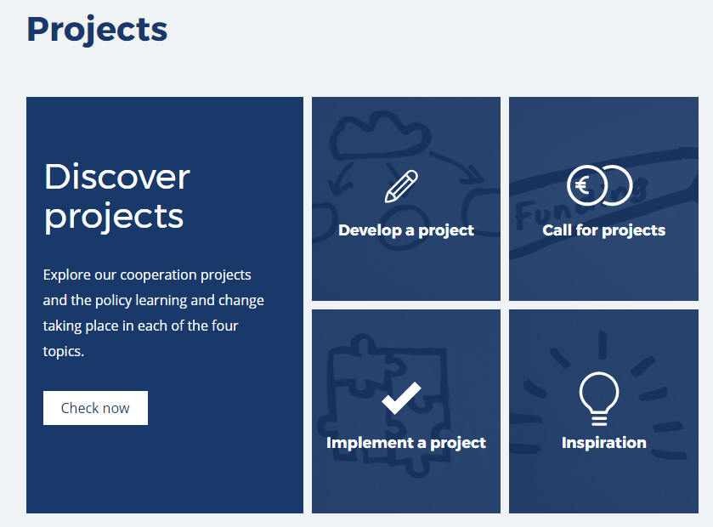
Surf through our website

Slide 5
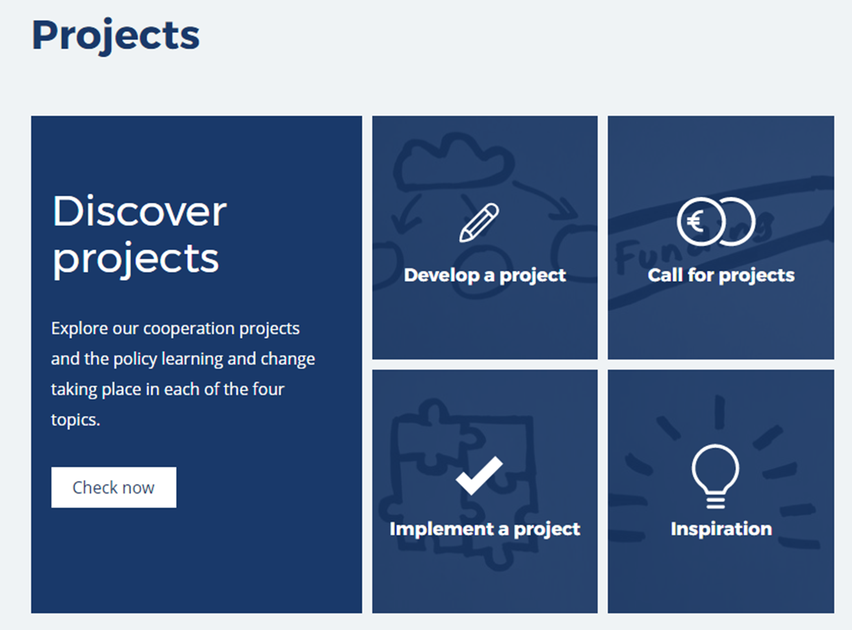
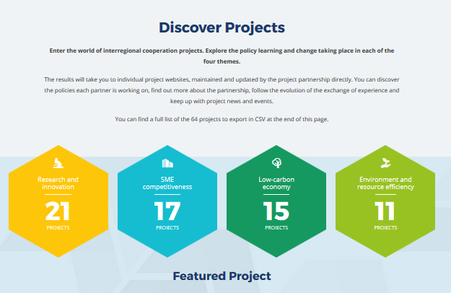
Check approved projects

Slide 6
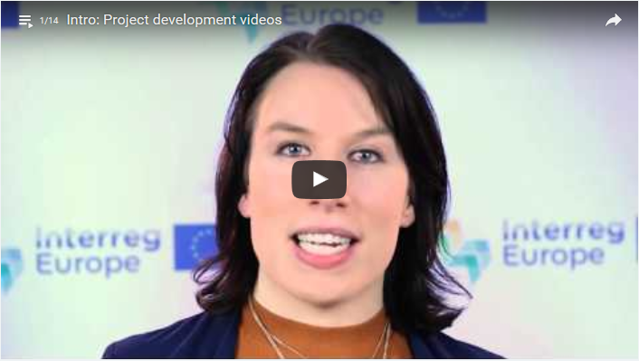
Check our videos
  http://www.interregeurope.eu/projects/project-development
Designing project methodology
Building relevant partnerships
Management, budget and finances
Planning a project communication strategy

Slide 7
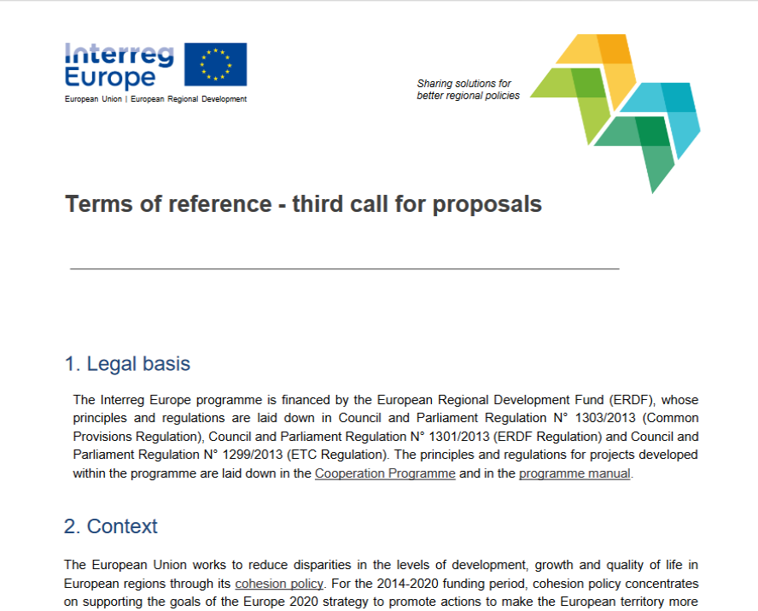
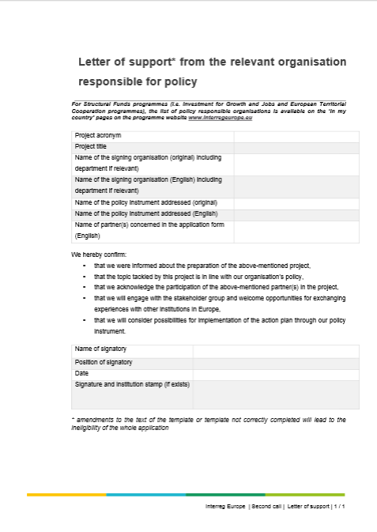
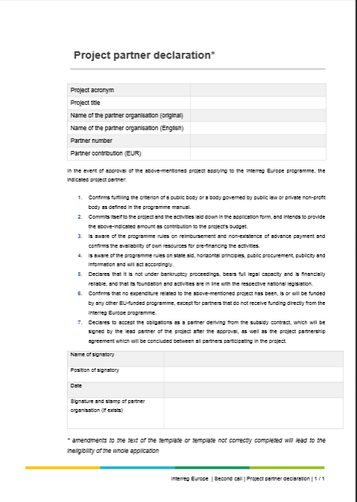

Get your application pack
  http://www.interregeurope.eu/projects/apply-for-funding/

Slide 8
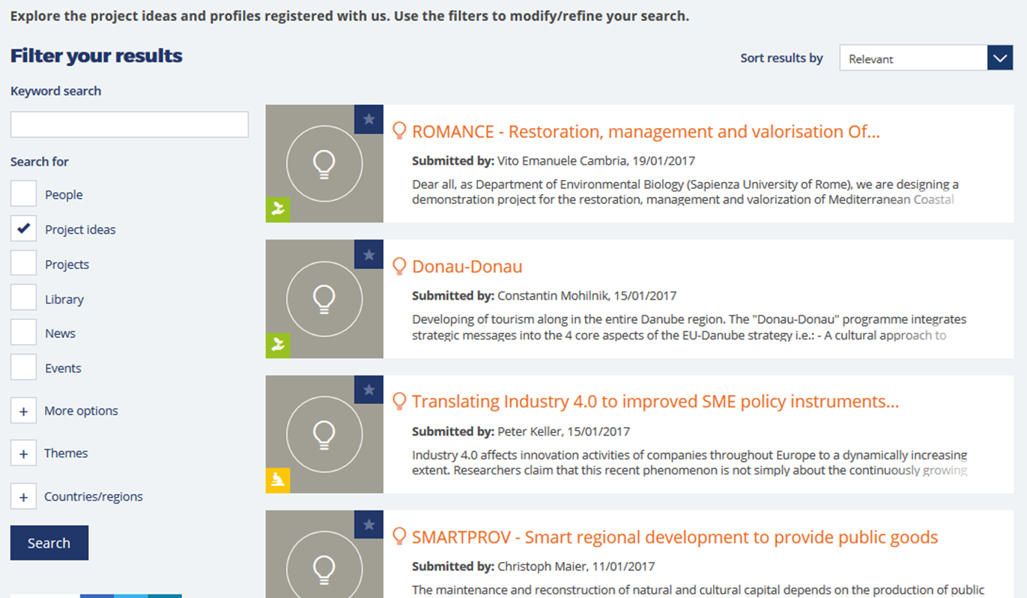
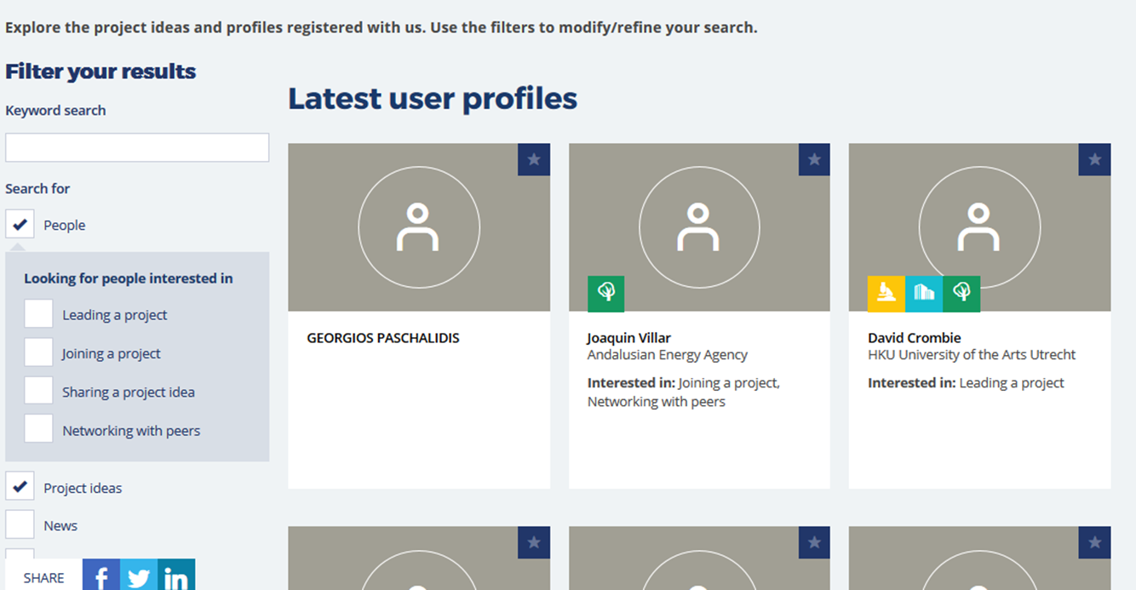

Find partners and ideas
Join our community!

Slide 9
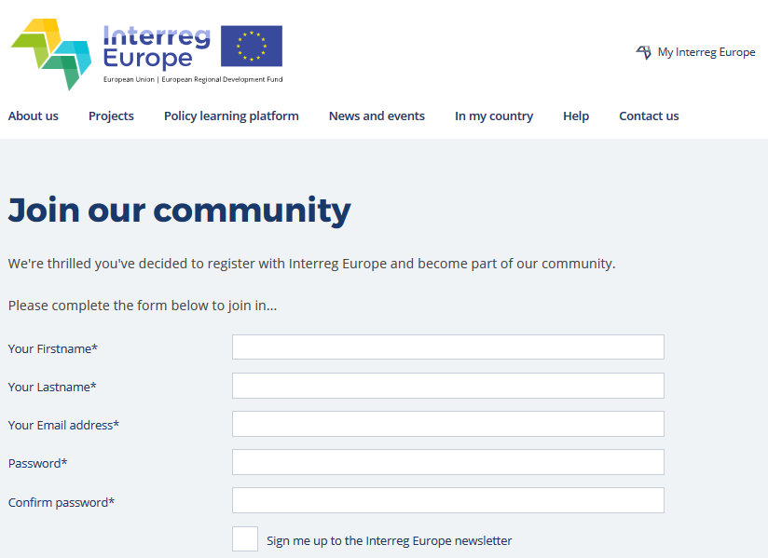
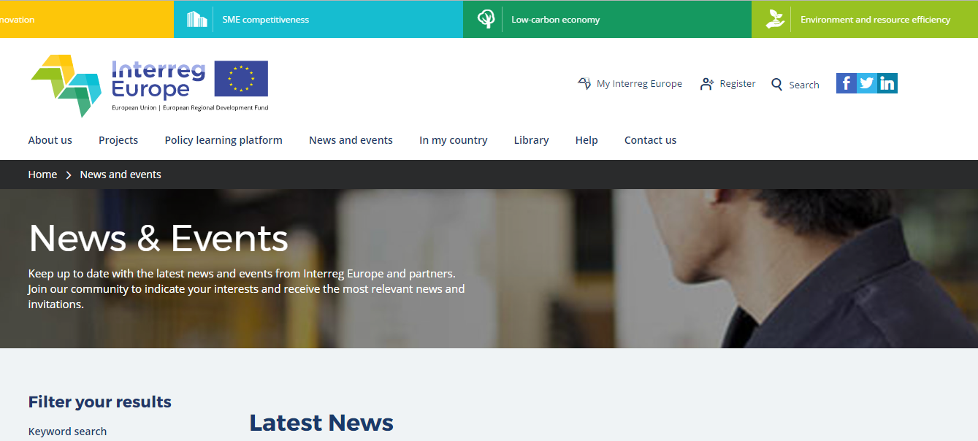

The Interreg Europe community

Slide 10
Get our feedback

Slide 11
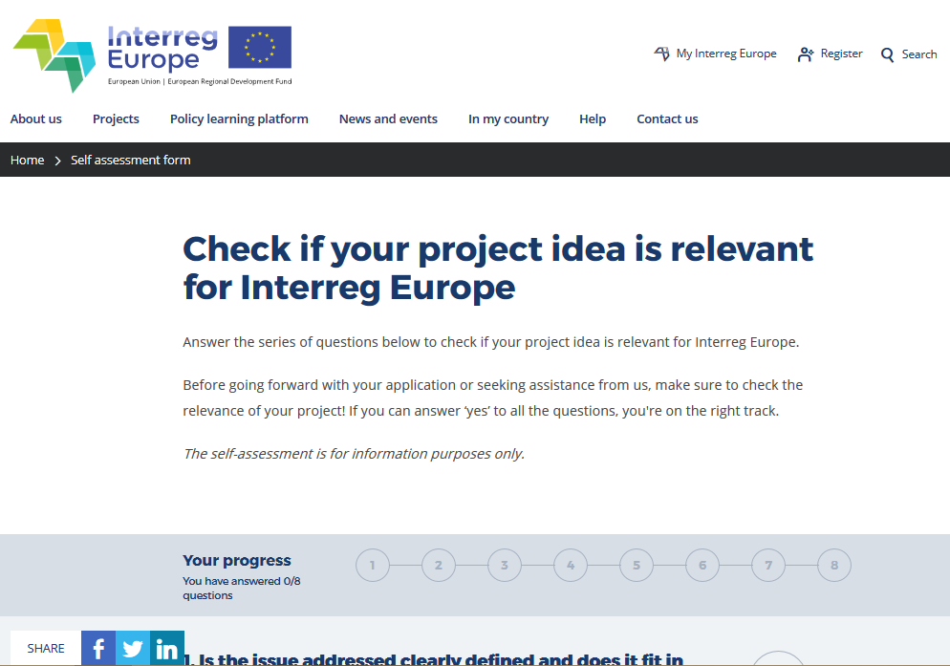
Assess the idea yourself

Slide 12
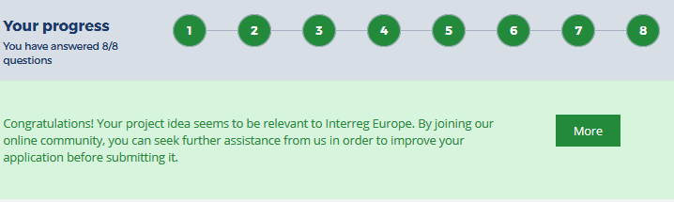
Assess the idea yourself
If green, submit your idea for our feedback
    Written
    Oral (phone/ Skype)
    Face-to-face at national event
        check for events at: www.interregeurope.eu/in-my-country/

Slide 13

Send idea for feedback
4 steps to follow:
  Log into My Interreg Europe
  Publish short description of your idea
  Add required details on your project idea
      Not published; for JS use only
      Submit advanced project idea (with first partners and policy instruments identified)
  Request feedback on your project idea. Select the format (and time) to receive our feedback
Feedback will be provided only once
per project idea!

Slide 14
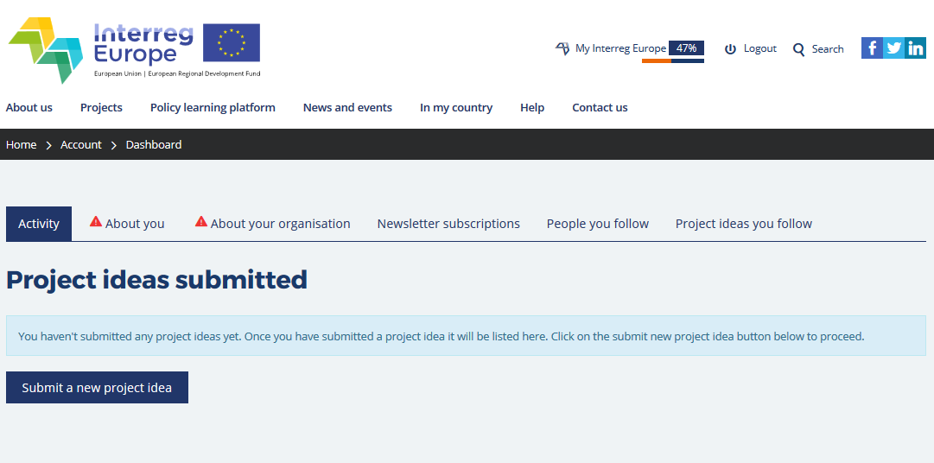

Send idea for feedback

Slide 15
Events, webinars and
Others

Slide 16

Networking in Malta

Slide 17
Lead applicant workshops
Live in Malta – 22-23 March 2017
  Register at: www.interregeurope.eu/europecooperates
Online – 31 March 2017, 10-12 am
  http://www.interregeurope.eu/europecooperates2017/online/
Webinar week – 24-28 April, 10-11 am
  Content from workshop & live Q&A
      Designing project methodology: 25 April
      Building relevant partnerships: 26 April
      Managing budget and finances: 27 April
      Planning a project communication strategy: 28 April
  Watch the videos and come with specific questions

Slide 18
Weekly Q&A sessions
Regular live talk with potential applicants (tbc)
  Starting Friday 3 March 2017
  Always from 10-11am
    3,10,17 March
    7, 14, 21 April
    5, 12, 19, 26 May
    2, 9, 23 June
Questions gathered via registration & on the spot
Answered during a live webinar on Fridays

Slide 19
Thank you!
Questions welcome

