Slide 1
Major projects in 2014-2020 programming period state of play
Unit F.1 Competence Centre Closure and Major Projects
DG Regional and Urban Policy
EGESIF meeting; 21 September 2016

Slide 2
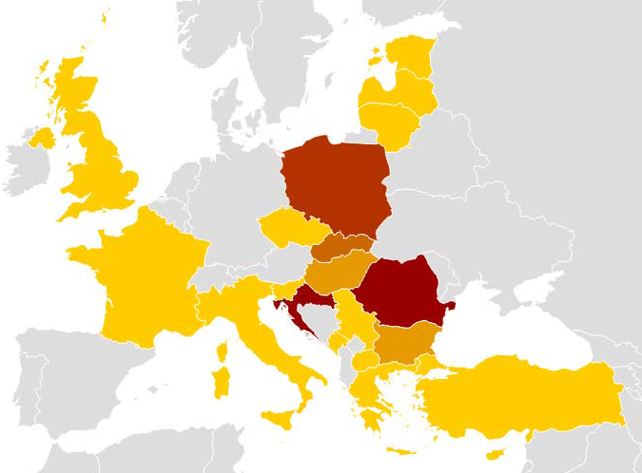
Improved system for major projects 2014-2020:
Fewer major projects from nearly 1000 in 2007-2013 period to ca. 600 thanks to change of thresholds
Increased role of JASPERS in appraising the projects (IRL, PT and ES in discussion)
Article 103 phased projects assure quick continuation of phased projects from 2007-2013
Positive role of ex ante conditionalities in defining the context for specific projects
Quicker decision making by the Commission: (average approval time for Article 102(2):114 days)
Increased result orientation and responsibility of the MS for selecting projects of appropriate quality
JASPERS countries
No of JASPERS assignments

Slide 3
Major projects in the OPs 2014-2020:
Only projects included in the OP can be submitted to the Commission
Table 27 of the OP presents major projects in the operational programmes
Table 27 is not included in the Commission decision approving certain elements of the OP
For the first time the OP specifies the key milestones for major projects:
Date of notification to the Commission;
Start date of the project;
Completion date of the project;
The MS can modify the list of major projects after the approval of the Monitoring Committee of the OP
Any change in this list should be notified to the Commission in line with Article 96 para. 11 within 1 month from the decision
The changes are notified via submission of new version of the OP, including changes to Table 27. If no other changes in the OP, the amendment will be registered as approved in the SFC automatically;

Slide 4
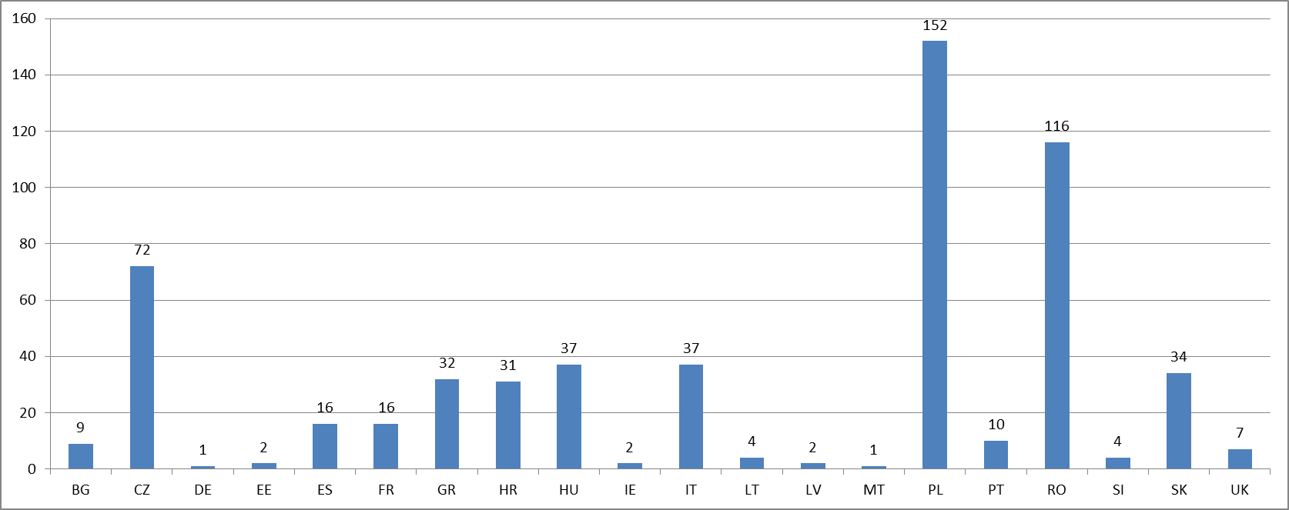
585 major projects in the OPs 2014-2020
(state of play 01 September 2016, SFC2014)

Slide 5
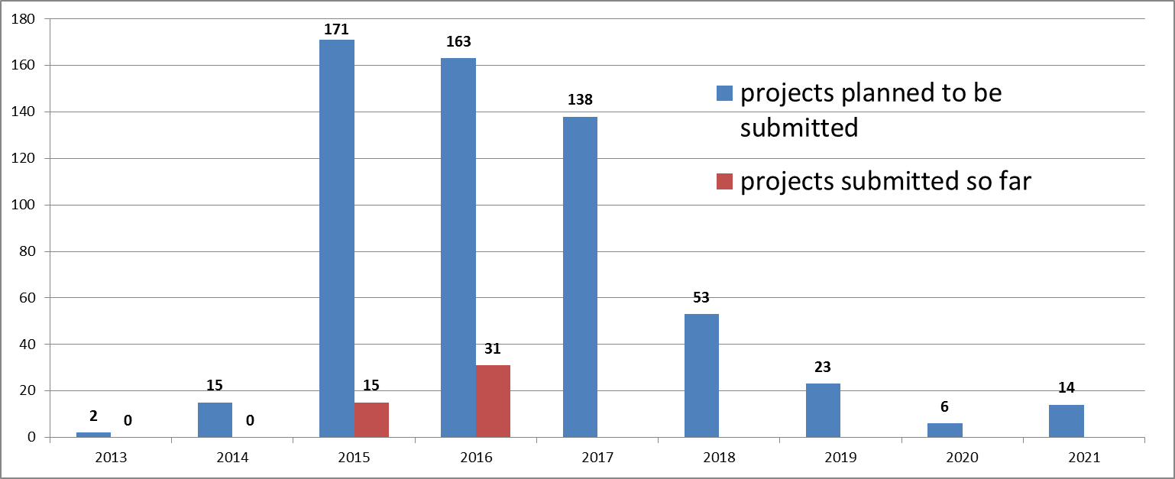
Expected submissions per year in the OPs 2014-2020
(state of play 1 September 2016, SFC2014)
Only 46 (8%) major projects submitted to the Commission as opposed to 213 (22%) major projects submitted until the end of 2009 in the period 2007-2013

Slide 6
Expected submission of MP by the end of 2016 versus projects already submitted (SFC2014)

Slide 7
Expected dates of start of implementation of major projects (SFC2014)

Slide 8
Project submission and decision making
There are 3 procedures for submision and decision-making on a major project:
Article 102 (1) - Notification based on IQR report
Article 102 (2) - Submission of all documents
Article 103 - Notification without IQR report (simplified procedure for phased projects only)

Slide 9
Role of Competence Centre (CC) for Major Projects in DG REGIO
All major projects "arrive" to REGIO.F.1 which is responsible for the completeness check (former admissibility check)
All major projects (except Article 103 for phased projects) will be reviewed by JASPERS*:
If under Article 102(1), through Independent Quality Review report,
If under Article 102(2), through Post-Submission Appraisal report;
Reinforces upstream work of geographic units (MC meetings, tripartite meetings with EC, JASPERS and MS)
Clear division of responsibilities between JASPERS and the Commission
CC ensures consistency in assessing projects from different Member States
Average approval time: 114 days as opposed to 340 days in 2007-2013
* Currently JASPERS is the only IQR body

Slide 10
Actions for the MS
To establish more reliable monitoring system of preparation and implementation of major projects by the Managing Authorities/IBs
To keep list of major projects in the OPs updated so that all projects can be sent to the Commission and the most recent timetables are included
To develop sufficient project pipeline to assure timely implementation in 2014-2020 period from all funding sources (mostly ESIF/CEF)
To identify all bottlenecks delaying the project preparation and implementation (e.g. administrative capacity, overregulation, procurement, market conditions)
To maximise the use of JASPERS initiative, starting as early as possible in the preparation phase, already during pre-feasibility discussions
To decide on which procedure to use for submission of major projects (proposed modification of the CPR (COM(2016) 605 final): certification of expenditure possible when major project is sent for IQR)
To double-check the quality of information in the Application/Notification Forms in SFC2014 before submitting to the Commission

Slide 11
Thank you for your attention

