Slide 1
ARACHNE
Risk scoring tool
Prague
24-27 October 2016

Slide 2
Arachne Agenda
09:00 – 09:30 General information about Arachne / Data flow
09:30 – 09:45 Data quantity / data quality / data sourcing issues
09:45 – 10:15 Search of companies and persons data (Orbis database)
10:15 – 10:30 Break
10:30 – 12:00 Search of companies and persons data: Exercises
12:00 – 13:00 Lunch break
13:00 – 14:30 Arachne functionalities : Dashboards / Risk details / Reports
14:30 – 14:45 Break
14:45 – 15:15 Arachne functionalities : Exercises
15:15 – 15:45 Arachne functionalities : Export / Case management system
15:45 – 16:00 Questions and answers

Slide 3
Arachne Agenda
09:00 – 09:30 General information about Arachne / Data flow
09:30 – 09:45 Data quantity / data quality / data sourcing issues
09:45 – 10:15 Search of companies and persons data (Orbis database)
10:15 – 10:30 Break
10:30 – 12:00 Search of companies and persons data: Exercises
12:00 – 13:00 Lunch break
13:00 – 14:30 Arachne functionalities : Dashboards / Risk details / Reports
14:30 – 14:45 Break
14:45 – 15:15 Arachne functionalities : Exercises
15:15 – 15:45 Arachne functionalities : Export / Case management system
15:45 – 16:00 Questions and answers

Slide 4
Objectives
Provide the MA's with a tool which can help them to comply to Article 125 (4)(c) of the Commission Regulation (EU) No 1303/2013:
  "managing authorities have to "put in place effective and proportionate anti-fraud measures taking into account the risks identified"

Slide 5
Arachne What ?
Provide the MA's involved in management of the Structural Funds with an operational risk scoring tool to identify
  their most risky projects/contracts ;
  potential risks linked to all their projects and contracts.

Slide 6
Arachne Objectives
Support the Management and Control Systems of the OPs, to lower the error rate, strengthen fraud prevention and detection and identify possible irregular circumstances continuously on the basis of predefined risk criteria.
Facilitate the continuous monitoring / overview of the internal and external data regarding projects, beneficiaries and contracts/contractors.
Promote the use of a risk based approach in the verifications of the projects (focus on most risky projects).
Complements the risk current assessment with regard to fraud alerts and irregularities
Increase efficiency and effectiveness of management verifications.
Carry out ex-ante checks before grant agreements or contracts are signed.
Show and document the result of increased efficiency and effectiveness of management verification.
Profit from automatic dataflow and decreased administrative burden.

Slide 7
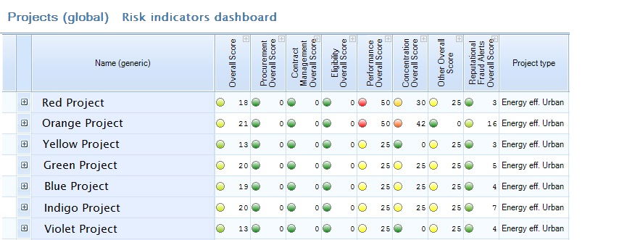
Arachne How ?
-> Based on a set of risk indicators and alerts
-> Using some key (internal) data of the projects
enriched with publicly available information
(external data)
-> Customized to the nature of OP expenditures
-> Results are displayed in dashboards

Slide 8
Arachne Users
Core users
  Managing Authorities
  Intermediate bodies
Other users
  Certifying Authority
  Audit Authority
  EC Auditors DG REGIO and DG EMPL
Case-by-case (no full access)
  Olaf
  ECA

Slide 9

Arachne Evolution
V1.2.4 → V2.0 → Web Interface
V2.0
  Reviewed welcome window
  Review of some risk indicators / category score calculation
  History of risk indicators
  Improved case management and user management
  Filter options / Save Filters
  Improved reports, statistics
  Automatic disconnection
  Upload functionality
Charter

Slide 10
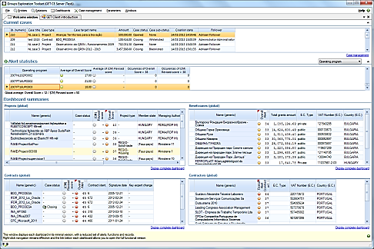
Arachne Data flow
Contract data
Contract ID
Contract description
Date signature
Initial end date / Final end date
Contractor / Subcontractors
Amount
Nbr Addenda / Amount of addenda
Key experts
Procurement information
  Type
  Tenders : valid / excluded / Total
  Publication date
Member States
DIGIT
Project data
Project ID
Project description
Status
Beneficiary
Start date / end date
EC Financial Assistance
Total project cost
Type of project
Project partners
Project details
Related people
GET Application Server
Operational Data
Operational Data
GET database
Vadis
European Commission
Member States
Expenses / invoices
Expense ID
Expense Type
Description
Amount
Contractor
Invoice date
Payment date
Operational Data
GET database
Orbis
World Compliance

Slide 11


Data Flow Orbis
  Orbis has information on :
    Companies : over 200 million companies worldwide
      Financial data of the company (turnover, cash flow, profit margin, …)
      Shareholders / subsidiaries
      Address information
      Sector, Type, Size
      Related people (directors, contact people, …)
      Indicators like credibility and bankruptcy
    Persons : 140 million individuals
      First name, last name, Age (birthdate)
      Number of affinities, number of companies and role in company
    Only officially published and public available data

Slide 12

Data Flow Orbis
  Orbis : Focus on Czech Republic
  main source is the Business Register where companies publish financial statements
  Service provider : Bisnode
  Currently 2.493.747 companies in the Business Register (including branches, inactive companies and companies only registered with no financial statement)

Slide 13
Data Flow Orbis
Added value of Orbis data in Arachne
  Administrative, financial and operational capacity of beneficiaries
  Not limited to National Register, also international companies
  Vadis predictive indicators : bankruptcy score
  Links between beneficiaries / contractors / partners / consortium members
  Affinity links
  SME status
  Links with projects
  …

Slide 14

Data Flow World Compliance
  World Compliance collects, aggregates and centralizes :
    PEP lists
    Sanctions lists
    Enforcement list
    Adverse media list
  The data is received from regulatory and governmental authorities (except for adverse media list)
  Access more than 2.3 million detailed profiles covering every country and territory throughout the globe
  Information is only accessible through the Arachne alert details (It won’t be possible for a user to explicitly retrieve these information for a given company/person)

Slide 15


Data Flow World Compliance
LexisNexis
  Global PEP List :
        Over 850,000 profiles of Politically Exposed Persons from over 230 countries, including family members and close associates. State owned companies and foreign officials are added to this list.
        Used in the alert ‘Involvement in PEP lists’
        Arachne shows Name + Role in the project + WorldCompliance position (e.g. Mayor of …) + WorldCompliance Remarks (e.g. former prime minister of …)
BACK

Slide 16
Data Flow World Compliance
LexisNexis
  Global Sanctions List :
    Aggregated information from sanction lists around the world and grouped into the Global Sanction List offering, with over 15,000 profiles covering a.o. EU Terrorism List, ICE List, CBI List, Office of Foreign Assets Control (OFAC) Sanctions, Her Majesty Treasury, Bureau of Industry and Security, World Bank Debarred Parties List, OCC Shell Bank List, Department of State, Interpol Most Wanted, SDN & Blocked Entities, SECO List, Treasury PML List, UN Consolidated List
    Used in the alert ‘Involvement in sanction lists’
    Arachne shows Name + Role in the project + WorldCompliance position (e.g. Added to OFAC list)
BACK

Slide 17
Data Flow World Compliance
LexisNexis
  Global Enforcement List:
    Information from regulatory and governmental authorities, including warnings and actions against individuals and companies, narcotic traffickers, money launderers, fraudsters, human traffickers, fugitives and other criminals. More than 500 enforcement lists are monitored to offer over 200.000 profiles.
    Used in the alert ‘Involvement in enforcement lists’
    Arachne shows Name + Role in the project + WorldCompliance position (e.g. Wanted for organized crime and fraud)
BACK

Slide 18
Data Flow World Compliance
LexisNexis
  Global Adverse Media List :
    The Global Adverse Media List is an extensive proprietary database, comprised of public domain news, money launderers, fraudsters, arms dealers, narcotic traffickers and other criminals. We monitor in excess of 25.000 newspapers and magazines in more than 35 languages for risk relevant information, providing over 100.000 profiles for protection from risk entities in the public domain.
    Used in the alert ‘Involvement in adverse media’
    Arachne shows Name + Role in the project + WorldCompliance position (e.g. Sentenced to 18 months of prison for tax evasion) + WorldCompliance Remarks (e.g. According to www.24chasa.bg; November 28, 2011: Emir Chamdeme was sentenced to …)
BACK

Slide 19
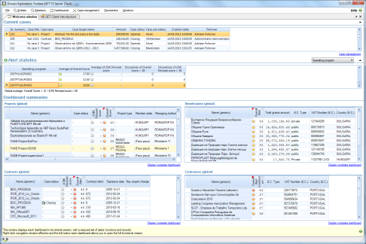
Arachne Data flow
Member States
DIGIT
GET Application Server
Operational Data
Operational Data
GET database
Vadis
European Commission
Member States
Operational Data
GET database
Orbis
World Compliance

Slide 20

Arachne Impact
Technical impact
providing the data for the risk calculation to Arachne in XML format
installation of the Arachne client software
Administrative impact
Define Arachne users / roles
Train the users
How and when to integrate / to use Arachne in management verifications

Slide 21
Arachne General info
Are all DG's involved in Arachne ?
What is the cost to integrate Arachne for a Member States ?
What currency should MS use for amounts ?
Are there direct links with other tools (IMS / EWS / TED / EDES / …) ?
Which operational programmes must be sourced to Arachne ?

Slide 22
Arachne Agenda
09:00 – 09:30 General information about Arachne / Data flow
09:30 – 09:45 Data quantity / data quality / data sourcing issues
09:45 – 10:15 Search of companies and persons data (Orbis database)
10:15 – 10:30 Break
10:30 – 12:00 Search of companies and persons data: Exercises
12:00 – 13:00 Lunch break
13:00 – 14:30 Arachne functionalities : Dashboards / Risk details / Reports
14:30 – 14:45 Break
14:45 – 15:15 Arachne functionalities : Exercises
15:15 – 15:45 Arachne functionalities : Export / Case management system
15:45 – 16:00 Questions and answers

Slide 23
Arachne Data Quantity
Data quantity (OP's, projects)
  Programmes for which data is uploaded
OP | ProjectType | Total Nbr of Projects
2007CZ052PO001 | ESF | 1044
2007CZ05UPO001 | ESF | 5482
2007CZ05UPO002 | ESF | 14805
2007CZ161PO004 | Other | 13810
2007CZ161PO006 | Other | 19977
2007CZ161PO007 | Other | 423
2007CZ161PO012 | Other | 225
2007CZ162PO001 | Other | 391
2007CZ16UPO002 | Other | 8604
2014CZ05M2OP001 | ESF | 169
2014CZ05M2OP001 | Other | 13
2014CZ05M9OP001 | ESF | 723
2014CZ05M9OP001 | Other | 14
2014CZ16CFTA001 | Other | 68
2014CZ16M1OP002 | Other | 3
2014CZ16M2OP001 | ESF | 2
2014CZ16RFOP001 | Other | 15
2014CZ16RFOP002 | Other | 209
2014TC16RFCB025 | Other | 4

Slide 24
Arachne Data Quality
Data quality (data fields)
  FOR ERDF programs : all projects are sourced with project type 'Other'
  → Impact : a lot of indicators are not calculated
  No expenses linked to the projects
    → Impact : No Eligibility and Other ('Reasonability') indicators are calculated

Slide 25
Arachne Data Quality
Data quality
  projects with project amount = 0
  → Impact : used in the calculation of 26 indicators (17 of them with peer group)
  projects with status closed and end date in the future
  projects with end date < start date
  → Impact : start or end date used in the calculation of 23 indicators
  Project Open but end date more than 1 year in the past
  → Impact : will keep on to be calculated
  Contract amount = 0 EUR
  → Impact : used in the calculation of 3 indicators (all with peer group)

Slide 26
Arachne Data Sourcing
Data matching -> Entities not found in Orbis
The reason why we could not match can be divers :
  The entity is not obliged to publish data
    → source additional data fields turnover and personnel
  Company has been added to Orbis very recently / not yet
    → Time lapse between registration in national database and collection of this data by BvD
    → Add source of data in Orbis by BvD
  Extra data sourced is not equal to the official published data in Orbis
    → Correct de CZ programs database based on the officially published data
  Official name is not the same (although we do some Fuzzy matching)
    → Correct de CZ database or improve matching process (version 2)
  Not enough data to identify one company
    → Add more information in data extraction

Slide 27
Arachne Agenda
09:00 – 09:30 General information about Arachne / Data flow
09:30 – 09:45 Data quantity / data quality / data sourcing issues
09:45 – 10:15 Search of companies and persons data (Orbis database)
10:15 – 10:30 Break
10:30 – 12:00 Search of companies and persons data: Exercises
12:00 – 13:00 Lunch break
13:00 – 14:30 Arachne functionalities : Dashboards / Risk details / Reports
14:30 – 14:45 Break
14:45 – 15:15 Arachne functionalities : Exercises
15:15 – 15:45 Arachne functionalities : Export / Case management system
15:45 – 16:00 Questions and answers

Slide 28
Arachne Company/person data
How to Connect to Arachne
Default screens / task pane / Arachne help file
Search for a company / person
Detailed report of a company
List of shareholders / subsidiaries
Hierachy view of the company
List Board of director members
List of companies of a person
List of affinities of a person
Affinity diagram
Personalize views and diagrams

Slide 29
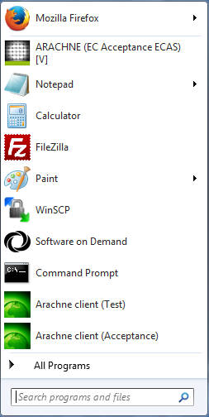
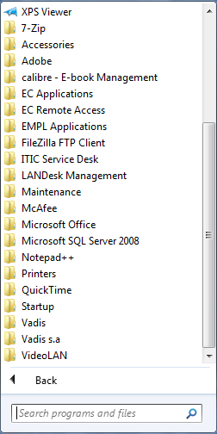
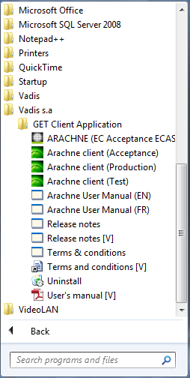
Arachne Login

Slide 30
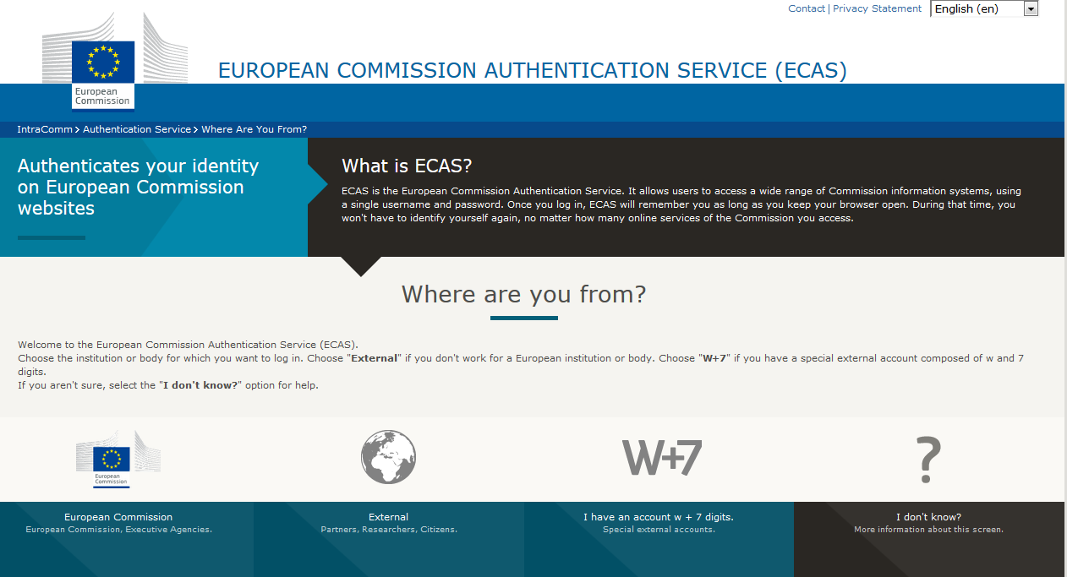
Arachne Login

Slide 31
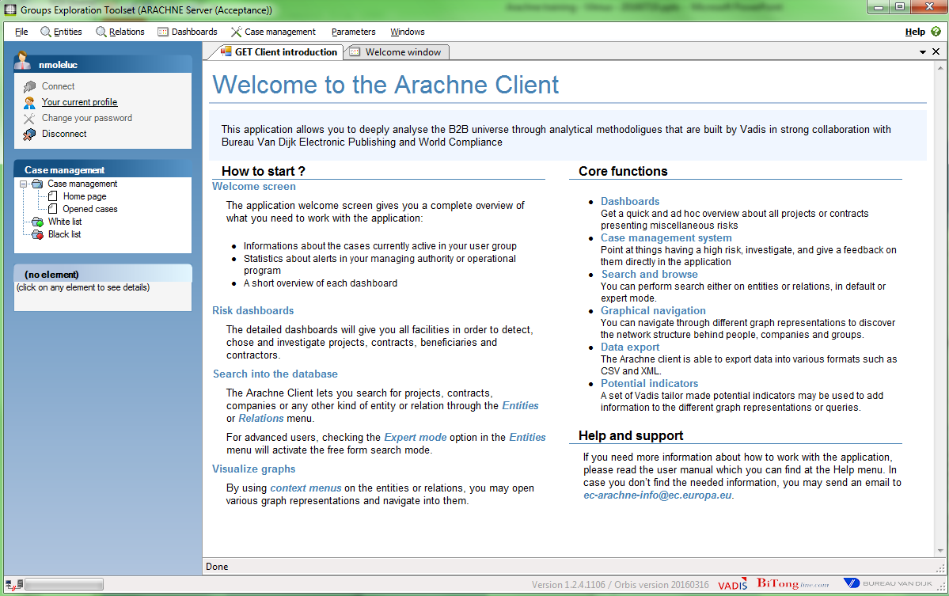
Arachne

Slide 32
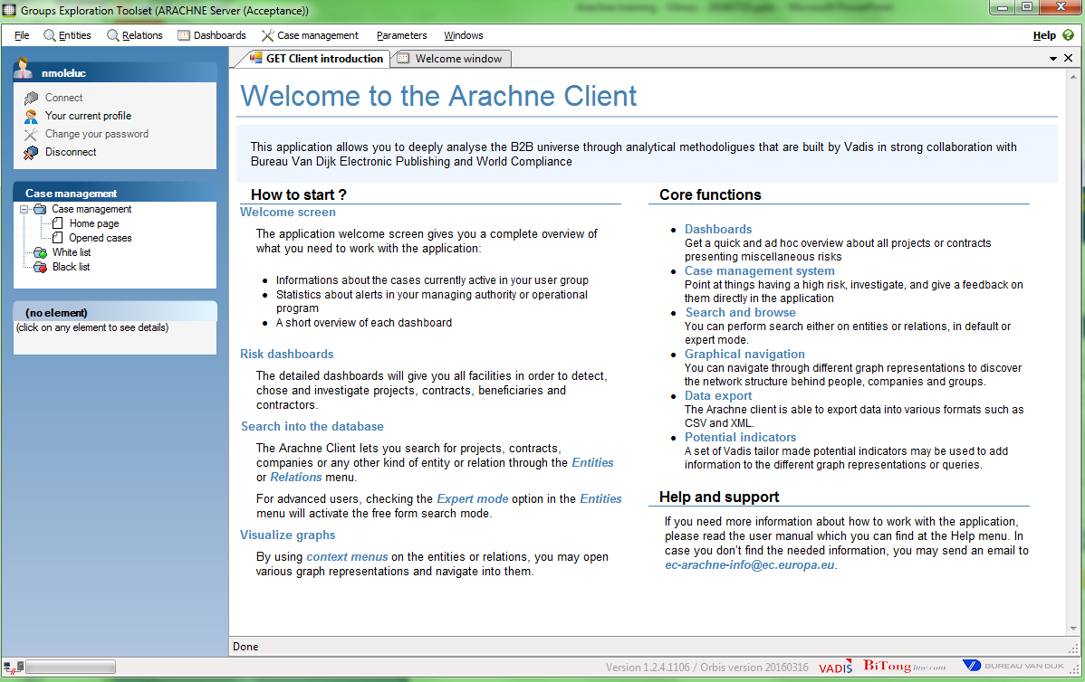

Arachne Close window
Right
Mouse-
Click
1
2

Slide 33
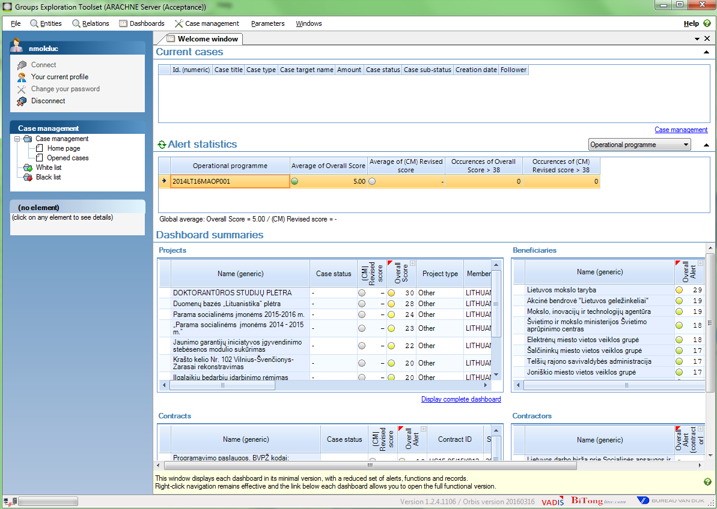
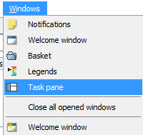
Arachne Task pane
1
2

Slide 34
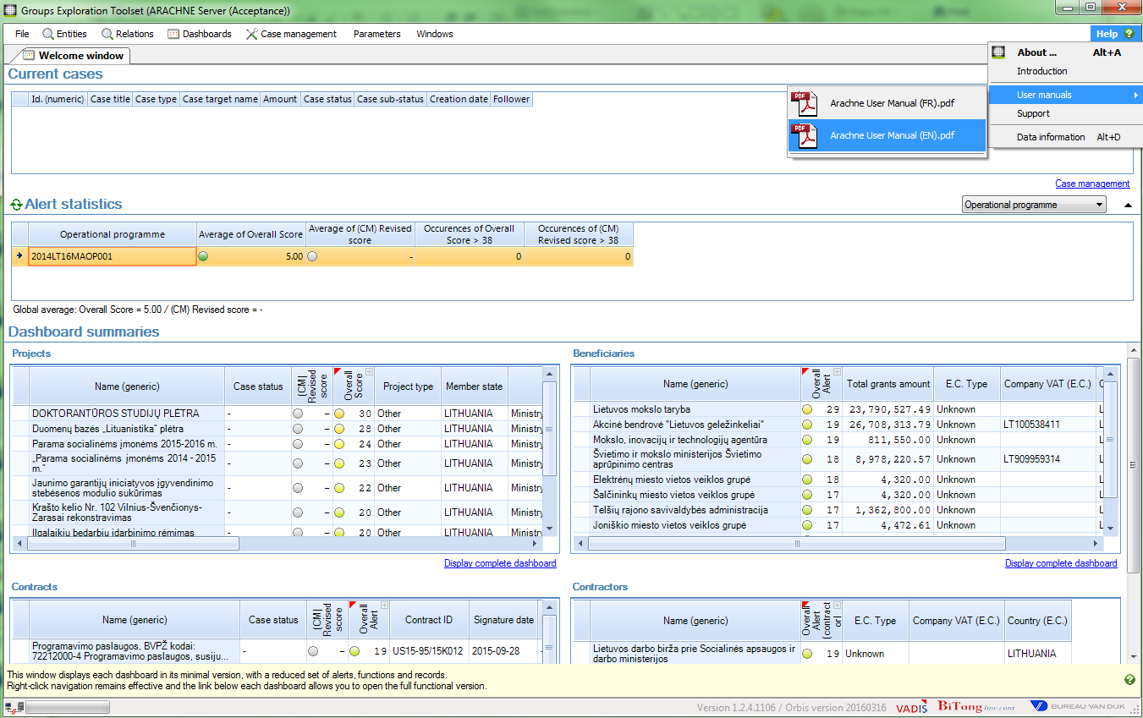
Arachne Help
1
2
3

Slide 35
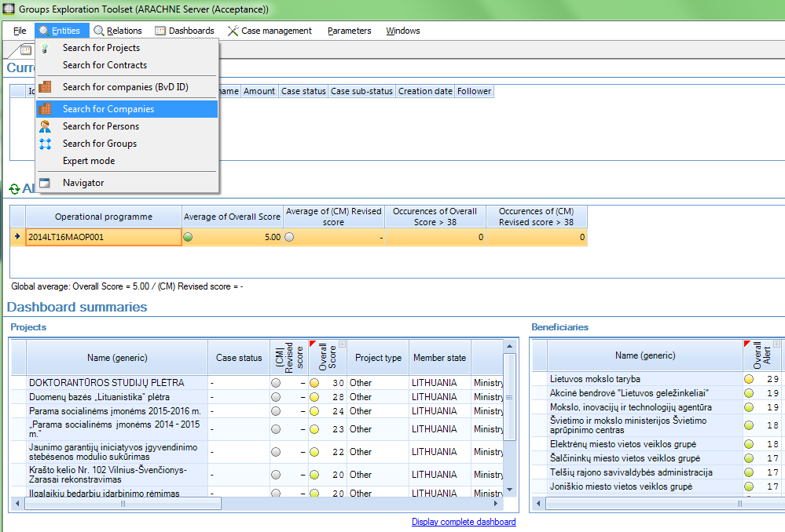
Arachne Search for company

Slide 36
Arachne Search for company
Search for company :
Look for all companies having the word
'FRENCKEN'
in their name

Slide 37
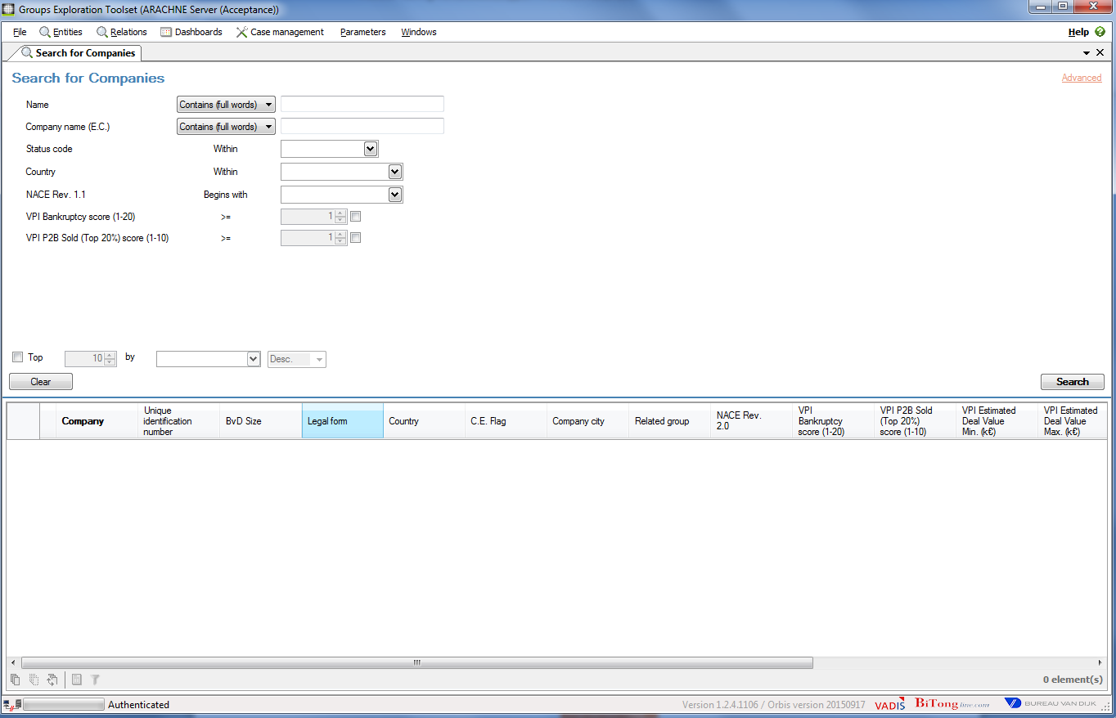
Arachne Search for company
Search Criteria
Advanced Search
more fields
Search results
MAX 5000 records retrieved at once

Slide 38
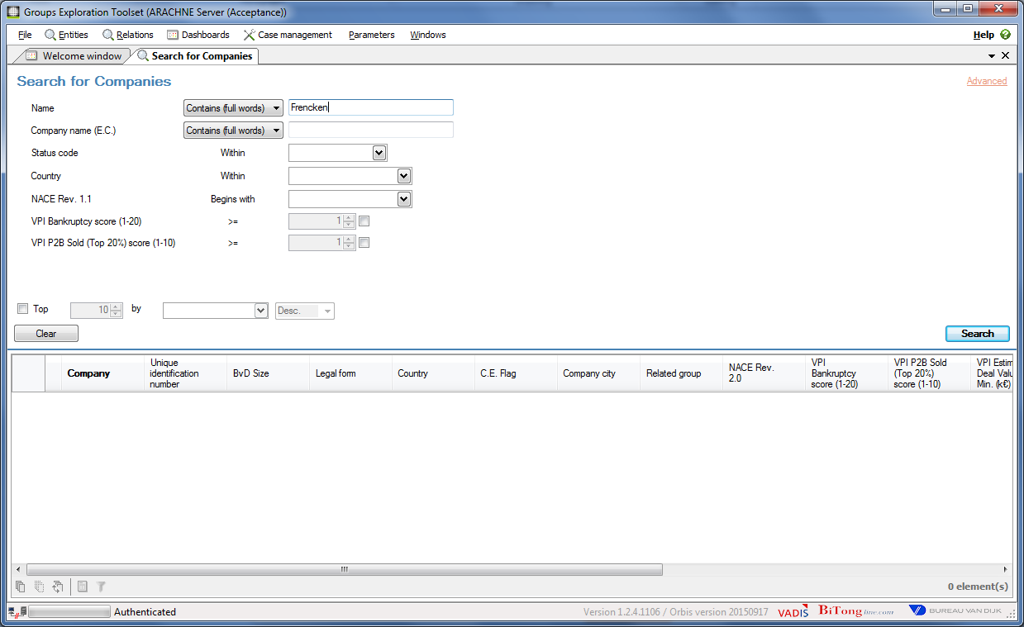
Arachne Search for company
Frencken
1
2

Slide 39
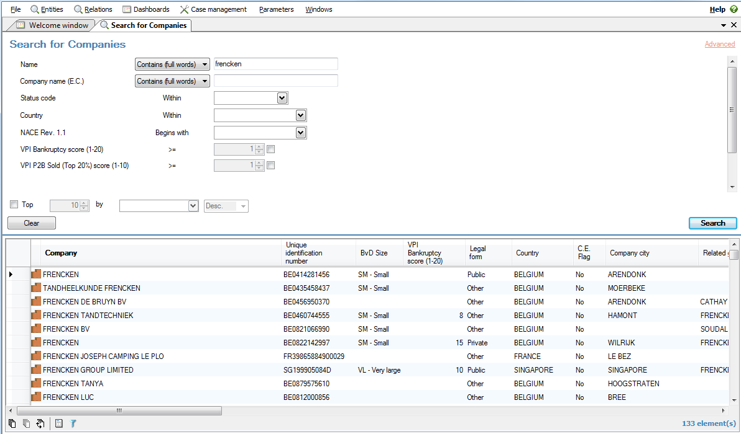
Arachne Search for company
133 companies were found, name containing Frencken →

Slide 40
Arachne Search for company
C.E. Flag

Slide 41
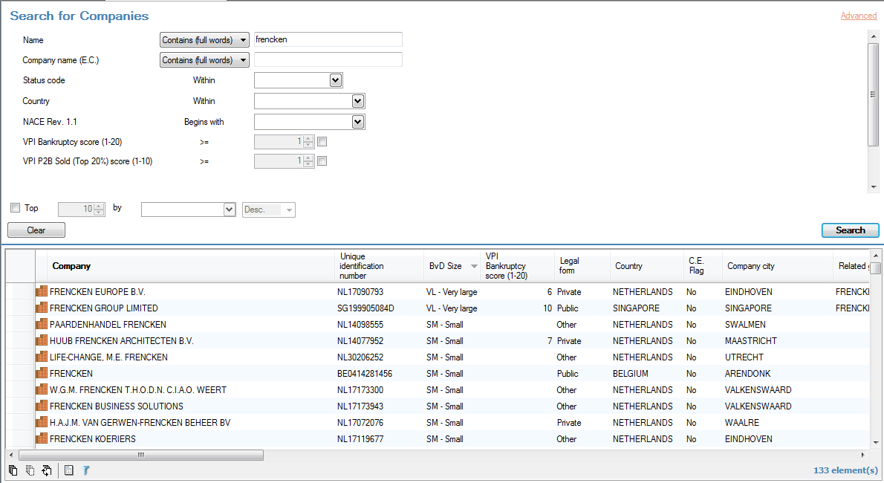
Arachne Search for company
Left click on the column to sort by size

Slide 42
Arachne Detailed Report
Open Detailed report of company
'Frencken Europe B.V.'

Slide 43
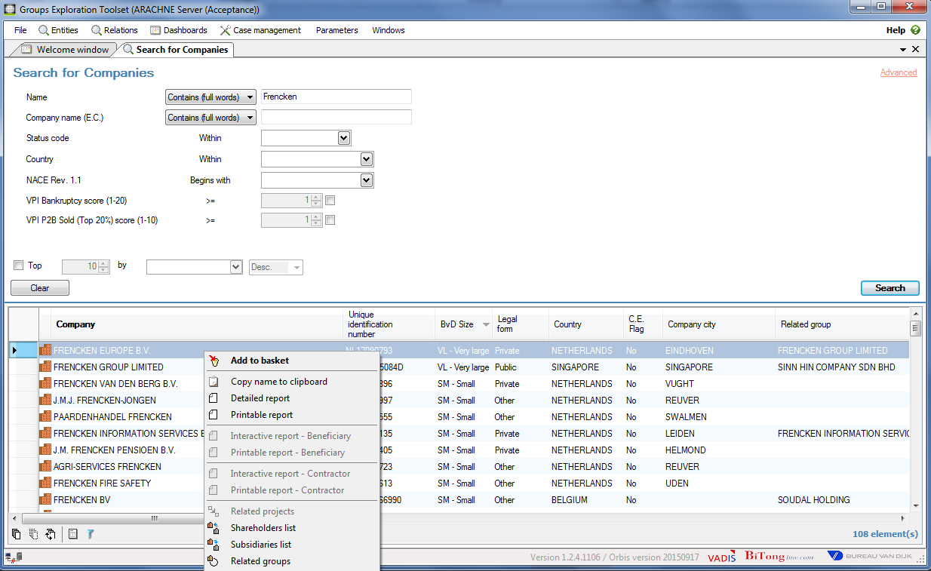
Arachne Detailed Report
Right
Mouse-
Click
1
2

Slide 44
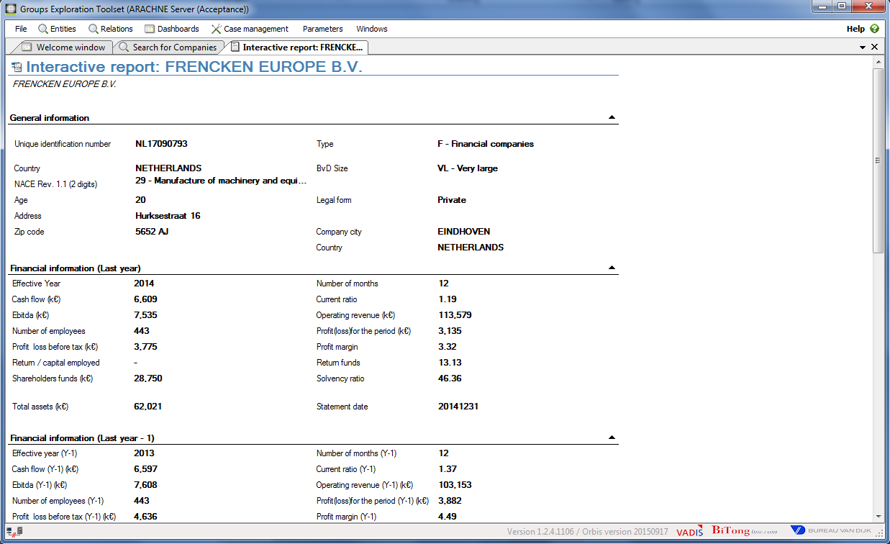
Arachne Detailed Report
Scroll down

Slide 45
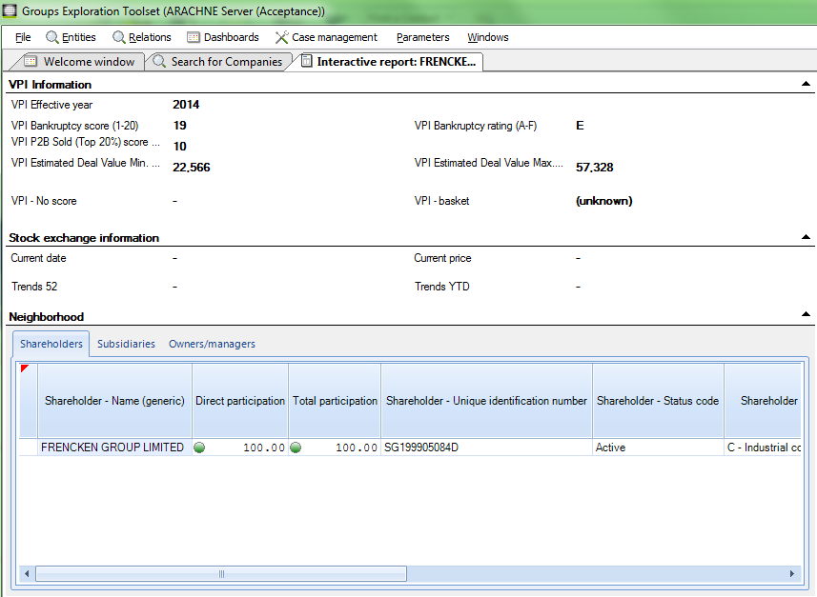
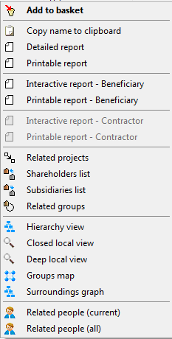
Arachne Detailed Report
Right
Mouse-
Click

Slide 46
Arachne Hierarchy view
Display the Hierarchy view
of company
'Frencken Europe B.V.'

Slide 47
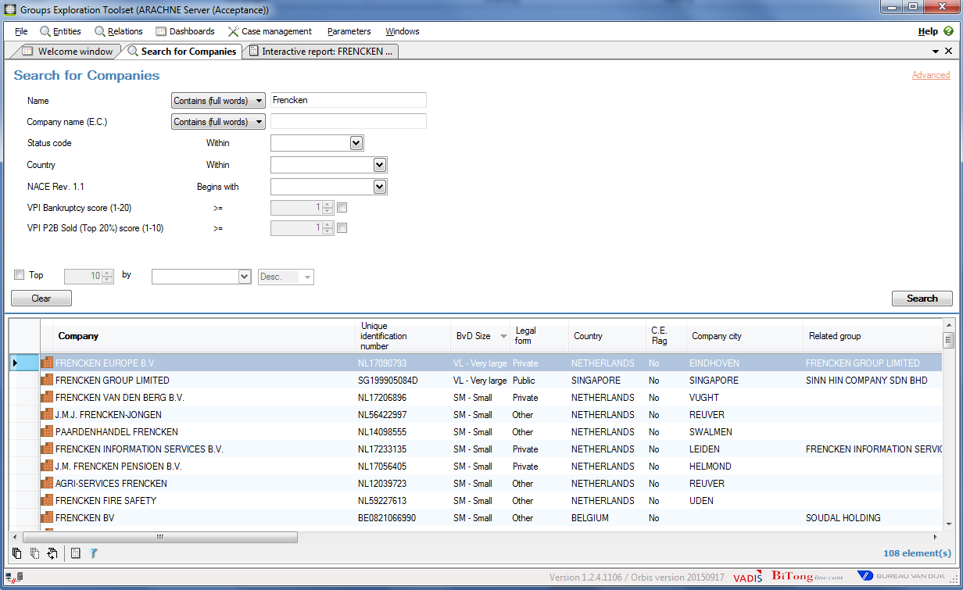
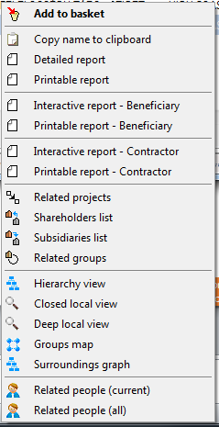
Arachne Hierarchy view
1
Right
Mouse-
Click
2

Slide 48
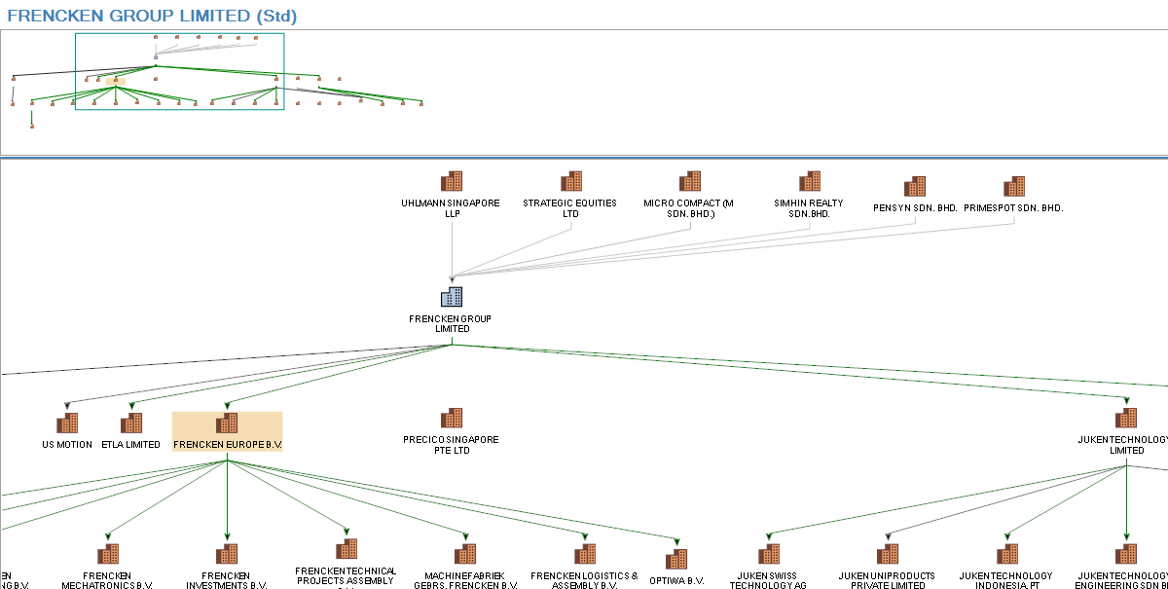
Arachne Hierarchy view
displays the set of companies belonging to a given group
related to the group clustering system

Slide 49
Arachne Hierarchy view
Zoom in/out : <Ctrl> + scroll
Put focus on lower panel : click left on panel
Select an element : click left on node
Select all elements : <Ctrl> + A
Drag and drop

Slide 50
Arachne Hierarchy view

Slide 51
Arachne Hierarchy view

Slide 52
Arachne Agenda
09:00 – 09:30 General information about Arachne / Data flow
09:30 – 09:45 Data quantity / data quality / data sourcing issues
09:45 – 10:15 Search of companies and persons data (Orbis database)
10:15 – 10:30 Break
10:30 – 12:00 Search of companies and persons data: Exercises
12:00 – 13:00 Lunch break
13:00 – 14:30 Arachne functionalities : Dashboards / Risk details / Reports
14:30 – 14:45 Break
14:45 – 15:15 Arachne functionalities : Exercises
15:15 – 15:45 Arachne functionalities : Export / Case management system
15:45 – 16:00 Questions and answers

Slide 53
Arachne Agenda
09:00 – 09:30 General information about Arachne / Data flow
09:30 – 09:45 Data quantity / data quality / data sourcing issues
09:45 – 10:15 Search of companies and persons data (Orbis database)
10:15 – 10:30 Break
10:30 – 12:00 Search of companies and persons data: Exercises
12:00 – 13:00 Lunch break
13:00 – 14:30 Arachne functionalities : Dashboards / Risk details / Reports
14:30 – 14:45 Break
14:45 – 15:15 Arachne functionalities : Exercises
15:15 – 15:45 Arachne functionalities : Export / Case management system
15:45 – 16:00 Questions and answers

Slide 54
Arachne Hierarchy view
Display the
countries linked
to the company
'ČD Cargo, a.s.'

Slide 55
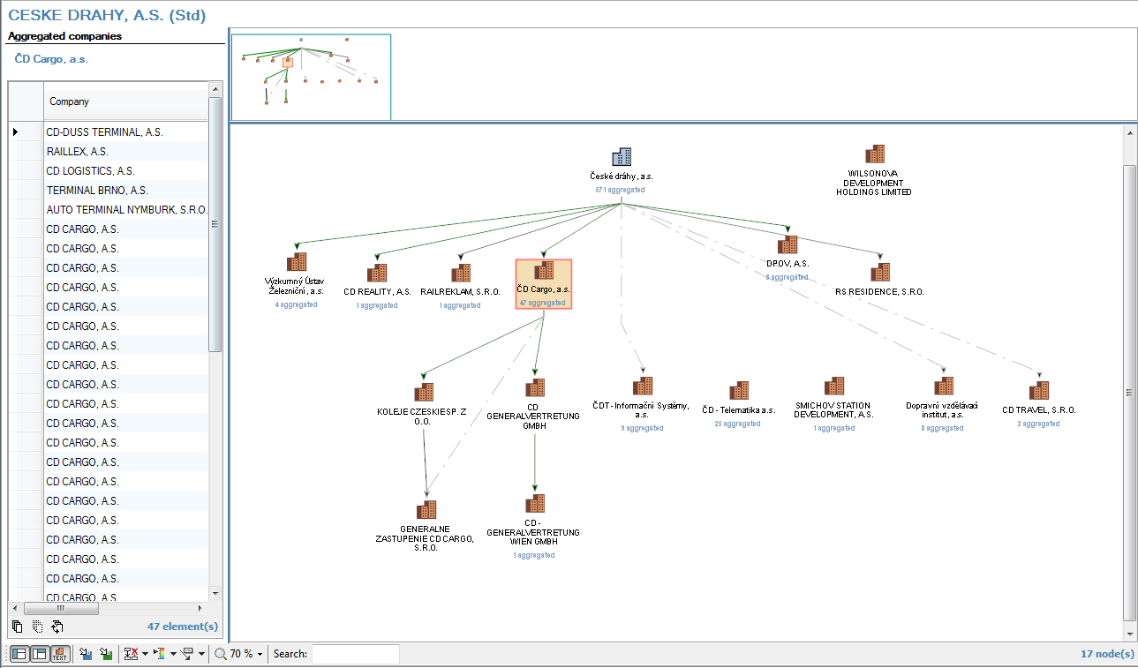
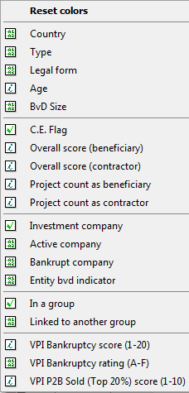
Arachne Hierarchy view
2
1

Slide 56
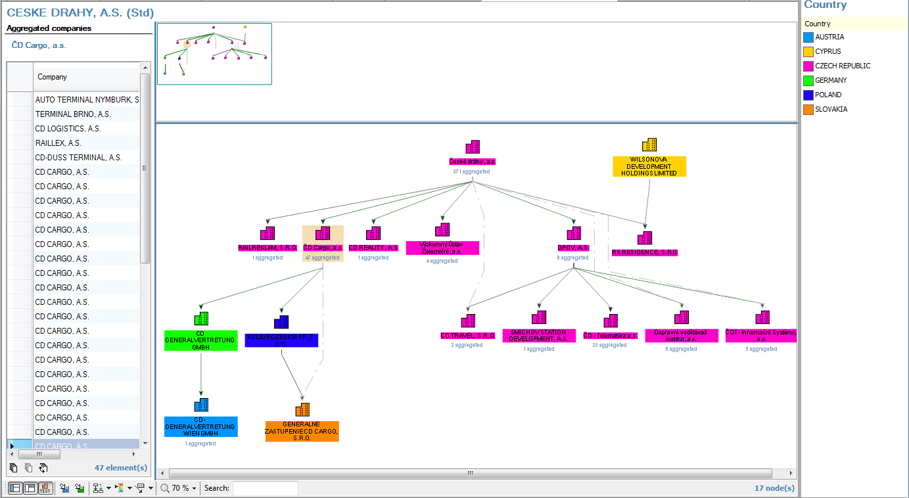
Arachne Hierarchy view

Slide 57
Arachne Shareholders
What is
the address of
the shareholder
of 'ČD Cargo, a.s.'

Slide 58
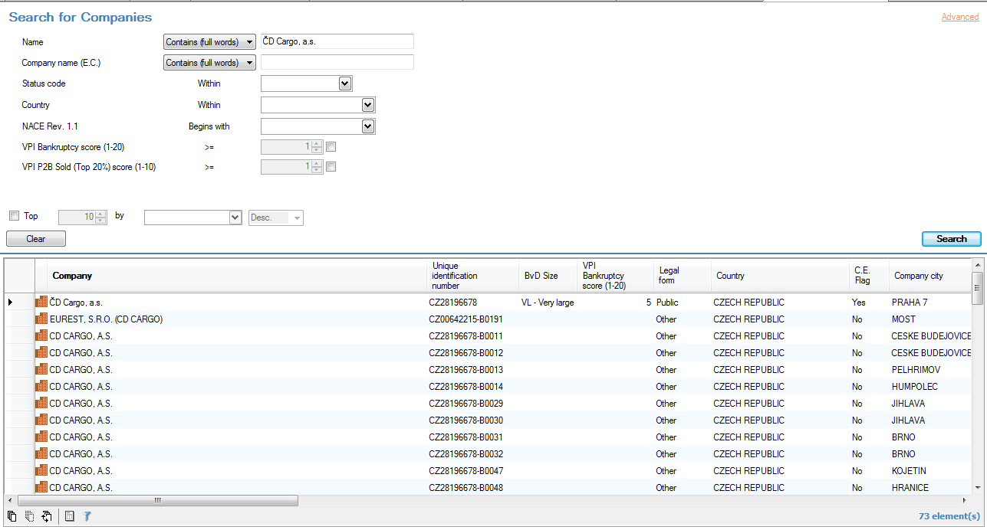
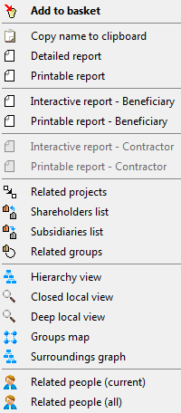
Arachne Shareholders
1
3
Right
Mouse
Click
2
4

Slide 59
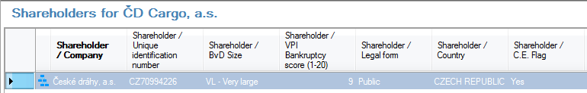
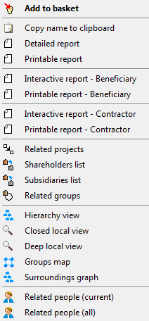
Arachne Shareholders
5
Right
Mouse
Click
6

Slide 60
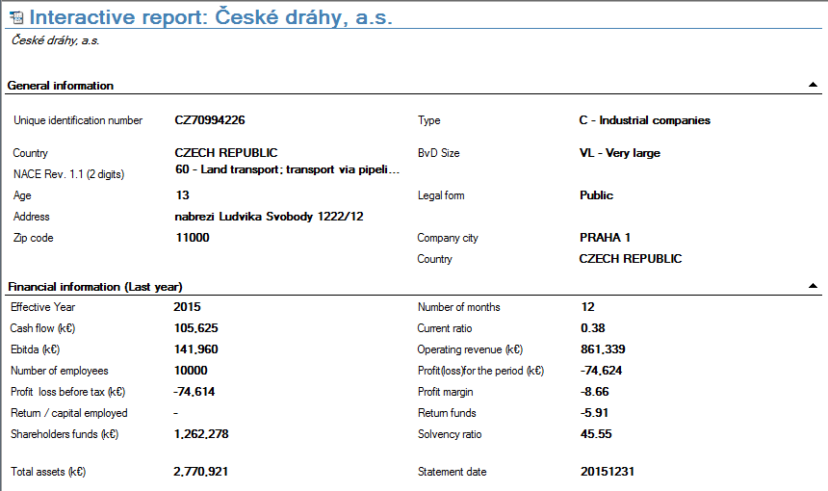
Arachne Shareholders

Slide 61
Arachne Local view
Display the Local view
of the company
' GEODIS BRNO '

Slide 62
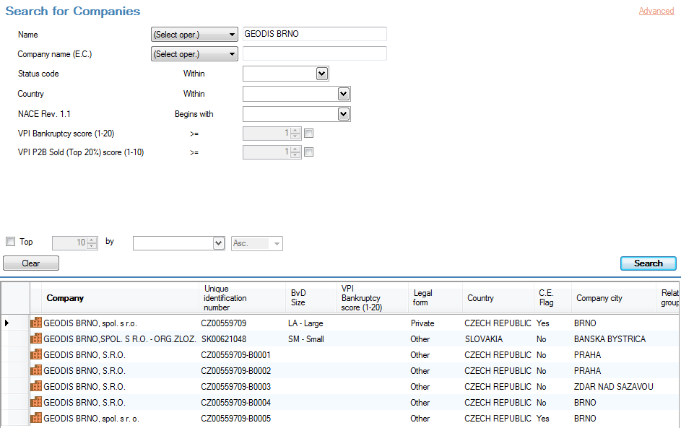
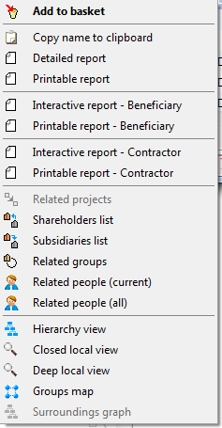
Arachne Local view
1
Right
Mouse-
Click
2
3

Slide 63
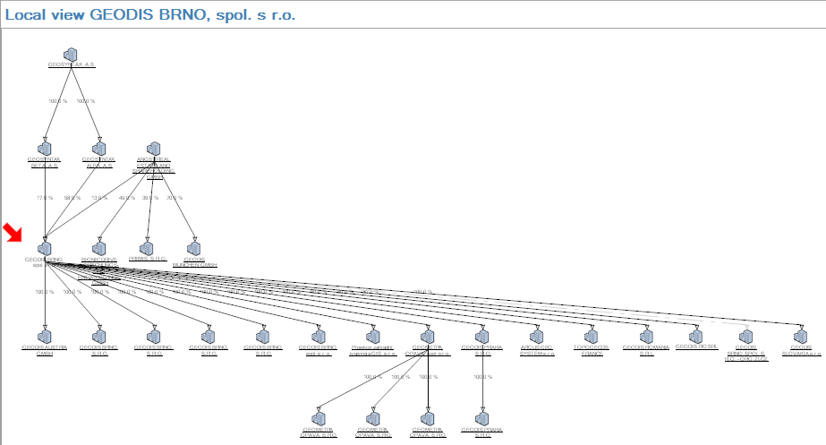
Arachne Local view
displays the legal links network, representing the set of shareholders and subsidiaries of the selected company (which is the entry point)

Slide 64
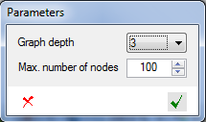
Arachne Local view
-> number of neighbourhood levels

Slide 65
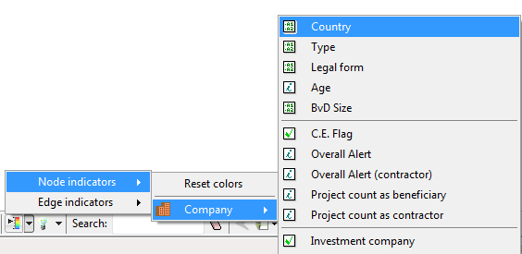
Arachne Local view

Slide 66


Arachne Local view

Slide 67
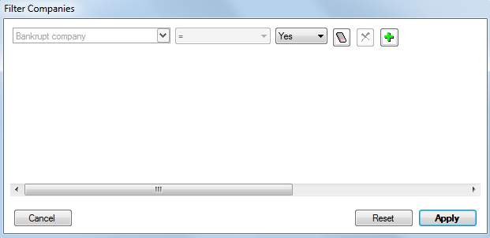
Arachne Local view

Slide 68
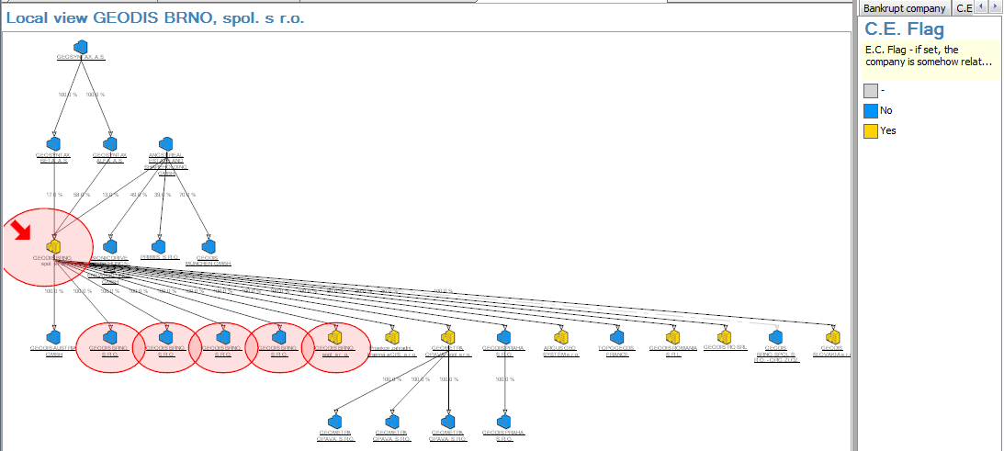
Arachne Local view

Slide 69
Arachne Related people
Display the
list of the current linked people
(Board of directors / Managers)
of PRIMIS, S.R.O.

Slide 70
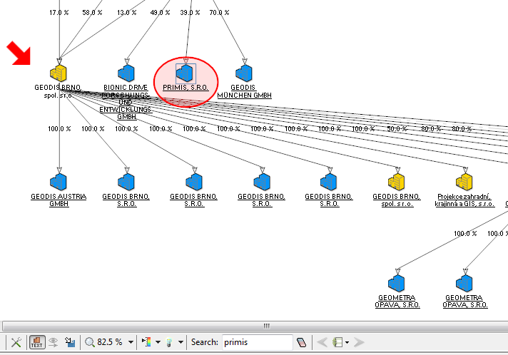
Arachne Related people
2
Right
Mouse-
Click
3
1

Slide 71
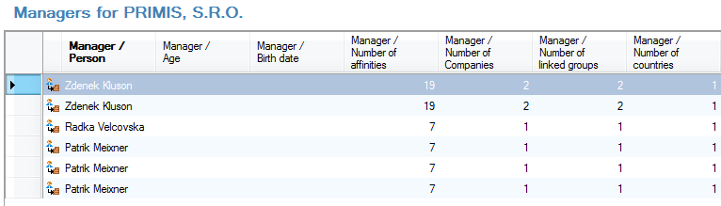
Arachne Related people
list of the current related people

Slide 72
Arachne Affinity Diagram
Display the
affinity diagram
of
Milos Petera

Slide 73
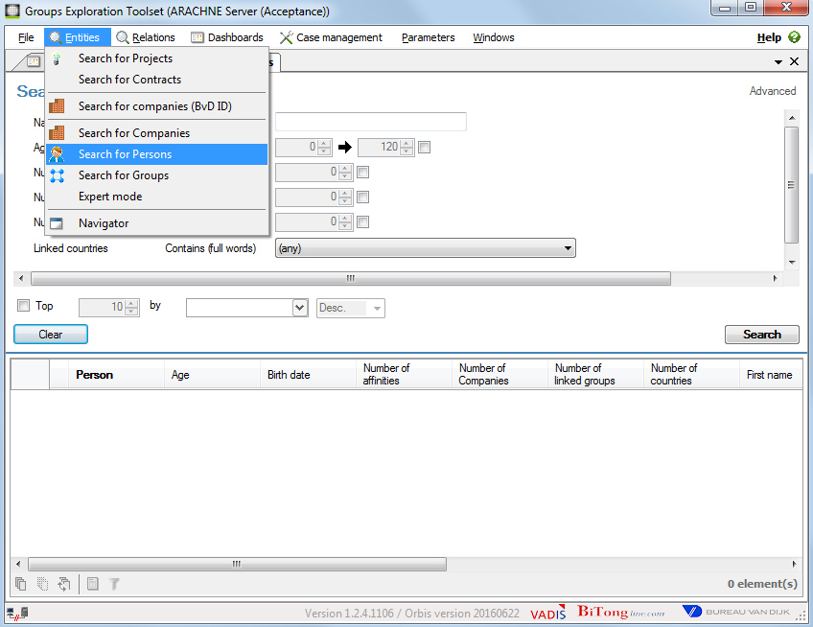
Arachne Search for person

Slide 74
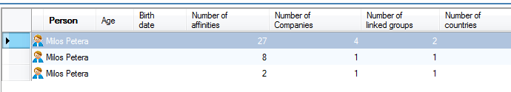
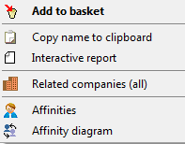
Arachne Linked people

Slide 75
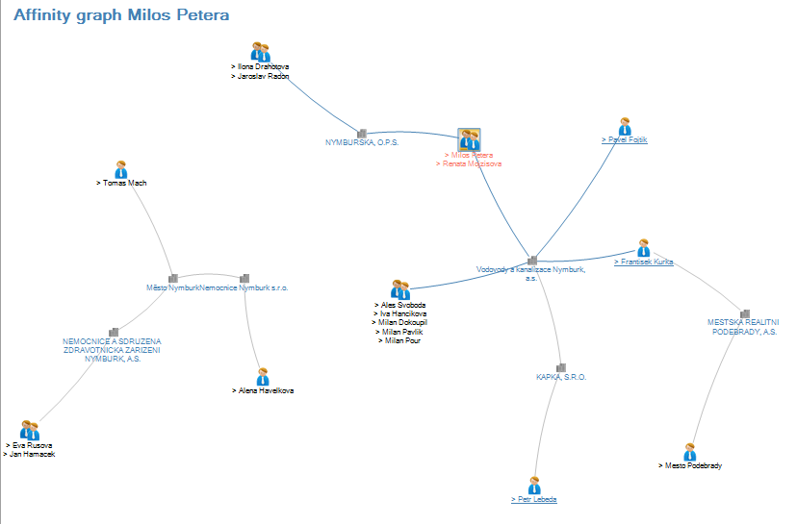
Arachne Affinity diagram
represents links between people through companies

Slide 76
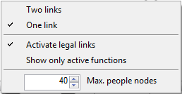
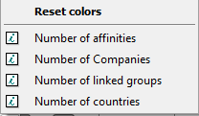

Arachne Affinity diagram

Slide 77
Arachne Related projects
Search the
related projects
of
Dusan Paroulek

Slide 78
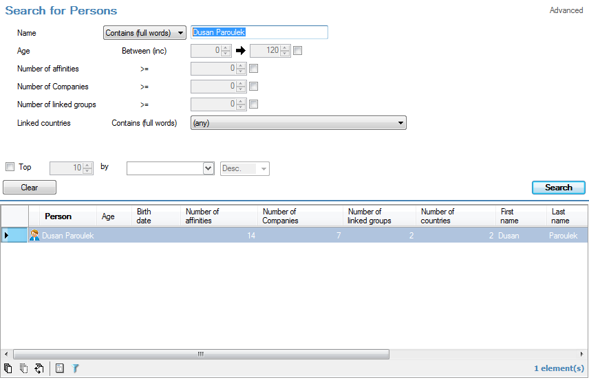
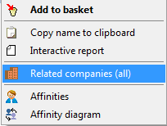
Arachne Related
projects
1
2
←Right Mouse Click
3
4

Slide 79
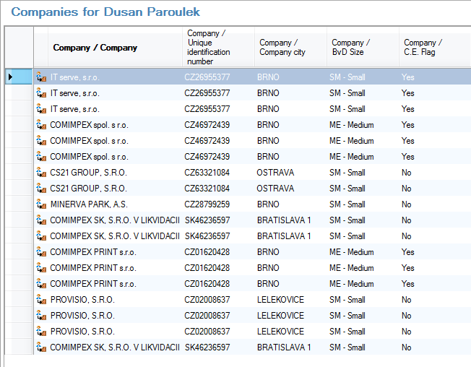

Arachne Related
companies
←Right Mouse Click
Flag = YES
company
linked to an OP

Slide 80
Arachne Agenda
09:00 – 09:30 General information about Arachne / Data flow
09:30 – 09:45 Data quantity / data quality / data sourcing issues
09:45 – 10:15 Search of companies and persons data (Orbis database)
10:15 – 10:30 Break
10:30 – 12:00 Search of companies and persons data: Exercises
12:00 – 13:00 Lunch break
13:00 – 14:30 Arachne functionalities : Dashboards / Risk details / Reports
14:30 – 14:45 Break
14:45 – 15:15 Arachne functionalities : Exercises
15:15 – 15:45 Arachne functionalities : Export / Case management system
15:45 – 16:00 Questions and answers

Slide 81
Arachne Agenda
09:00 – 09:30 General information about Arachne / Data flow
09:30 – 09:45 Data quantity / data quality / data sourcing issues
09:45 – 10:15 Search of companies and persons data (Orbis database)
10:15 – 10:30 Break
10:30 – 12:00 Search of companies and persons data: Exercises
12:00 – 13:00 Lunch break
13:00 – 14:30 Arachne functionalities : Dashboards / Risk details / Reports
14:30 – 14:45 Break
14:45 – 15:15 Arachne functionalities : Exercises
15:15 – 15:45 Arachne functionalities : Export / Case management system
15:45 – 16:00 Questions and answers

Slide 82
Arachne Main Functionalities
Internal data upload from Member States
External data enrichment (Orbis, WorldCompliance)
Risk score calculation based on internal and external data
Output visualisation in dashboards
    Visualisation of links between entities/individuals
    High risk beneficiaries / projects / contractors / contracts
    Drill-down functionalities
Export options
Case management
Feedback loop
User management

Slide 83

Arachne Welcome window
1
2

Slide 84

Arachne Welcome window
Arachne Menu
Case Management Dashboard
Alert Statistics on the MS Operational Programs
Projects Dashboard
Beneficiairies Dashboard
Contracts Dashboard
Contractors Dashboard

Slide 85

Arachne Risk indicators

Slide 86

Arachne Task Pane

Slide 87


Arachne Number of items
Top 20 of most risky projects

Slide 88

Arachne Filter options
2
1
3

Slide 89

Arachne Involved companies
Left
Mouse-
Click

Slide 90


Arachne Involved companies
Right
Mouse-
Click
Company menu
=> Orbis data

Slide 91
Arachne Involved companies
Left Mouse-Click
=> Close

Slide 92


Arachne Involved companies
Right
Mouse-
Click
Project
menu

Slide 93
Arachne Involved companies
Left
Mouse-
Click

Slide 94


Arachne Involved companies
XA : not matched with Orbis

Slide 95

Arachne Sorting
Column left click = sort within existing set of data
=> Sorting the same 20 projects

Slide 96
Arachne Sorting
Triangle = current sort
Column left click = select new set of data with highest score for selected risk/category
=> Sorting entire database

Slide 97

Arachne expanding / collapsing alert
1
Right
Mouse-
Click
Left
Mouse-
Click
2

Slide 98

Arachne expanding / collapsing alert
6 new columns : individual risk scores within procurement category

Slide 99
Arachne Risk indicators
Risk category | Description
Procurement | Risk indicators on the procurement process
Contract management | Assessment of contract management aspects of the project and comparison to the peer group
Eligibility | Verification of the eligibility period and existence of contractors and subcontractors
Performance | Assessment of the coherence of activity sector ratios with the benchmark values
Concentration | Cross-project and cross-operational program checks
Other | Basic checks on logicality and reasonability of project data
Reputational and fraud alerts
 | Financial: Overall financial performance of beneficiaries, contractors / suppliers and sub-contractors, based on financial reporting data
 | Relationship: Existence of relationships between beneficiaries and contractors / suppliers or sub-contractors and their respective personnel
 | Reputation: Involvement in activities (such as bankruptcies) that could possibly result in reputational damages
 | Sanction: Identification of beneficiaries, contractors/suppliers, subcontractors or their respective personnel, blacklisted of appearing in any type of sanction list
 | Change: Any type of changes to the company structure

Slide 100

Arachne Risk indicators
Project Cycle phases and Management Verification processes

Slide 101

Arachne Risk indicators
Admissibility
Economic operators in financial distress : exclude an economic operator from participation in a procurement procedure if the operator is the subject of insolvency or winding-up proceedings
  Regulation (EU) No 1303/2013 of the European Parliament and of the Council 17 Dec. 2013. Art. 125 (3.d).
  Directive 2014/24/EU of the European Parliament and of the Council of 26 February 2014 on public procurement and repealing Directive 2004/18/EC. Art 57 (1).
  Ibid. Art. 57 (4).
High or deteriorating propensity to bankruptcy

Slide 102


Arachne Risk indicators
Right
Mouse-
Click
Link to interactive report (Orbis)

Slide 103


Arachne Risk indicators
Admissibility
Search for companies (expert mode)

Slide 104
Arachne Risk indicators
Admissibility
Economic operators convicted for crimes : exclude an economic operator if the operator or any member of the administrative, management or supervisory body has been the subject of a conviction.
Economic operators convicted for tax evasion : exclude an economic operator if the operator is in breach of its obligations relating to the payment of taxes or social security contributions.
  Directive 2014/24/EU of the European Parliament and of the Council of 26 February 2014 on public procurement and repealing Directive 2004/18/EC. Art 57 (1).
  Ibid. Art. 57 (1).
  Ibid. Art. 57 (2).
Involvement in sanction lists
Involvement in enforcement lists
Involvement in adverse media lists

Slide 105

Arachne Risk indicators
Admissibility
Select Projects : right-click 'Involvement in enforcement lists'
1
Right
Mouse-
Click
2

Slide 106


Arachne Risk indicators
Admissibility
Involvement in enforcement lists

Slide 107
Arachne Risk indicators
Conflict of interest
Arachne shows legal and personal links between potential and actual project stakeholders in order to detect potential conflict of interest
  Directive 2014/24/EU of the European Parliament and of the Council of 26 February 2014 on public procurement and repealing Directive 2004/18/EC. Art 24.
  Ibid. Art 24.
  Ibid. Art. 57 (4).
Links between beneficiaries/project partners
Links between beneficiaries/project partners and contractors/Consortium members
Links between beneficiaries/project partners and sub-contractors
Links between contractors/consortium members
Links between contractors/consortium members and sub-contractors

Slide 108

Arachne Risk indicators
Member State 1
Member State 2
OP1
OP2
OP1
OP2
PRJ1
PRJ2
PRJ3
PRJ1
PRJ2
PRJ3
PRJ1
PRJ2
PRJ3
PRJ1
PRJ2
BENEF1
BENEF1
BENEF1
BENEF1
BENEF1
Contractors
Contractor3
Contractor2
Contractor4
Contractor1

Slide 109

Arachne Risk indicators
Conflict of interest : links between beneficiaries/project partners and contractors/consortium members

Slide 110

Arachne Interactive
report
Dashboard
Interactive report
Which are the projects with the highest
- overall score
- score for 1 indicator
- score for 1 category
- score on combination of indicators
All indicators for 1 project

Slide 111


Arachne Interactive
report
Interactive report : Místní akční plán vzdělávání v ORP Nymburk

Slide 112

Arachne Interactive
report

Slide 113


Arachne Interactive
report

Slide 114


Arachne Interactive
report
Left Click
on plus sign
1
Right Click
on the score
2

Slide 115


Arachne Risk indicators
←Left Mouse Click
On the link

Slide 116



Arachne Risk indicators
Conflict of interest : links between beneficiaries/project partners and contractors/consortium members
Místní akční plán vzdělávání v ORP Nymburk

Slide 117
Arachne Risk indicators
State Aid
The intensity of aid (percentage over eligible cost) that can be allocated to an undertaking may vary according to its size: small, medium, large or very large enterprise
  Commission Regulation (EU) 651/2014 of 17 June 2014 declaring certain categories of aid compatible with the internal market in application of Articles 107 and 108 of the Treaty. Chapter III.
  Guidance for Member States and Programme Authorities. Management verifications to be carried out by Member States on operations co-financed by the Structural Funds, the Cohesion Fund and the EMFF for the 2014-2020 programming period. EGESIF 14-0012.
Example:
  FREZITE s.r.o.
  Medium-sized company / part of an international group => might not be known
  => See hierarchy view

Slide 118




Arachne Risk indicators
State Aid

Slide 119
Arachne Risk indicators
Project Cycle phases and Management Verification processes

Slide 120

Arachne Risk indicators
Project Risk Monitoring
Verify that the co-financed products and services have been delivered and that expenditure declared by the beneficiaries complies with applicable law, the operational programme and the conditions for support of the operation.
  Article 125(4)(a) and 5(1) of the Commission Regulation (EC) 1303/2013
Put in place effective and proportionate anti-fraud measures taking into account the risks identified.
  Article 125(4)(c) of the Commission Regulation (EC) 1303/2013
Project risk indicators dashboard : orienting verification efforts of Managing Authorities towards most risky elements in projects

Slide 121

Arachne Risk indicators
Project Risk Monitoring
Projects appear listed and ranked by risk score
Filter possibilities
-> orienting verification efforts of managing authorities towards most risky elements in projects

Slide 122


Arachne Risk indicators
Project Risk Monitoring
The list of sensitive regions is based on official lists of tax havens and regions sensitive to corruption.
Involvement of directors/shareholders from sensitive regions
Incorporation in sensitive regions
Group involvement in sensitive regions

Slide 123
Arachne Risk indicators
Project Risk Monitoring
Identify projects for which the VAT number of an involved company does not comply with the ‘VAT structure requirements’ as mentioned on the VIES website of the European Commission.
V1.2.4
only VAT format
Category: Eligibility
V2.0
VAT format
VAT existence in VIES database (http://ec.europa.eu/taxation_customs/vies/vatRequest.html)
Category: Contract management / Reputational & Fraud
Beneficiaries with invalid VAT number
Suppliers (project partners) with invalid VAT number
Contractors with invalid VAT number
SubContractors with invalid VAT number

Slide 124



Arachne Risk indicators
Project Risk Monitoring
Beneficiaries with invalid VAT number
V1.2.4
V2.0

Slide 125
Arachne Risk indicators
Eligibility
State-bound rules on eligibility are diverse, although they are complemented by some specific rules laid down in the Common Provisions Regulation 1303/2013 and Fund-specific regulations.
  Article 125 (4)(a) 5(1) of the Commission Regulation (EC) 1303/2013
  Article 125(1) of the Commission Regulation (EC) 1303/2013
  Article 69(3)(b) of the Commission Regulation (EC) 1303/2013 : non-eligible expenditures include "the purchase of land in the amount exceeding 10% of the total eligible expenditure for the operation concerned. For derelict sites and for those formerly in industrial use which comprise buildings, that limit shall be increased to 15%".
Arachne offers 9 different indicators linked to eligibility that could alert Managing Authorities
about irregularities or fraud signs within the different legal framework of the Member States.
CZ: no expenses => no risks calculated

Slide 126
Arachne Risk indicators
Public Procurement
Verify that expenditure declared by the beneficiaries complies with applicable law, including public procurement EU and state bound rules guaranteeing an equal, non-discriminatory, transparent and proportionate treatment to all economic operators. Arachne can inform Managing Authorities of a variety of risky situations that may better drive their verifications on public procurement rules.
  Regulation (EU) No 1303/2013 of the European Parliament and of the Council 17 Dec. 2013. Art. 125 (4.a).
  Directive 2014/24/EU on public procurement. Art. 18.
  Directive 2014/24/EU on public procurement. Art. 26 (4).
  Directive 2014/24/EU on public procurement. Art. 32 (2).
f.i. Arachne can raise alerts on an abnormally high amount of contracts procured via negotiated procedure
(restricted procedure and direct award) per total project cost,
in relation to a peer group of projects within an Operational Programme and a sector.
CZ: only type 'ESF' and 'other' => risks NOT YET calculated

Slide 127
Arachne Risk indicators
Performance indicators
Verify that the co-financed products and services have been delivered and that they are in accordance with the principle of sound financial management.
Regulation 1303/2013: Art.125.4.a
Regulation 1303/2013: Art.125.1
Regulation 1303/2013: Art.22
Arachne includes up to 18 performance risk indicators applied to different programme priorities.
These alerts can inform Managing Authorities at a glance about remarkable performance deficiencies
projects might have across the whole programme in real time,
so that action can be taken before arriving to a suspension or financial corrections scenario.
CZ: no project type specific project details => no risks calculated

Slide 128
Arachne Risk indicators
Concentration
The aggregation and centralisation of purchases should be carefully monitored in order to avoid excessive concentration of purchasing power and collusion, and to preserve transparency and competition, as well as market access opportunities for SMEs.
  Directive 2014/24/EU on public procurement. (59)
Arachne can detect whether an entity acts as a beneficiary, contractor or project partner
for multiple projects, within the same or in several operational programmes,
in addition to the involvement in multiple projects of staff or management of the entity.
These alerts allow Managing Authorities to focus the resources on projects
presenting for instance the risk of double financing.
F.i. : why has this contractor so many contracts ?

Slide 129



Arachne Risk indicators
Concentration

Slide 130


Arachne Surrounding graph
Starting from a project, the graph takes first all related companies from the Beneficiary relation.
From these companies, the graph then takes all their related projects using the Beneficiary relation, and all related companies using the Legal link relation.
Finally, based on this result, the graph takes all related persons through the Private relation (thus all persons linked to companies).
customization parameters allow adding multiple additional relations

Slide 131
Arachne Risk indicators
Project Cycle phases and Management Verification processes

Slide 132

Arachne Risk indicators
Positive impacts
Certifying Authorities are more likely to certify to the European Commission that payment applications submitted "have been subject to verifications by the Managing Authority".
Audit Authorities may endorse the "proper functioning of the management and control system of the operational programme" towards the European Commission.
The adoption and good management of Arachne during the whole life cycle by Managing Authorities can make a remarkable contribution to reduce the error rates, therefore easing the work of Certifying and Audit Authorities, as well as improving their conclusions submitted to the European Commission on the functioning of the Managing Authority and the whole management and control system.
Support for planning on-the-spot verifications by selecting most risky projects.

Slide 133
Arachne Agenda
09:00 – 09:30 General information about Arachne / Data flow
09:30 – 09:45 Data quantity / data quality / data sourcing issues
09:45 – 10:15 Search of companies and persons data (Orbis database)
10:15 – 10:30 Break
10:30 – 12:00 Search of companies and persons data: Exercises
12:00 – 13:00 Lunch break
13:00 – 14:30 Arachne functionalities : Dashboards / Risk details / Reports
14:30 – 14:45 Break
14:45 – 15:15 Arachne functionalities : Exercises
15:15 – 15:45 Arachne functionalities : Export / Case management system
15:45 – 16:00 Questions and answers

Slide 134
Arachne Agenda
09:00 – 09:30 General information about Arachne / Data flow
09:30 – 09:45 Data quantity / data quality / data sourcing issues
09:45 – 10:15 Search of companies and persons data (Orbis database)
10:15 – 10:30 Break
10:30 – 12:00 Search of companies and persons data: Exercises
12:00 – 13:00 Lunch break
13:00 – 14:30 Arachne functionalities : Dashboards / Risk details / Reports
14:30 – 14:45 Break
14:45 – 15:15 Arachne functionalities : Exercises
15:15 – 15:45 Arachne functionalities : Export / Case management system
15:45 – 16:00 Questions and answers

Slide 135
Arachne Exercises
Some exercises on Project data
  Open the project dashboard / select the 20 project with the highest identified Reputation & Fraud risk
  Show/Open the 29 detail risk indicators for Reputation and fraud
  Select a project for which you see a link between the beneficiary and the contractors (8th indicator)
  Open the detailed path of one of the projects with a link
  Do you see any risk for the project : ' Komplexní rozvojový program pro klíčové zaměstnance společnosti PHARMOS, a.s. ' linked to the enforcement list
  Please show the details of the risk indicator

Slide 136
Arachne Agenda
09:00 – 09:30 General information about Arachne / Data flow
09:30 – 09:45 Data quantity / data quality / data sourcing issues
09:45 – 10:15 Search of companies and persons data (Orbis database)
10:15 – 10:30 Break
10:30 – 12:00 Search of companies and persons data: Exercises
12:00 – 13:00 Lunch break
13:00 – 14:30 Arachne functionalities : Dashboards / Risk details / Reports
14:30 – 14:45 Break
14:45 – 15:15 Arachne functionalities : Exercises
15:15 – 15:45 Arachne functionalities : Export / Case management system
15:45 – 16:00 Questions and answers

Slide 137
Arachne Main Functionalities
Internal data upload from Member States
External data enrichment (Orbis, WorldCompliance)
Risk score calculation based on internal and external data
Output visualisation in dashboards
    Visualisation of links between entities/individuals
    High risk beneficiaries / projects / contractors / contracts
    Drill-down functionalities
Export options
Case management
Feedback loop
User management

Slide 138

Arachne Export
Select projects
Shift + left click
Select all / unselect all

Slide 139

Arachne Export

Slide 140

Arachne Export
1
2

Slide 141

Arachne Export
3
4

Slide 142

Arachne Export
5

Slide 143

Arachne Export
6
7
8
9

Slide 144

Arachne Export

Slide 145
Arachne Main Functionalities
Internal data upload from Member States
External data enrichment (Orbis, WorldCompliance)
Risk score calculation based on internal and external data
Output visualisation in dashboards
    Visualisation of links between entities/individuals
    High risk beneficiaries / projects / contractors / contracts
    Drill-down functionalities
Export options
Case management
Feedback loop
User management

Slide 146
Arachne Case
Management
Workflow where you can create and work on so called cases on projects or contracts.
There are three roles to be defined. All of them can create cases.
Guest: can see cases, but cannot change anything except comments
Follower: can add additional information to the cases that are assigned to him; can propose a case status change ; but cannot assign cases to specific users nor approve other case status changes
Supervisor: can (re-)assign the cases to specific users (user with a Follower role) ; can accept or decline case status change proposals.
Roles are assigned by local administrators on user account creation.
Some users may not access the case management module depending on how their account has been created.

Slide 147
Arachne Main Functionalities
Internal data upload from Member States
External data enrichment (Orbis, WorldCompliance)
Risk score calculation based on internal and external data
Output visualisation in dashboards
    Visualisation of links between entities/individuals
    High risk beneficiaries / projects / contractors / contracts
    Drill-down functionalities
Export options
Case management
Feedback loop
User management

Slide 148

Arachne Feedback loop
(1)
Mapping error
(3)
Feedback loop
(2)
False positive ?
Operational Data
Data enrichment
Risk calculation
Orbis
World Compliance

Slide 149
Arachne Main Functionalities
Internal data upload from Member States
External data enrichment (Orbis, WorldCompliance)
Risk score calculation based on internal and external data
Output visualisation in dashboards
    Visualisation of links between entities/individuals
    High risk beneficiaries / projects / contractors / contracts
    Drill-down functionalities
Export options
Case management
Feedback loop
User management

Slide 150

Arachne User management

Slide 151
Arachne Other Functionalities
Navigator
Parameters: columns, dashboards configuration
Basket
Task pane
Search - Expert Mode

Slide 152
Arachne Agenda
09:00 – 09:30 General information about Arachne / Data flow
09:30 – 09:45 Data quantity / data quality / data sourcing issues
09:45 – 10:15 Search of companies and persons data (Orbis database)
10:15 – 10:30 Break
10:30 – 12:00 Search of companies and persons data: Exercises
12:00 – 13:00 Lunch break
13:00 – 14:15 Arachne functionalities : Dashboards
14:15 – 14:30 Arachne functionalities : Export / Case management system
14:30 – 15:15 Break
15:15 – 15:45 Arachne functionalities : Risk details / Reports / Exercises
15:45 – 16:00 Questions and answers

Slide 153

Thank you for your attention
Questions?
EC-ARACHNE-INFO@ec.europa.eu

