Slide 1
ARACHNE
PROJECT
Risk scoring tool
Prague April 2015
Notes:
Good morning everybody.
Let me tell you that we Luc Molemans and me appreciate it very much that we do have the possibility to present the ARACHNE Risk Scoring Tool. If you have any technical question you can rely on the vast professional experience as an IT expert.
We came here to Ljubljana in order to give you the chance to get a deeper understanding of this brand new programme and to go with you a step further towards the integration of the ARACHNE Risk Scoring Program to your daily work. Our final aim is to meet your expectation to use this programme effectively and efficiently in order to get the added value that we are intending to provide.

Slide 2
Arachne Data Quantity
Data quantity
  Programs for which data is uploaded (2007-2013)
  What about the other programs ? Will they not be integrated in Arachne ?
ESF | 2007CZ052PO001 | OP Praha Adaptabilita
 | 2007CZ05UPO001 | OP Lidské zdroje a zaměstnanost
 | 2007CZ05UPO002 | OP Vzdělávání pro konkurenceschopnost
ERDF | 2007CZ161PO004 | OP Podnikání a inovace
 | 2007CZ161PO006 | OP Životní prostředí
 | 2007CZ161PO012 | OP Výzkum a vývoj pro inovace
 | 2007CZ162PO001 | OP Praha Konkurenceschopnost
 | 2007CZ16UPO002 | Integrovaný operační program

Slide 3
Arachne Data Quality
Data quality / data sourcing issues
  FOR ERDF programs : all projects are sourced with project type 'Other'
  → Impact : a lot of indicators are not calculated
  Contracts data : Only contract definition and amount
    No contract signature date, initial end date and final end date
    No public procurement information, No addenda information
    → No public procurement risks and contract management risk indicators could be calculated
  No expenses linked to the projects !
    → No eligibility indicators are calculated,
  No contract details provided
    → No performance indicators are calculated
  Sourcing for 'MMR' MA → 3 old projects : to delete ?

Slide 4

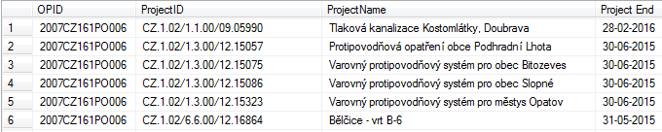
Arachne Data Quality
projects with project amount = 0
2007CZ052PO001 1 project
2007CZ161PO006 3 projects
projects with status closed and end date in the future
2007CZ161PO006 22 projects

Slide 5
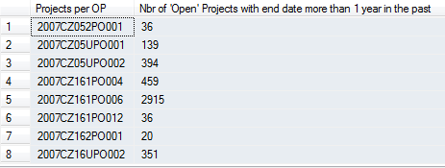
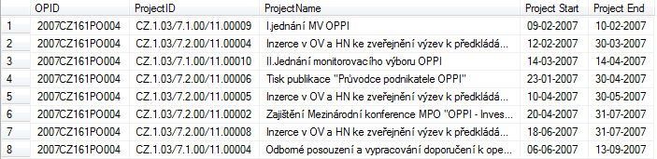
Arachne Data Quality
projects with end date < start date
2007CZ161PO004 1 project
Project Open but end date more than 1 year in the past

Slide 6
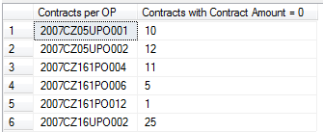
Arachne Data Quality
Contract amount = 0 EUR

Slide 7
Arachne General info
Who can change the data in Arachne ?
  Project / contract / expense data
  Data on companies / financial data / board of directors members
  World compliance
  Case management information
What currency should MS use for amounts ?
Next versions of Arachne → V1.2.4 → V2.0 → Web Interface

Slide 8
Arachne Functionalities
Automatic disconnection (after 30 minutes)
Welcome window
  Task pane
  Menu structure
  Help
  Parameters (Colors / Windows / Default columns)
Company data : consultation of the Orbis database
Search for companies
  Filter options
  Detailed / printable report
  Shareholders list / subsidiaries list
  Hierarchy view
  Close local view
  Related people
  Links with projects

Slide 9
Arachne Functionalities
Company data : consultation of the Orbis database
Search for persons
  Filter options
  Related companies
  Affinity list
  Affinity Diagram

Slide 10
Arachne Functionalities
Exercise on company / persons data
Search for company : COMIMPEX in Czech Republic in BRNO
  Use filter to find the company
  Show detailed report
  Display Hierarchy view / are all subsidiaries located in CZ ?
  List all related people
  List affinity diagram of Dusan Paroulek
  Show the link of all the projects with involvement of COMIMPEX

Slide 11
Arachne Functionalities
Company data : consultation of the Orbis database
Expert Mode
Navigator window
How to close windows

Slide 12
Arachne Functionalities
Projects Dashboard
  Number of items in the dashboard
  Filter options
  Involved companies (+ more information)
  Linked Contracts / expenses
  Detailed report
  Columns on the dashboard
  Sorting the projects
  Risk categories + details
  Surrounding graph
  Basket
  Grouping
  Search for more projects via Entities

Slide 13
Arachne Agenda
Case management
Export

Slide 14
Arachne
V2.0
  Reviewed Welcome window
  History of risk indicators
  Ex-ante checks
  Filter options / Save Filters
  Improved reports
  Improved detailed risk indicator information
  Statistics / Evolutions

Slide 15
Arachne
Contact
  EC ARACHNE INFO
  (EC-ARACHNE-INFO@ec.europa.eu)

