Slide 1
National Information Days
12 October 2017, Prague
Tips on developing a good budget
Alexandra Kulmer | Interreg CENTRAL EUROPE | Joint Secretariat

Slide 2
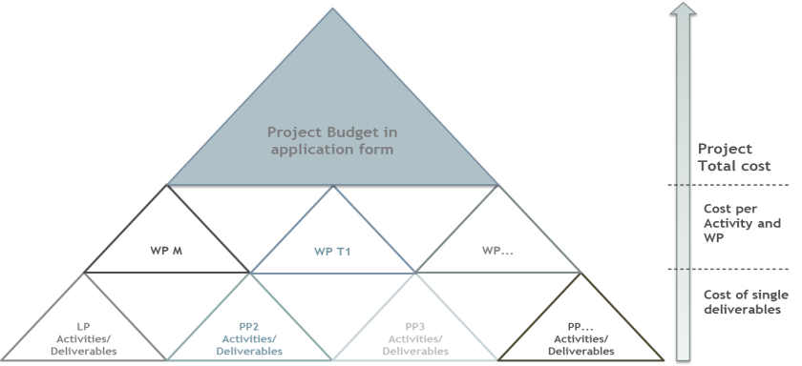
BuildING the budget
What is in it
Notes:
If tools are used to design the project budget, these must allow
to plan at the level of each PP, BL, WP and reporting periods.

Slide 3
What makes a good BUDGET?
The budget needs to reflect the work plan, i.e. activities, deliverables and outputs to achieve the intended results
Realistic
Transparent
Consistent
Timely
Partners have to estimate the costs keeping in mind the principles of economy, efficiency and effectiveness
Partners have to ensure to provide sufficient and detailed information (BL4-6)
Partners have to ensure that the budget reflects the work plan
Partners have to allocate the budget to the periods according to the timing of the payments
Notes:
Realistic – the words sound financial management and adequacy of costs should be kept in mind

Slide 4
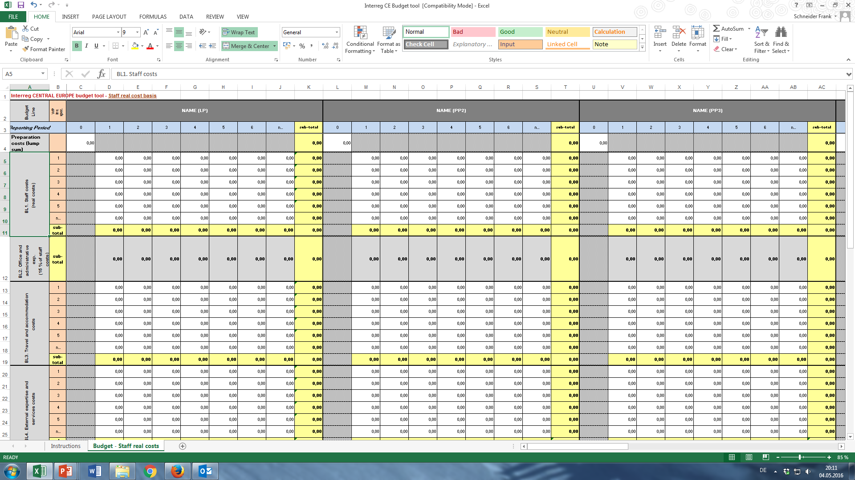
Build THE budget
Using a tool
The use of a tool to build the budget is recommended
We developed a tool for budget design - use not compulsory
Our tool has to be personalised – risk of making mistakes when changing formulas, we take no responsibility for correctness
Data should then be inserted in the eMS at PP level.
http://www.interreg-central.eu/Content.Node/apply/documents.html
Notes:
The tool needs to be adapted to:
No. of partners
No. of WPs/investment specifications
No. of reporting periods
Use of the “20 % flat rate” option for staff costs
The tool does not include where to insert descriptions for BLs 4, 5 and 6
The risk of making mistakes when personalising the table is high

Slide 5
Build The budget
Understanding the budget lines
1
2
3
Staff
costs
Office and administrative
Travel and accomodation
Costs of staff employed by the beneficiary institution for implementing the project. Either real cost or flat rate, the chosen option cannot be changed.
Flat rate – 15% of eligible staff costs.
Costs refer to the travel of the staff of the beneficiary.
Notes:
BL 1:
Staff can either be already employed or contracted specifically for the project.
Two options of reimbursements:
Real costs; or
Flat rate up to 20% of direct costs other than staff costs
(i.e. costs under budget lines 3-6)
Issue with one-man companies
BL 2:
Calculated as a flat rate: 15 % of eligible staff costs
No direct cost
BL 3:
Limitations on eligibility of travel outside the programme area apply.
Travel and accommodation costs of external experts and “associated partners” to be included under BL4 “external expertise and services costs.”

Slide 6
Build THE budget
4
5
6
External expertise and services
Equipment
Infrastructure
and works
Costs for external expertise and services provided by a public body/private body/natural person outside the beneficiary organisation
Costs of essential project equipment, which is purchased, rented or leased by a beneficiary
Costs of essential infrastructure execution within the programme area. Directive 2014/24/EU defines works and provides a detailed list of eligible elements in Annex II
NOTE: Investment specification is needed if for a single investment the cost fo thematic equipment +/or infrastructure and works is above €15.000
Notes:
BL 4:
This budget line refers to external expertise and services provided by a public or private body or a natural person outside the beneficiary organisation
Eligible costs shall refer to the exhaustive list provided in part B, chapter II.7.3 of the application manual and part C, chapter C.2.4 of the implementation manual
Eligibility of costs is subject to the full respect of EU, programme and national public procurement rules
Costs for tasks sub-contracted to in-house bodies and costs referring to cooperation between public bodies, are eligible if charged on a real costs basis and need to be included under the relevant BL (and not under BL4)
BL5
Two categories of equipment:
Equipment for general (office) use as computers, office furniture, etc. which is necessary for the implementation of the project and which is used for project purposes only. → depreciable assets.
Thematic equipment directly linked to (or forming part of) the project thematic activities, which will be used for the project implementation by beneficiaries and target groups in line with the project
objectives. → requirements for investments and can be reimbursed in full.

Slide 7
Build your budget
Preparation cost
15.000 €
Lump sum that covers all costs for preparation and contracting
Notes:
Lump sum amounting to EUR 15.000 of total eligible expenditure per project.
ERDF contribution linked to the actual co-financing rate applicable to the partner(s) to which the lump sum is allocated (as in the AF).
It covers all costs for preparation and contracting.
Paid after the signature of the subsidy contract.

Slide 8

Get in Touch
Joint Secretariat
Interreg CENTRAL EUROPE Programme
www.interreg-central.eu
info@interreg-central.eu
+43 1 8908088-2403
facebook.com/InterregCE
linkedin.com/in/InterregCE
twitter.com/InterregCE
youtube.com/c/InterregCentralEurope

