Slide 1
  Interreg Europe
  1st Call & support for applicants
Petra Polaskova| Communication Officer
Interreg Europe Secretariat
6 May 2015

Slide 2
INTERREG EUROPE
First call for proposals
Provisional timing:
  March – June – 1st call information campaign
  Mid-June – mid-July – 1st call for proposals open (tbc)
No thematic restrictions: call open to all priority axes
No specific requirement in terms of geographical coverage
One third ERDF budget available: MEUR28 per priority axis
Procedure: on-line system

Slide 3


  Support for projects
Tools
partner search tool
project idea database
Programme manual
programme FEEDBACK
events

Slide 4
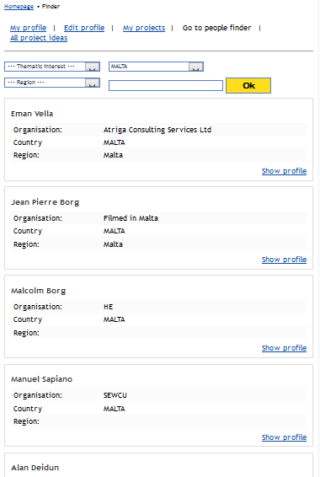
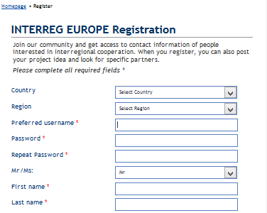
1. partner search tool
Partner search
Join our community
≈ 1600 people
and growing
Search for potential partners
http://www.interreg4c.eu/nc/people/register

Slide 5
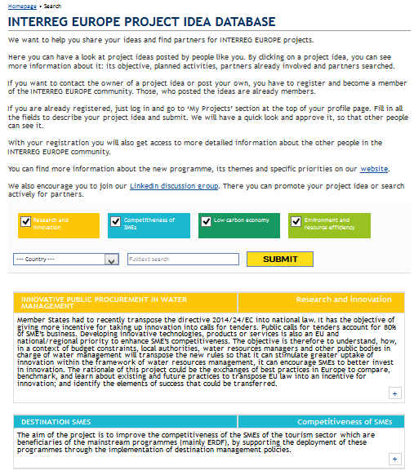
2. project idea database
Find project ideas
Share you own project idea
4 colours = 4 themes
  Contact to idea owner (click on +)
    After joining INTERREG EUROPE community
  Partners involved and partners searched for are indicated
! Ideas are NOT validated by JS !
http://www.interreg4c.eu/nc/project/search

Slide 6
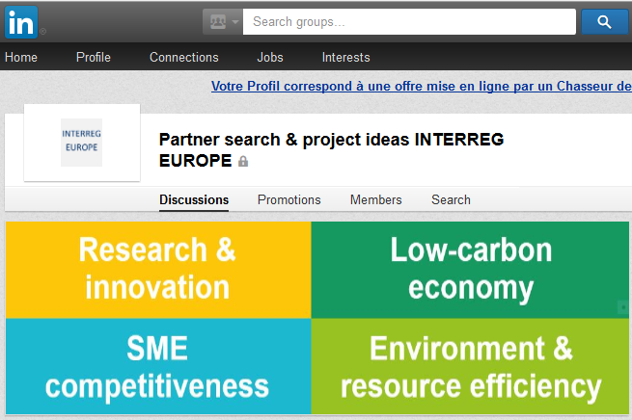


2. Social media
Partner search & project idea sharing
also via our social media channels
LinkedIn groups
on partner search & project ideas
4 thematic sub-groups
www.facebook.com/interregeurope
twitter.com/interregeurope

Slide 7

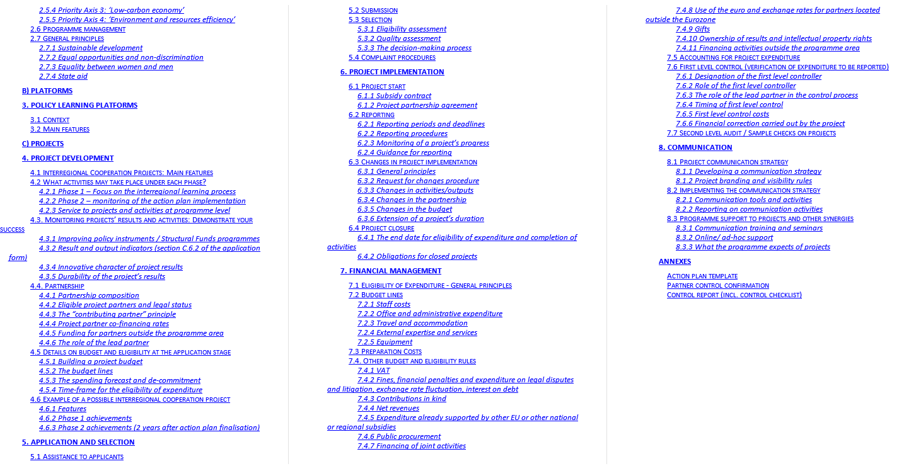
3. programme manual
Need information for project development?
Go to our website
Get the programme manual

Slide 8
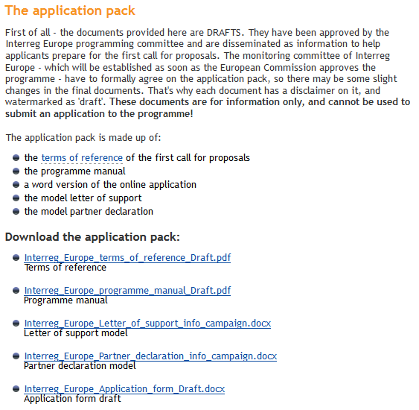
3. programme manual
Need information for project development?
Go to our website

Slide 9
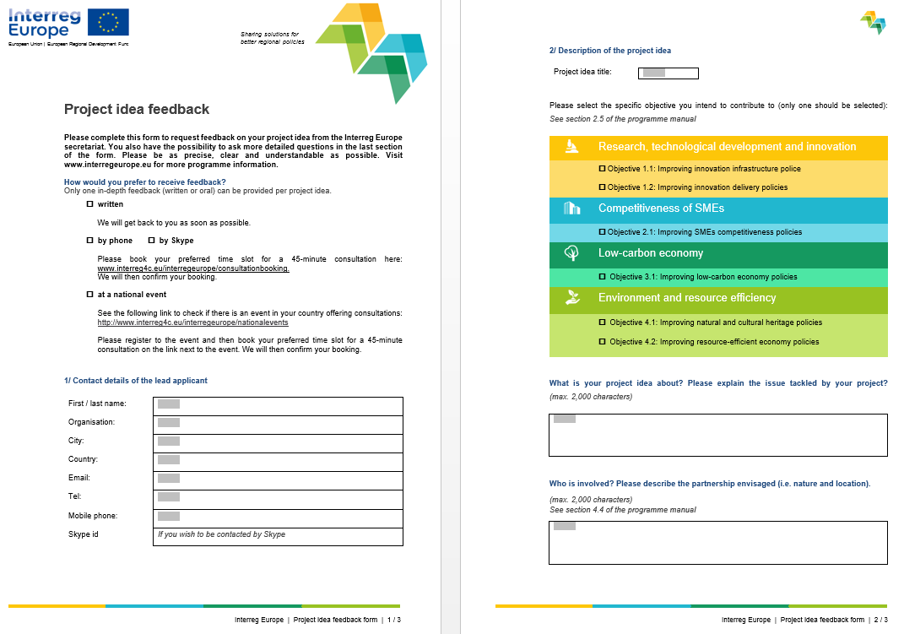
4. programme FEEDBACK
Need our feedback on your project idea?
Go to our website
Get the project idea feedback form
Send it filled in back to us by email
Get our comments and answers to your questions
http://www.interreg4c.eu/interregeurope/assistance/

Slide 10

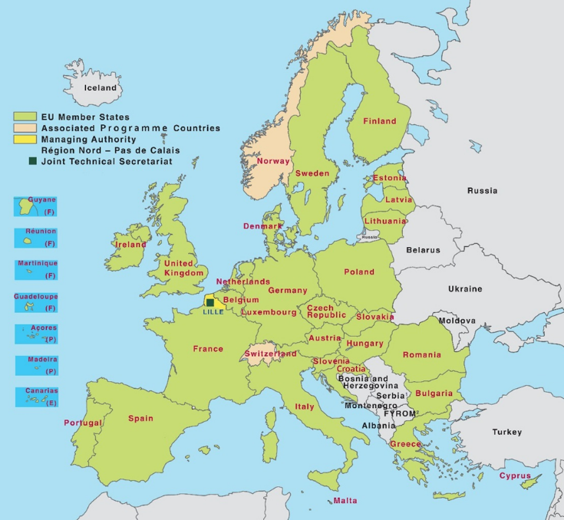
5. events
National information events
For local participants
Information about the programme & funding opportunities
Inspiration from local project partners
Lead applicant workshops
2 events per call for proposals
  (June 2015, tbc)
For lead applicants in projects
Guidance for submitting the application
Usually with individual consultations

Slide 11




INTERREG EUROPE
For more information, please, follow us on:
interreg4c.eu/interreg-europe
interregeurope.eu
facebook.com/interregeurope
twitter.com/interregeurope
changing-regions.eu

Slide 12
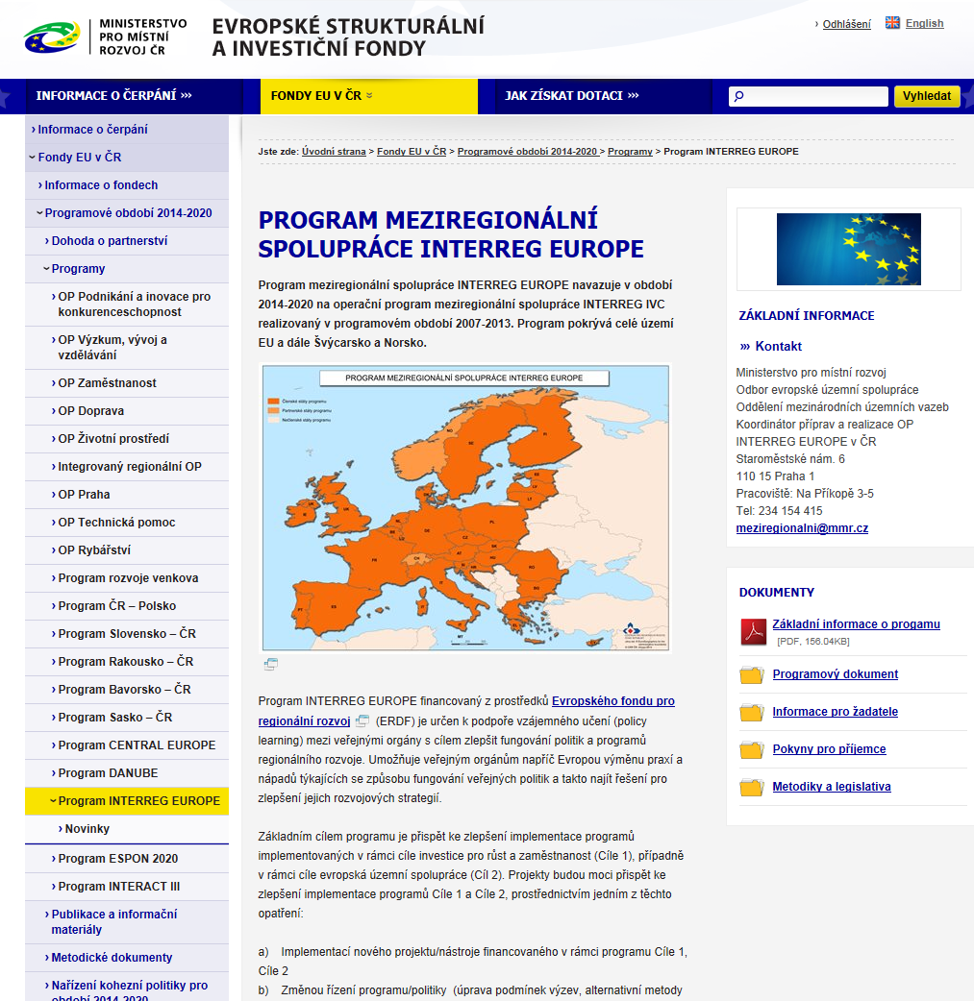
INTERREG EUROPE
Informace o programu v České republice
Národní kontaktní místo v ČR
Alice Štollová Kovandová
Ministerstvo pro místní rozvoj
Odbor evropské územní spolupráce
Email: alice.stollova@mmr.cz
Pavel Lukeš
Ministerstvo pro místní rozvoj
Odbor evropské územní spolupráce
Email: pavel.lukes@mmr.cz
www.dotaceEU.cz
www.mmr.cz
www.interregeurope.eu
http://www.strukturalni-fondy.cz/cs/Fondy-EU/2014-2020/Operacni-programy/OP-INTERREG-EUROPE

Slide 13


Slide 14

Thank you for your attention!

